Slide 1
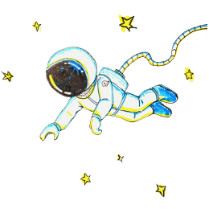







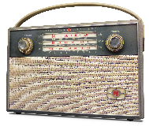
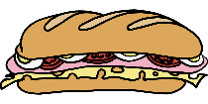


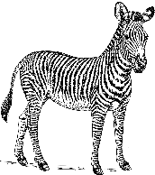


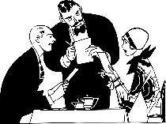
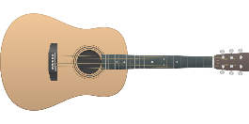


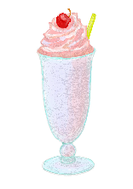
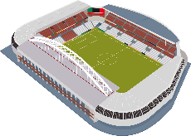
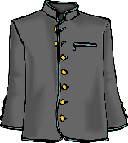
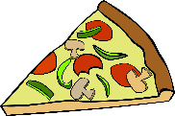







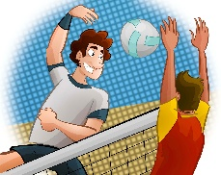
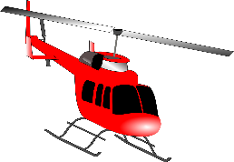





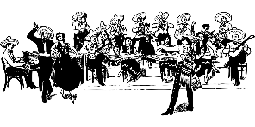
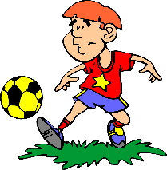
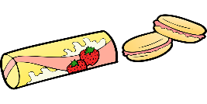

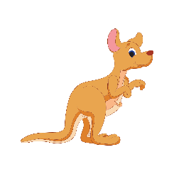

WORDS
2.1
START

Slide 2









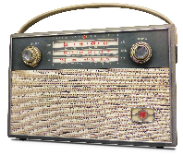

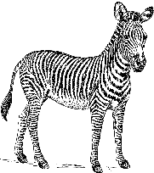




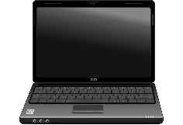
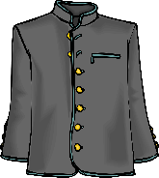










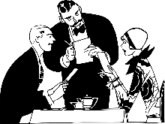
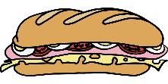









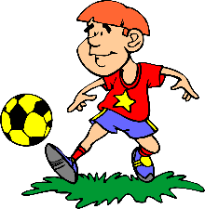


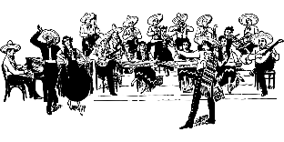
1- Ambulance

Slide 3
2- Astronaut

Slide 4
3- Balloon

Slide 5
4- Biscuit

Slide 6
5- Basketball

Slide 7
6- Camp

Slide 8
7- Coffee

Slide 9
8- Cheetah

Slide 10
9- Chimpanzee

Slide 11
10- Cake

Slide 12
11- Dance

Slide 13
12- Doctor

Slide 14
13- E-mail

Slide 15
14- Football

Slide 16
15- Helicopter

Slide 17
16- Hamburger

Slide 18
17- Internet

Slide 19
18- Jacket

Slide 20
19- Kangaroo

Slide 21
20- Lemon

Slide 22
21- Laptop

Slide 23
22- Microphone

Slide 24
23- Milkshake

Slide 25
24- Note

Slide 26
25- Orchestra

Slide 27
26- Panda

Slide 28
27- Pizza

Slide 29
28- Radio

Slide 30
29- Restaurant

Slide 31
30- Stadium

Slide 32
31- Salad

Slide 33
32- Sandwich

Slide 34
33- Telephone

Slide 35
34- Train

Slide 36
35- Tennis

Slide 37
36- Volleyball

Slide 38
37- Wagon

Slide 39
38- Yoga

Slide 40
39- Yoghurt

Slide 41
40- Zebra

Slide 42
CONGRATULATIONS

