Slide 1


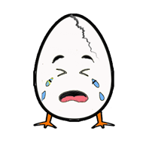
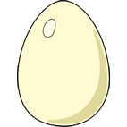




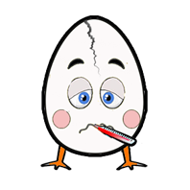
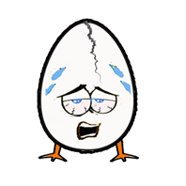
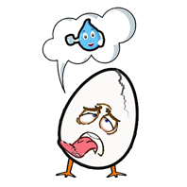

NUTTY EGGS
START
FEELINGS – LET’S ……

Slide 2
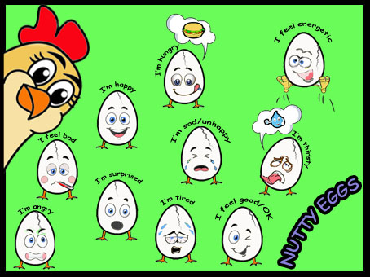
NEXT

Slide 3
Verilen duygu ifadesine uygun yumurtayı tıklayın.
START

Slide 4

I’m angry

Slide 5
I feel good/OK

Slide 6
I’m surprised

Slide 7
I’m thirsty

Slide 8
I’m hungry

Slide 9
I feel energetic

Slide 10
I feel bad

Slide 11
I feel happy

Slide 12
I’m sad/unhappy

Slide 13
I feel tired

Slide 14
Verilen duygu ifadesini bulun, öneri olarak verilen cümleyi duygu ifadesine uygun tamamlayın.

Slide 15
listen to music
watch TV
dance and sing songs
drink water
cut the birthday cake
watch a comedy
ride a bike
play the guitar
Hello ! How are you?
I’m ……………….
sleep
cook and eat
Let’s ………………
good / OK
surprised
energetic
bad
thirsty
happy
tired
sad / unhappy
hungry
angry

Slide 16
listen to music
watch TV
dance and sing songs
drink water
cut the birthday cake
watch a comedy
play the guitar
ride a bike
Hello ! How are you?
I’m ……………….
sleep
cook and eat
Let’s ………………
good / OK
surprised
energetic
bad
thirsty
happy
tired
sad / unhappy
hungry
angry

Slide 17
listen to music
watch TV
dance and sing songs
drink water
cut the birthday cake
watch a comedy
play the guitar
ride a bike
Hello ! How are you?
I’m ……………….
sleep
cook and eat
Let’s ………………
good / OK
surprised
energetic
bad
thirsty
happy
tired
sad / unhappy
hungry
angry

Slide 18
listen to music
watch TV
dance and sing songs
drink water
cut the birthday cake
watch a comedy
play the guitar
ride a bike
Hello ! How do you feel?
I feel ……………….
sleep
cook and eat
Let’s ………………
good / OK
surprised
energetic
bad
thirsty
happy
tired
sad / unhappy
hungry
angry

Slide 19
listen to music
watch TV
dance and sing songs
drink water
cut the birthday cake
watch a comedy
play the guitar
ride a bike
Hello ! How do you feel?
I feel ……………….
sleep
cook and eat
Let’s ………………
good / OK
surprised
energetic
bad
thirsty
happy
tired
sad / unhappy
hungry
angry

Slide 20
listen to music
cook and eat
dance and sing songs
cut the birthday cake
drink water
watch a comedy
play the guitar
ride a bike
Hello ! How do you feel?
I feel ……………….
sleep
watch TV
Let’s ………………
good / OK
surprised
energetic
bad
thirsty
happy
tired
sad / unhappy
hungry
angry

Slide 21

listen to music
watch TV
dance and sing songs
drink water
cut the birthday cake
watch a comedy
play the guitar
ride a bike
Hello ! How do you feel?
I feel ……………….
sleep
cook and eat
Let’s ………………
good / OK
surprised
energetic
bad
thirsty
happy
tired
sad / unhappy
hungry
angry

Slide 22
listen to music
watch TV
dance and sing songs
drink water
cut the birthday cake
watch a comedy
play the guitar
ride a bike
Hello ! How do you feel?
I feel ……………….
sleep
cook and eat
Let’s ………………
good / OK
surprised
energetic
thirsty
bad
happy
tired
sad / unhappy
hungry
angry

Slide 23
listen to music
watch TV
dance and sing songs
drink water
cut the birthday cake
watch a comedy
ride a bike
play the guitar
Hello ! How do you feel?
I feel ……………….
sleep
cook and eat
Let’s ………………
good / OK
surprised
energetic
bad
thirsty
happy
tired
sad / unhappy
hungry
angry

Slide 24
listen to music
dance and sing songs
watch TV
drink water
cut the birthday cake
watch a comedy
play the guitar
ride a bike
Hello ! How are you?
I’m ……………….
sleep
cook and eat
Let’s ………………
good / OK
surprised
energetic
bad
thirsty
happy
tired
sad / unhappy
hungry
angry

Slide 25
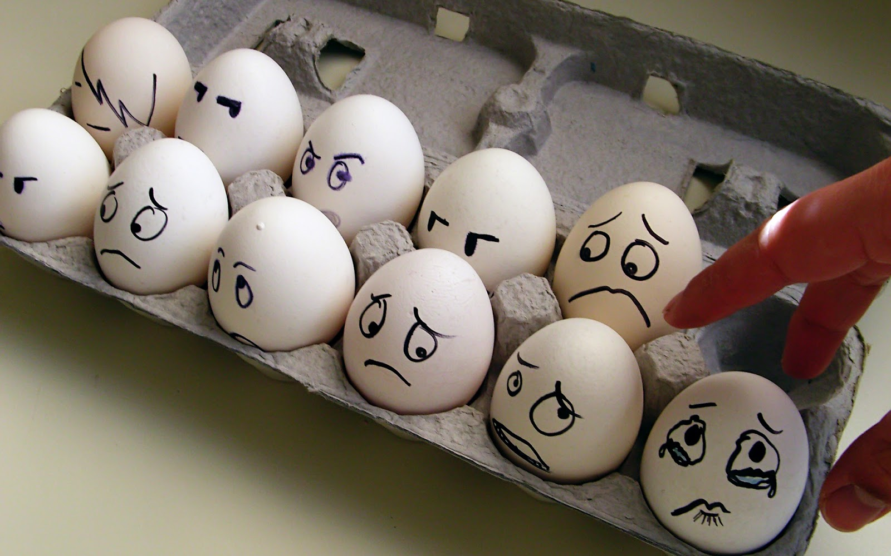

I’m scared

