Slide 1

NUMBERS (1-10)
2
4
3
1
5
2-4
START
10
6
7
8
9

Slide 2

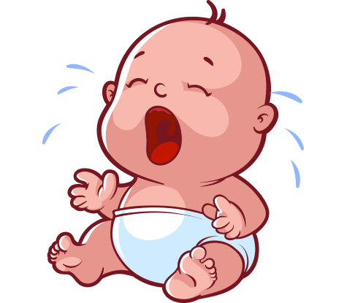
Why don’t you sleep?
Let’s count the sheep

Slide 3
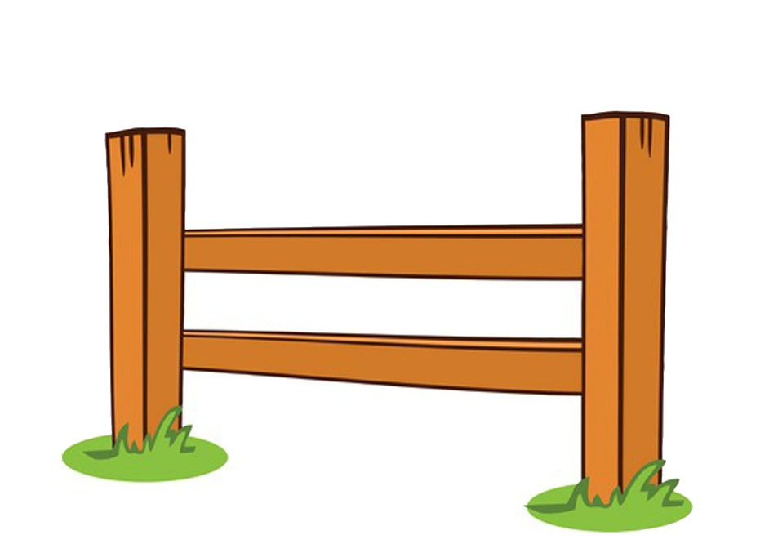
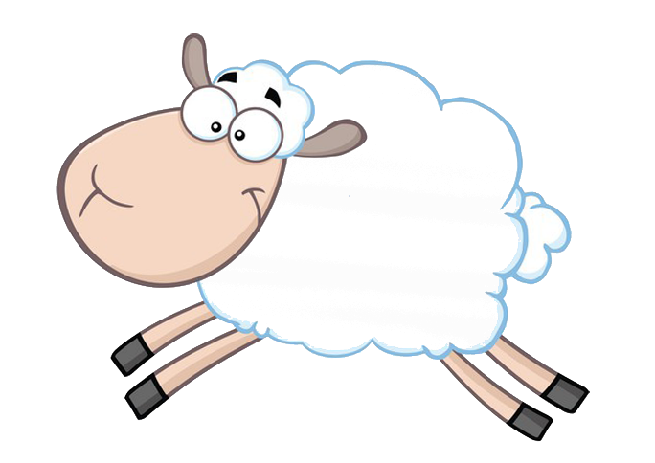
one

Slide 4
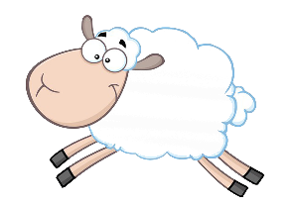
two

Slide 5
three

Slide 6
four

Slide 7
five

Slide 8
six

Slide 9
seven

Slide 10
eight

Slide 11
nine

Slide 12
ten

Slide 13
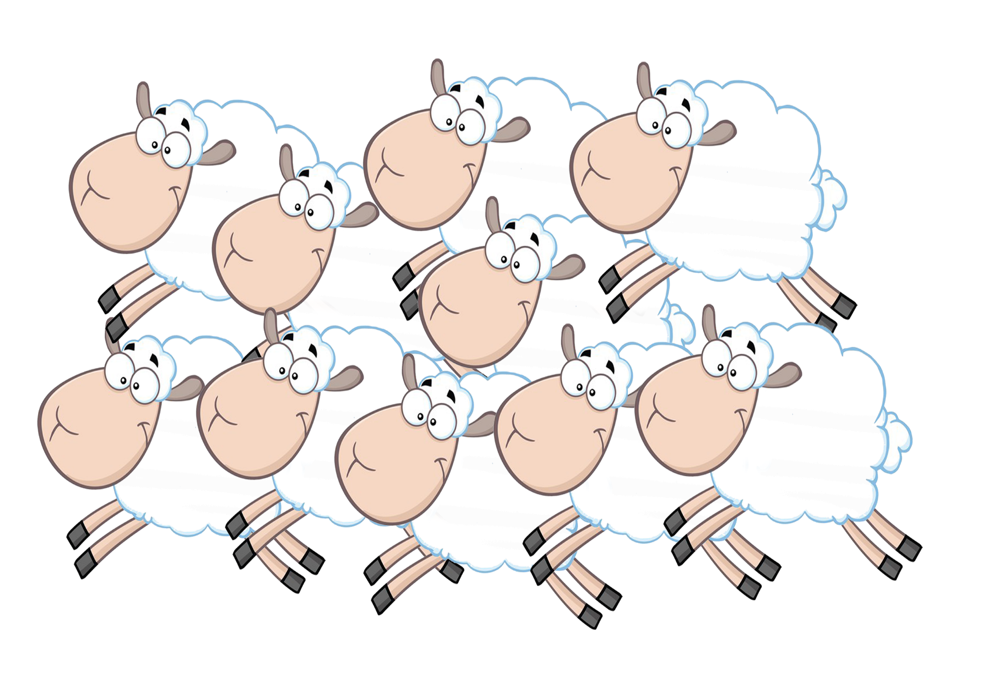
Let's count back now

Slide 14
ten

Slide 15
nine

Slide 16
eight

Slide 17
seven

Slide 18
six

Slide 19
five

Slide 20
four

Slide 21
three

Slide 22
two

Slide 23
one

Slide 24
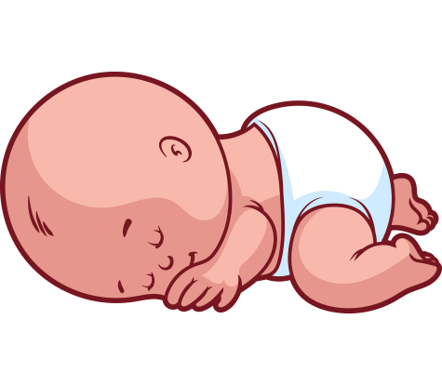
Sleep well

Slide 25




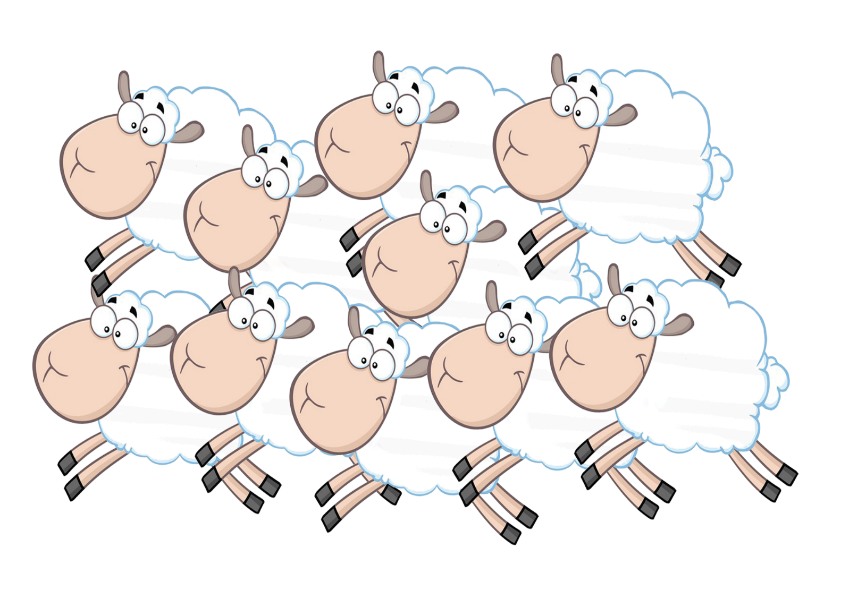
Let’s sing a song
3
1
5
2
4
6
10
7
9
8

