Slide 1



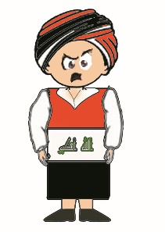







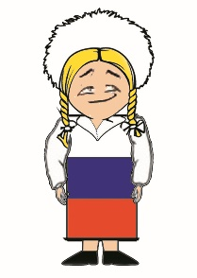

Nationality
4.2
START

Slide 2


Where are you from?
I’m from …………………
Turkish
Turkey
Britain
British

Slide 3

Where are you from?
I’m from …………………
Japanese
China
Chinese
Japan

Slide 4
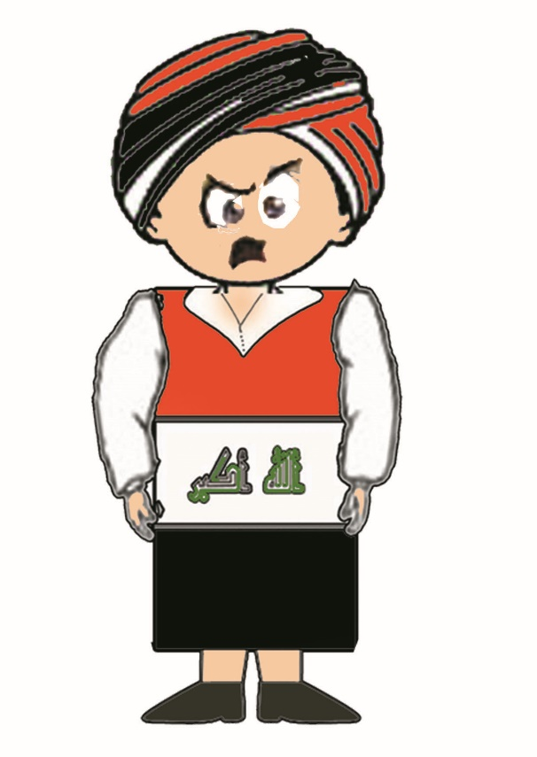
Where are you from?
I’m from …………………
Pakistan
Iraq
China
Germany

Slide 5

Where are you from?
I’m from …………………
Russia
Germany
Britain
Pakistan

Slide 6

Where are you from?
I’m from …………………
Iraq
Germany
Italy
France

Slide 7

Where are you from?
I’m from …………………
France
Germany
Russia
Italy

Slide 8

Where are you from?
I’m from …………………
Russia
France
Pakistan
Italy

Slide 9

Where are you from?
I’m from …………………
Japan
Germany
China
Britain

Slide 10

Where are you from?
I’m from …………………
Britain
Italy
France
The USA

Slide 11

Where are you from?
I’m from …………………
Britain
Spain
France
Italy

Slide 12

Where are you from?
I’m from …………………
Iraq
Russia
Pakistan
Germany

Slide 13

Where are you from?
I’m from …………………
Italy
France
Spain
Britain

Slide 14
What nationality are you?
I’m …………………
Spanish
German
Italian
Russian

Slide 15
What nationality are you?
I’m …………………
Spanish
German
Italian
Russian

Slide 16
What nationality are you?
I’m …………………
Turkish
Turkey
Britain
British

Slide 17
What nationality are you?
I’m …………………
French
Pakistani
German
Iraqi

Slide 18
What nationality are you?
I’m …………………
Japanese
China
Chinese
Japan

Slide 19
What nationality are you?
I’m …………………
Russian
French
Japanese
German

Slide 20
What nationality are you?
I’m …………………
Chinese
Spanish
Japanese
British

Slide 21
What nationality are you?
I’m …………………
American
French
Italian
British

Slide 22
What nationality are you?
I’m …………………
American
British
Spanish
Italian

Slide 23
What nationality are you?
I’m …………………
Russian
German
Iraqi
Spanish

Slide 24
What nationality are you?
I’m …………………
Iraqi
Italian
Pakistani
Chinese

Slide 25
What nationality are you?
I’m …………………
French
Italian
Chinese
American

Slide 26

Good Job

