Slide 1
MY CLOTHES
CLOTHES

Slide 2
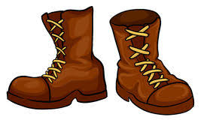
1-
shoes
boots
jacket
coat

Slide 3
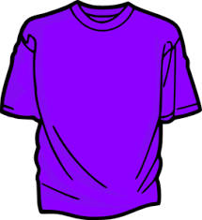
2-
umbrella
T-shirt
coat
trousers

Slide 4
3-
shoes
scarf
hat
raincoat

Slide 5
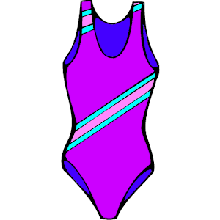
4-
swimsuit
umbrella
sunglasses
skirt

Slide 6
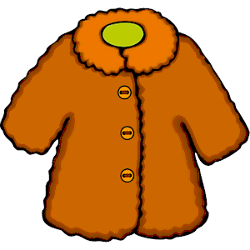
5-
gloves
boots
scarf
coat

Slide 7
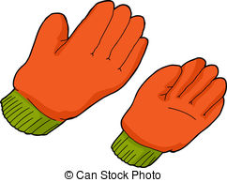
6-
coat
skirt
gloves
trousers

Slide 8
7-
raincoat
boots
T-shirt
umbrella

Slide 9
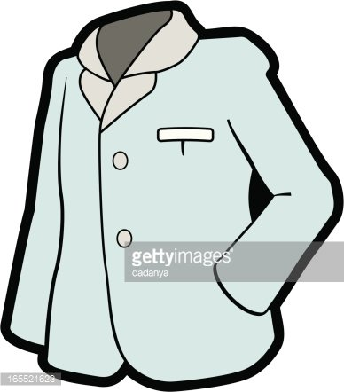
8-
coat
gloves
jacket
trousers

Slide 10
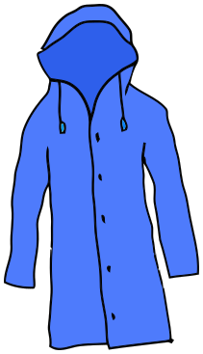
9-
shoes
raincoat
shorts
scarf

Slide 11
10-
shorts
swimsuit
trousers
scarf

Slide 12
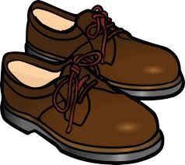
11-
shoes
boots
umbrella
trousers

Slide 13
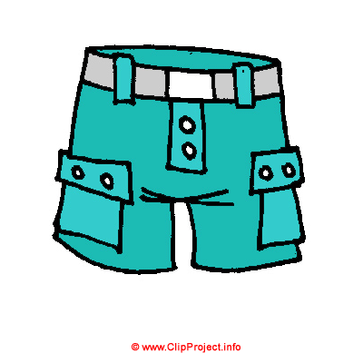
12-
trousers
boots
gloves
shorts

Slide 14
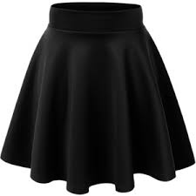
13-
hat
trousers
skirt
sunglasses

Slide 15
14-
sunglasses
boots
shoes
gloves

Slide 16
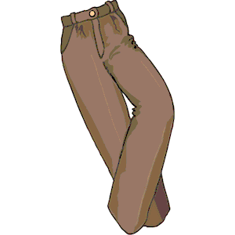
15-
shorts
gloves
trousers
jeans

Slide 17
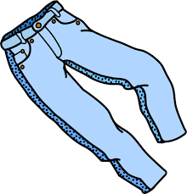
16-
shorts
gloves
trousers
jeans

Slide 18
SEASONS / WEATHER

Slide 19
17-
spring
summer
winter
autumn

Slide 20
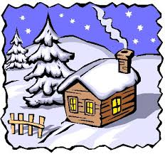
18-
winter
autumn
spring
summer

Slide 21
19-
autumn
winter
summer
spring

Slide 22
20-
spring
summer
autumn
winter

Slide 23
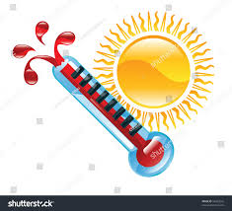
21-
wet
hot
cold
warm

Slide 24
22-
hot
cold
warm
wet

Slide 25
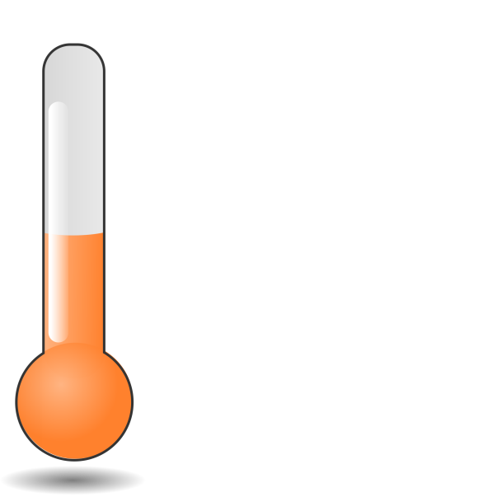
23-
cold
wet
hot
warm

Slide 26
24-
snowy
sunny
thundery
foggy

Slide 27
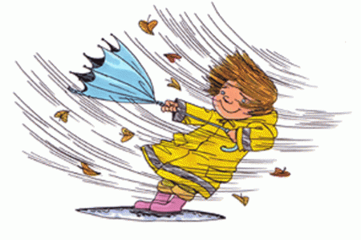
25-
snowy
sunny
windy
cloudy

Slide 28
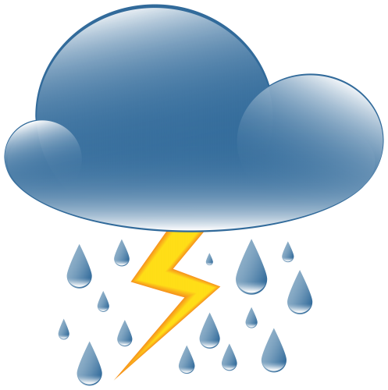
26-
thundery
snowy
sunny
foggy

Slide 29
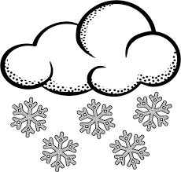
27-
rainy
foggy
sunny
snowy

Slide 30
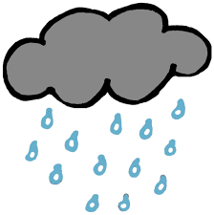
28-
windy
sunny
rainy
snowy

Slide 31
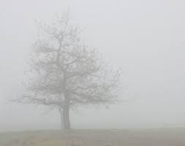
29-
foggy
cloudy
thundery
snowy

Slide 32
30-
cloudy
windy
rainy
foggy

Slide 33
MONTHS

Slide 34
31-Which one is in winter?
june
september
january
august

Slide 35
32-Which one is in autumn?
november
july
february
april

Slide 36
33-Which one is in summer?
october
july
december
may

Slide 37
34-Which one is in spring?
september
june
february
march

Slide 38
35-Which one is different?
august
july
june
october

Slide 39
36-Which one is different?
april
january
december
february

Slide 40
37-Which one is different?
may
march
june
april

Slide 41
38-Which one is different?
october
november
september
february

Slide 42
CONGRATULATIONS

