Slide 1

JOBS
START

Slide 2
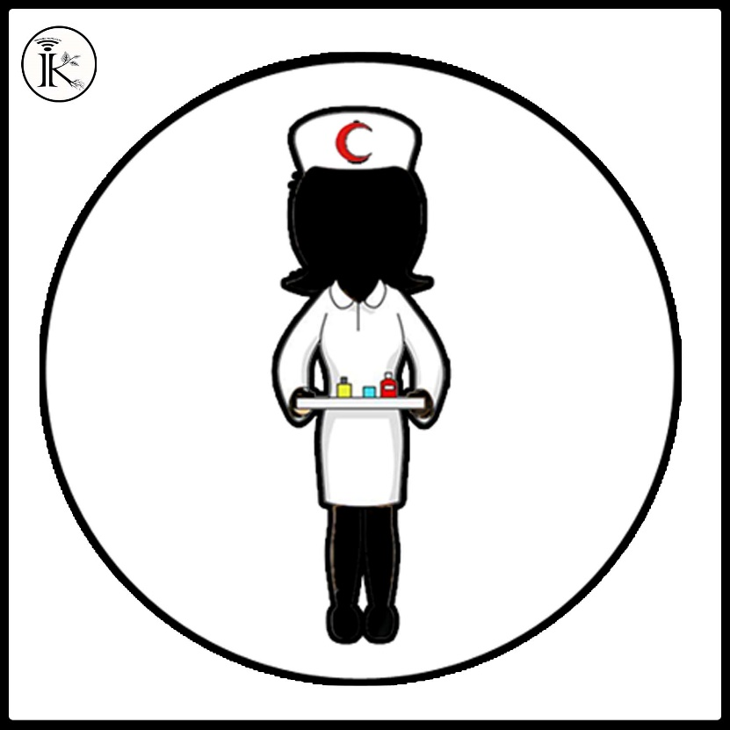
What is her job?
policewoman
nurse
actress
farmer

Slide 3
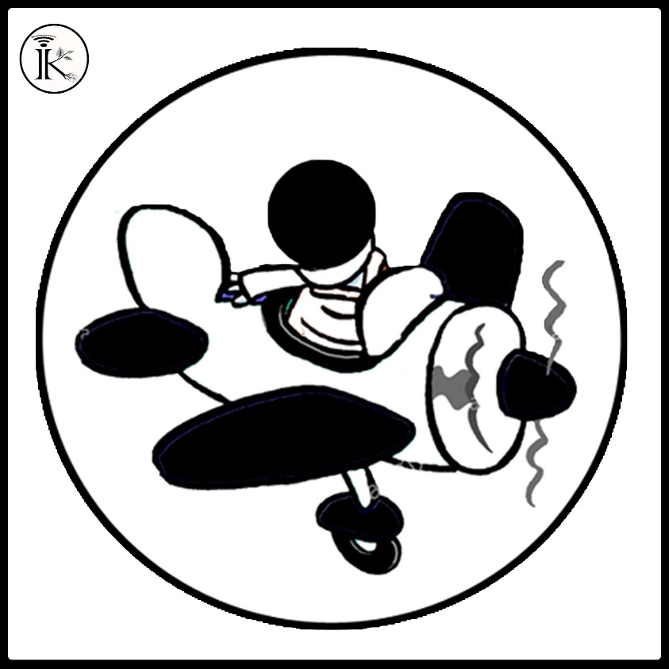
What does he like?
flying
actor
pilot
at the airport

Slide 4
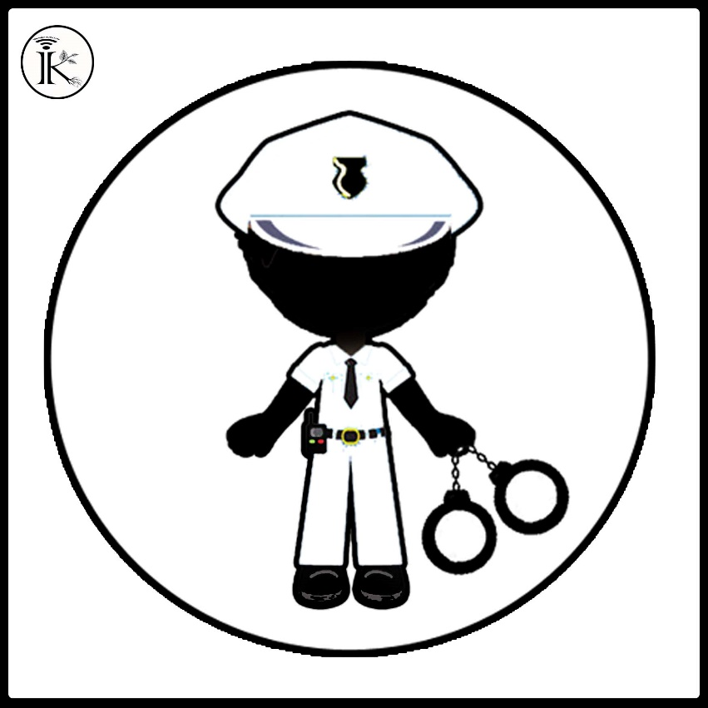
What is his job?
postman
fireman
policewoman
policeman

Slide 5
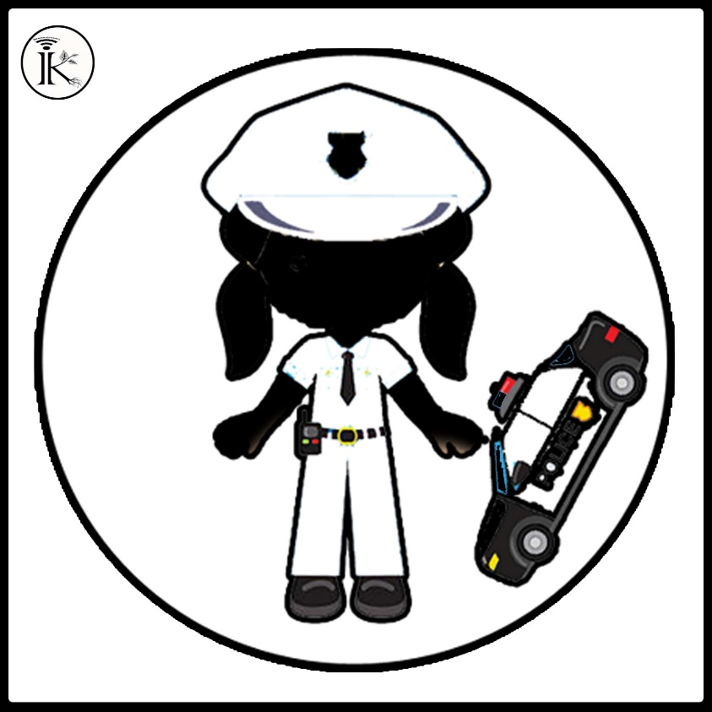
Where does she work?
policewoman
policeman
at the police station
helping people

Slide 6
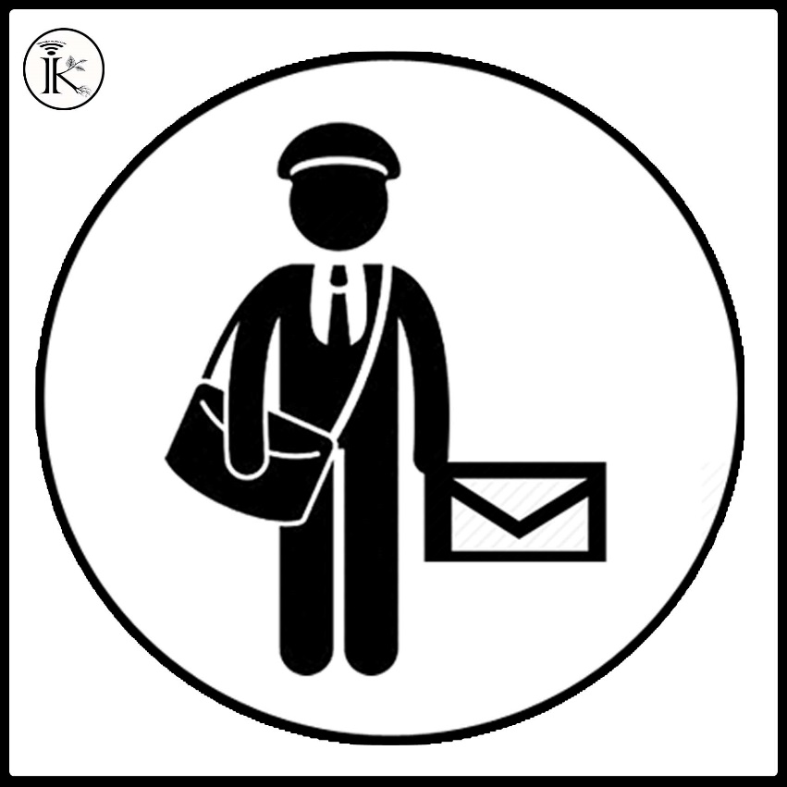
What’s your job?
fireman
postman
businessman
actor

Slide 7
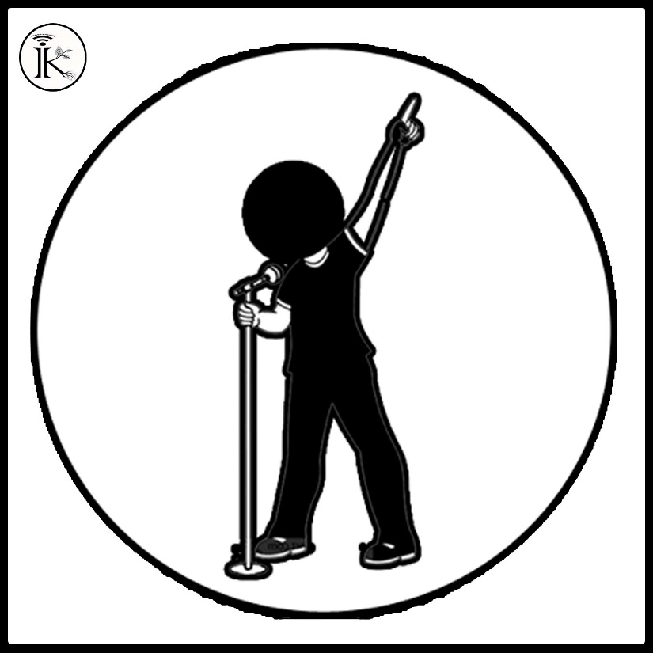
What do you do?
dancer
actor
teacher
singer

Slide 8
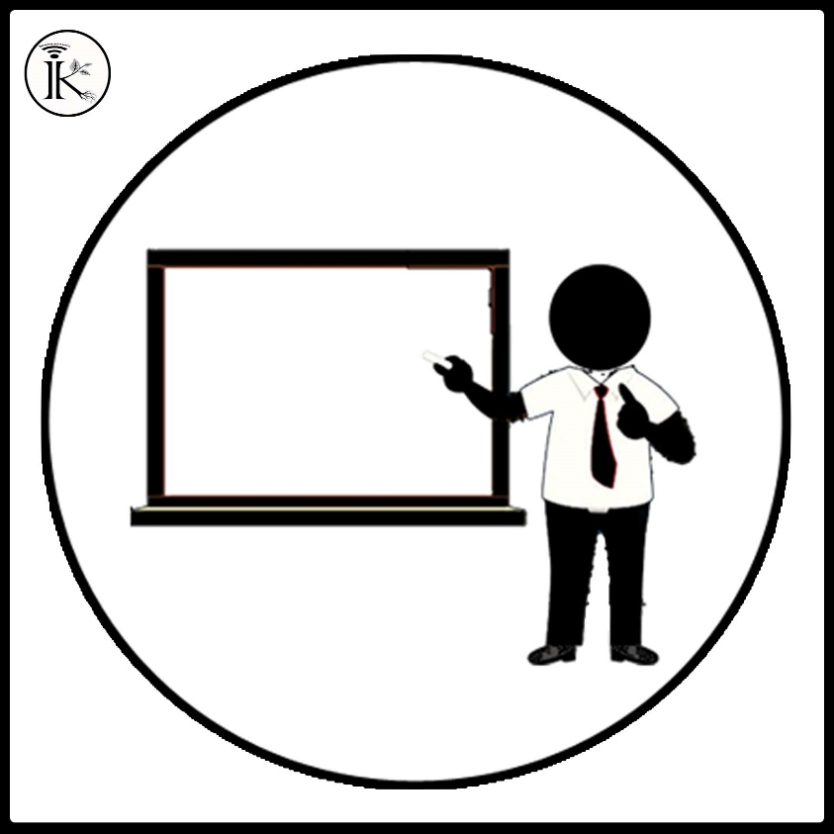
Where does he work?
teacher
at the school
teaching
writer

Slide 9
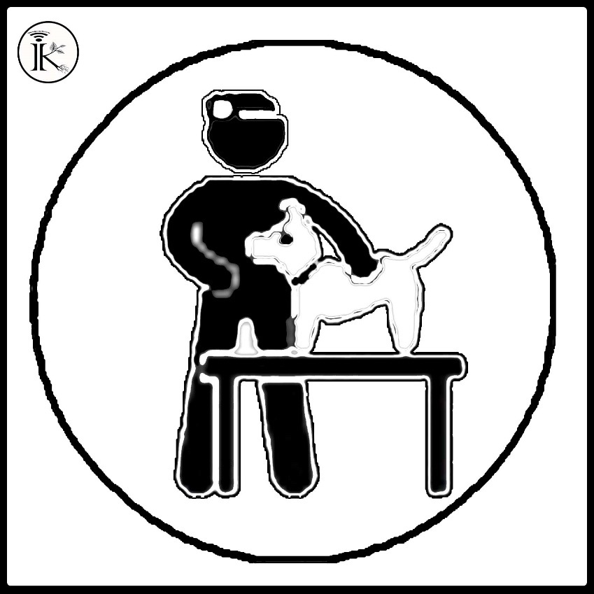
What does he like?
doctor
helping animals
vet
at the veterinary clinic

Slide 10
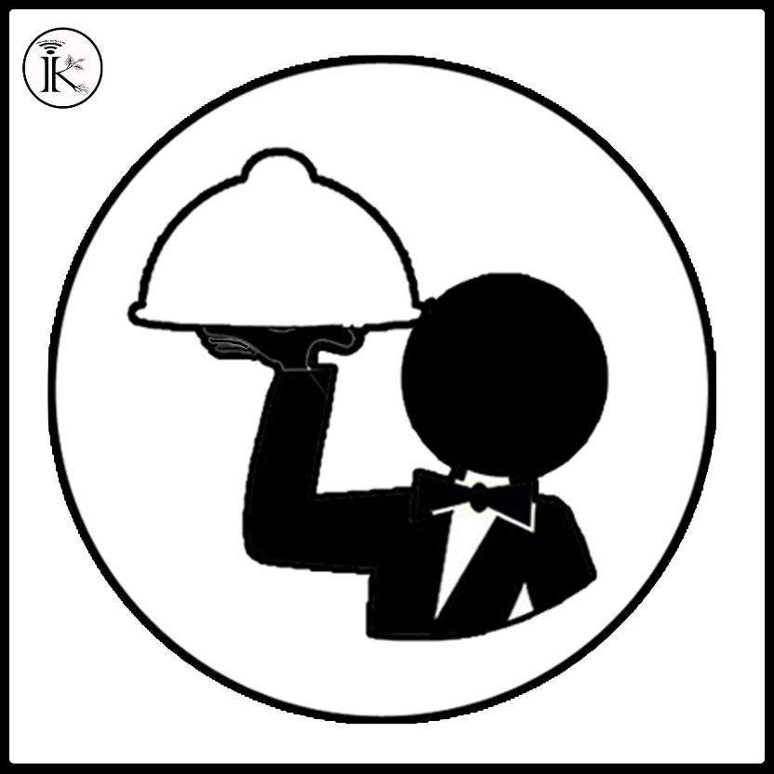
What does he do?
writer
waiter
at the restaurant
writing books

Slide 11
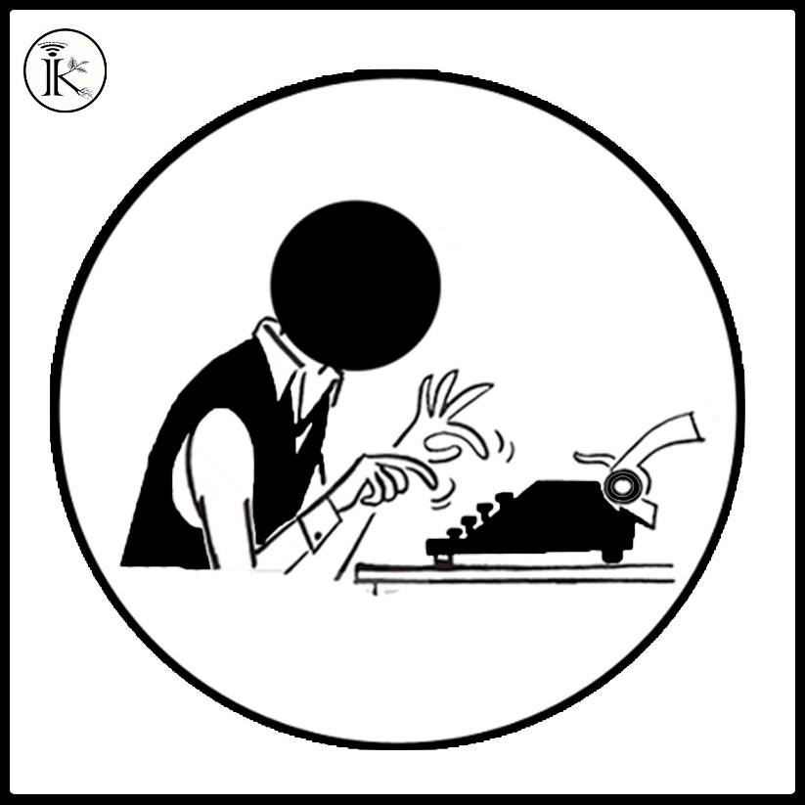
What does he like?
writer
waiter
writing books
at the restaurant

Slide 12

What’s his job?
actress
dancer
singer
actor

Slide 13

Where does she work?
actor
actress
at the theatre
dance school

Slide 14

What’s his job?
businessman
postman
fireman
at an office

Slide 15

What does he like?
cooking
waiter
chef
at a restaurant

Slide 16

What does she do?
singer
dancer
actress
actor

Slide 17
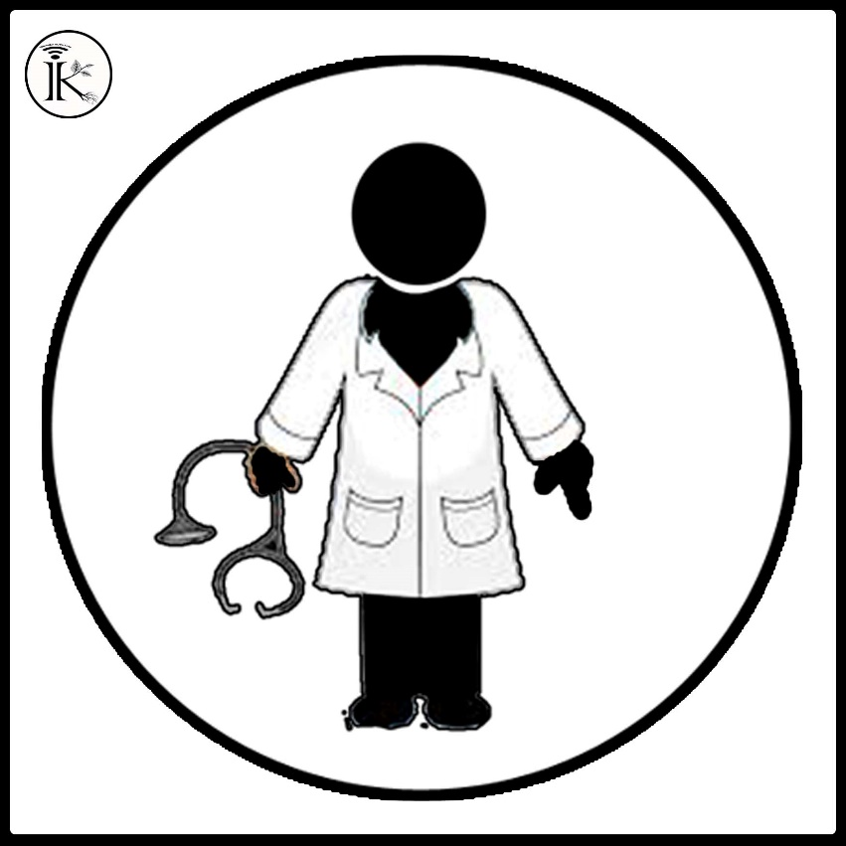
What does he like?
at the hospital
nurse
doctor
helping people

Slide 18

What does he like?
fireman
on a farm
planting vegetables
farmer

Slide 19
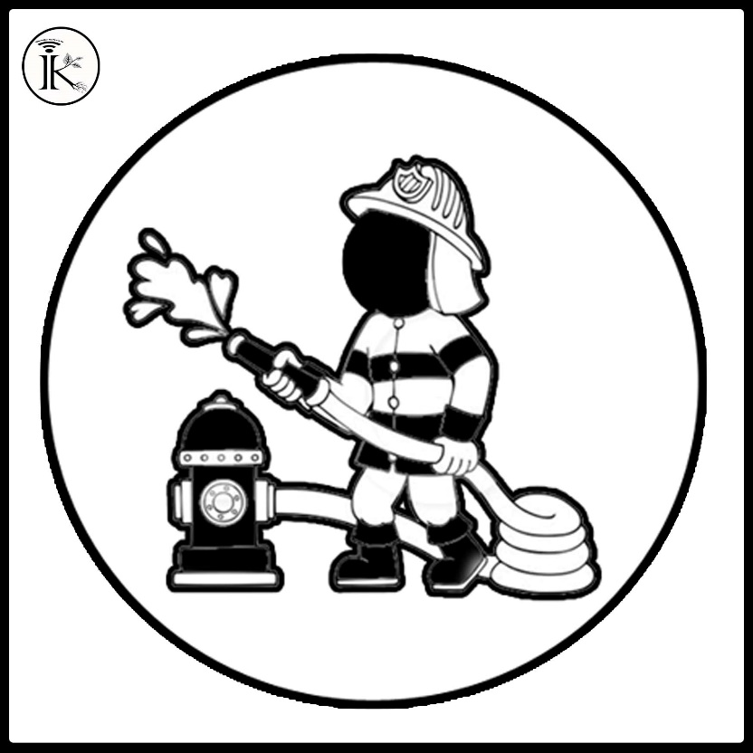
What is his job?
fireman
farmer
firefighting
at the fire station

Slide 20

A pilot works ……………………
pilot
flying
At the clinic
At the airport

Slide 21

A singer works ……………
dancer
at a dance school
at the concert hall
singing

Slide 22

A farmer works …………
at the airport
at the restaurant
at the music hall
on a farm

Slide 23

A fireman works …………
at the post office
at the police station
at the fire station
at the theatre

Slide 24

Where does a doctor work?
at the school
at the shopping center
at the veterinary clinic
at the hospital

Slide 25

…………………… works at an office
Waiter
Chef
Businessman
Teacher

Slide 26

Where do you work?
policeman
policewoman
fire station
at police station

Slide 27

Where do you work?
postman
at the post office
bringing letters
at the fire station

Slide 28
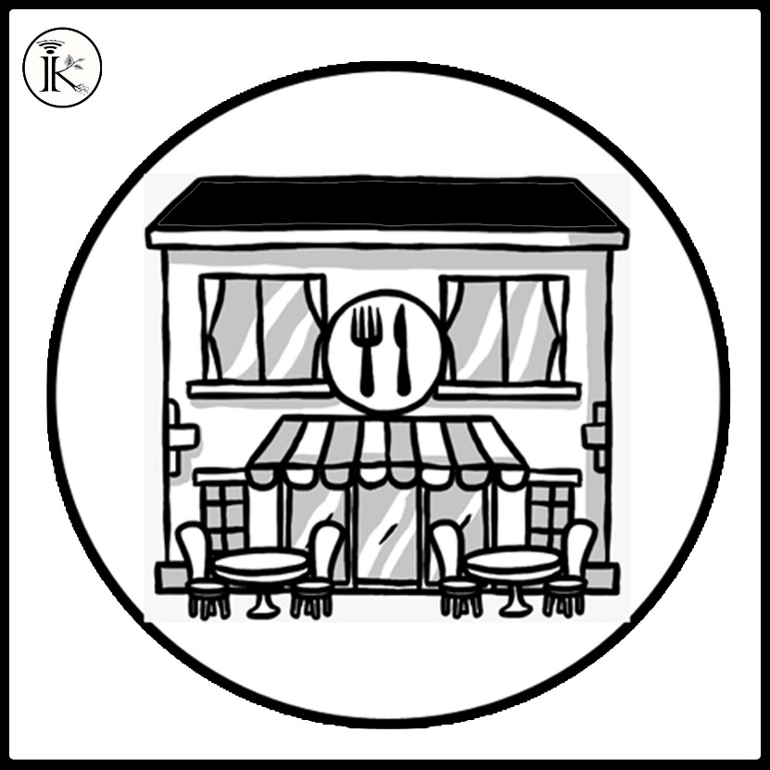
A chef works …………
at the restaurant
at the cafe
chef
cooking

Slide 29

What do you like?
teacher
at the school
teaching
writing books

Slide 30
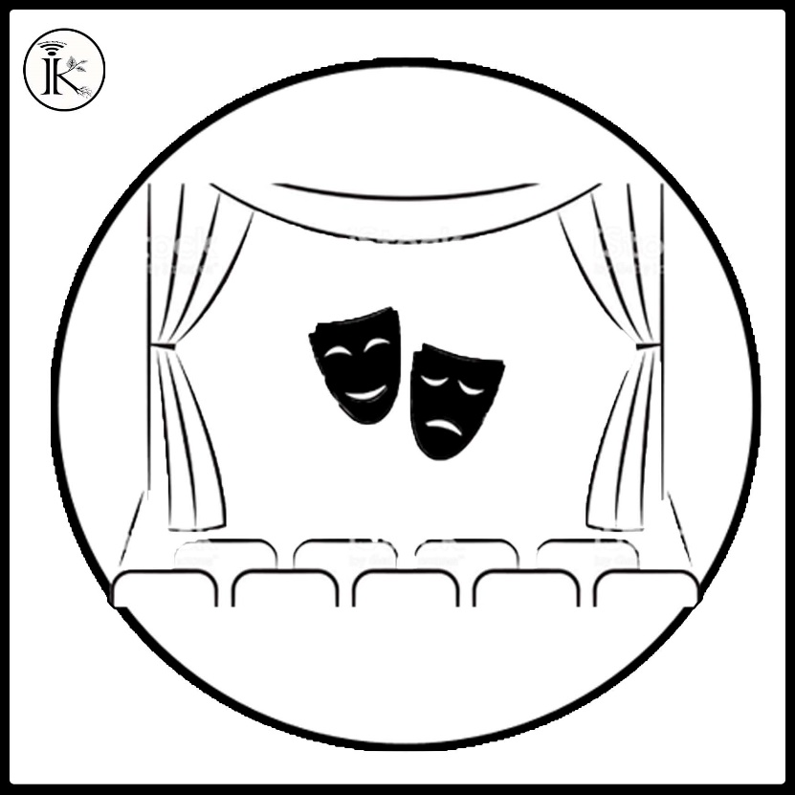
An …………… works at the theatre.
singer
dancer
actress
chef

Slide 31
WELL DONE

