Slide 1


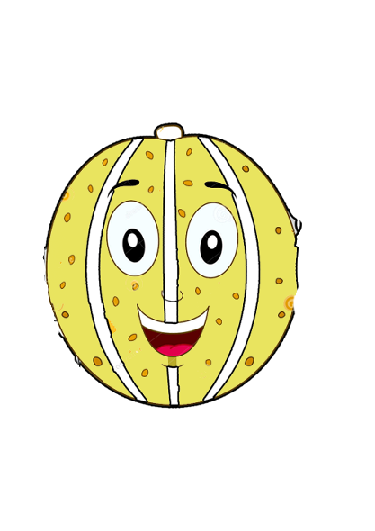



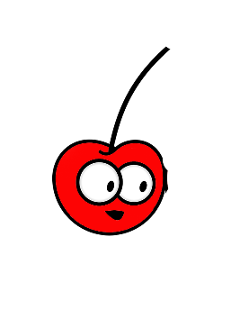
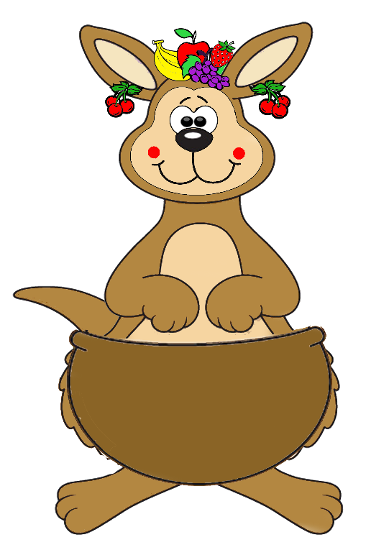
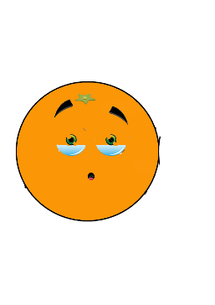

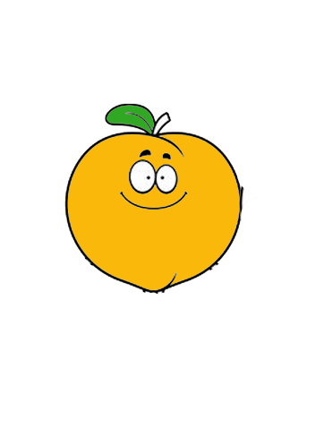
FRUIT
2.9
START

Slide 2
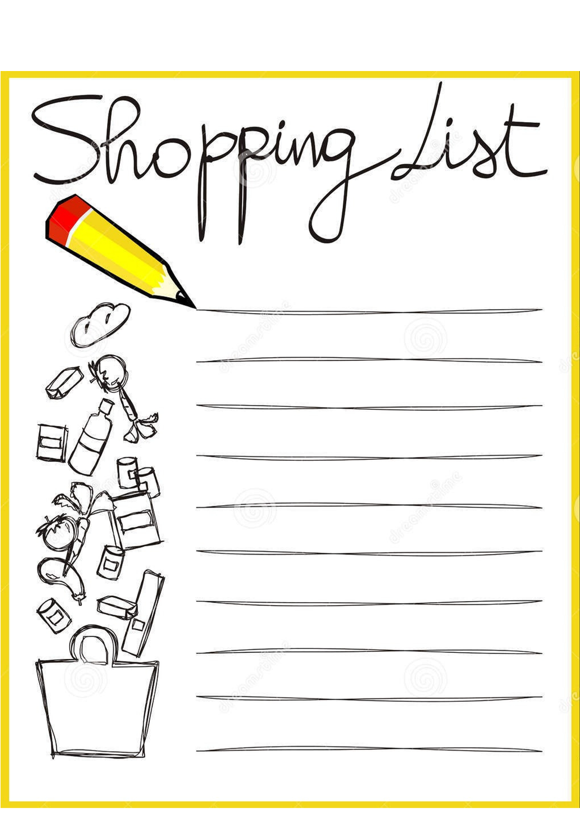

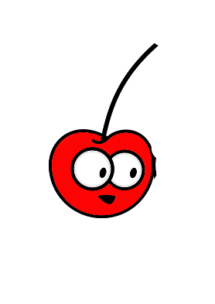
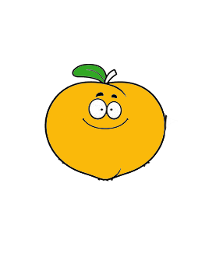

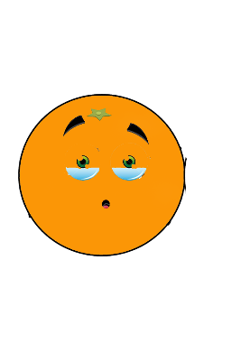
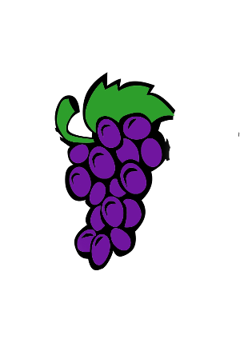




Match
4
7
6
1-orange
2
2-melon
3-banana
1
4-apple
5-strawberry
8
6-peach
9
7-cherry
8-grapes
9-lemon
3
5

Slide 3








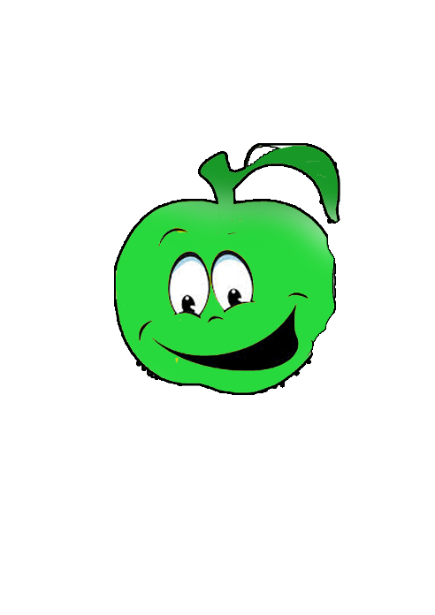

Buy the fruit I like.
(Sevdiğim meyveyi satın al.)
NEXT

Slide 4
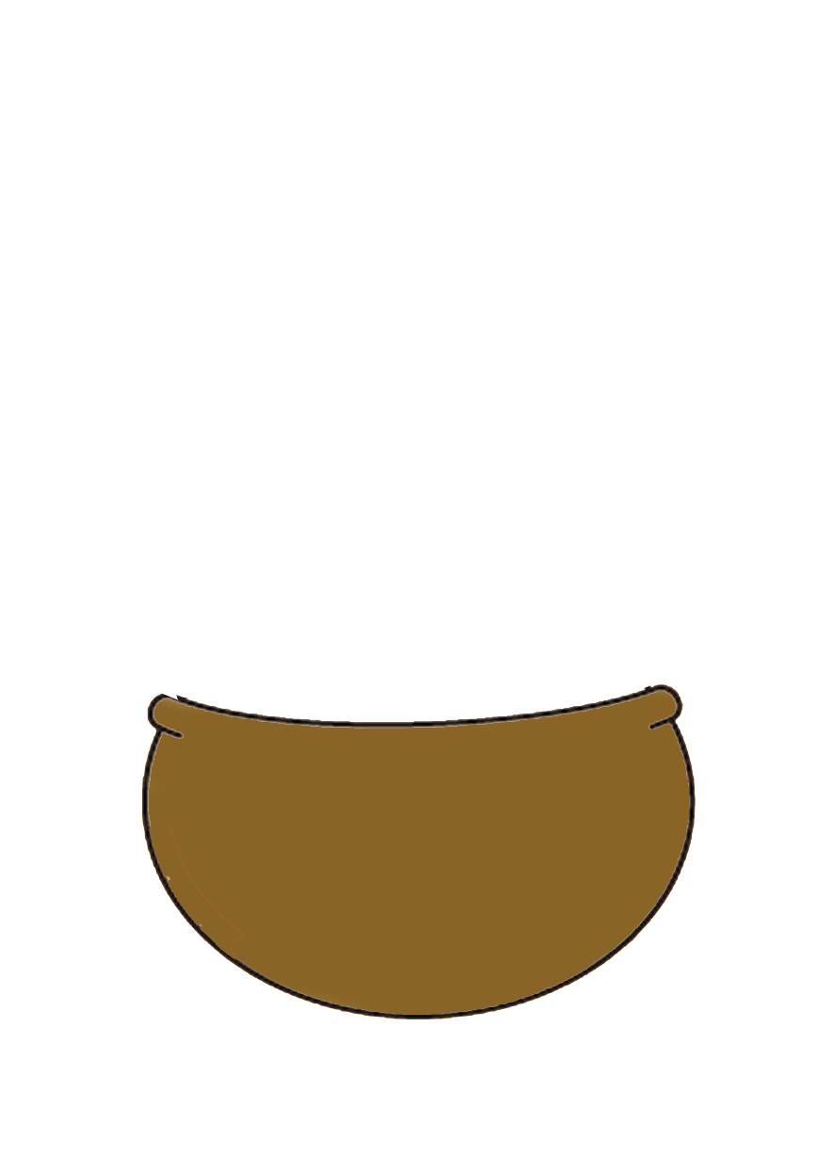
I like grapes

Slide 5
I like cherry

Slide 6
I like strawberry

Slide 7
I like melon

Slide 8
I like apple

Slide 9
I like orange

Slide 10
I like peach

Slide 11
I like banana

Slide 12
I don’t like lemon

