Slide 1


DIRECTIONS
START
Happy 29th of October Republic Day

Slide 2

Go fifteen dots to the North.

Slide 3
Go eight dots to the east

Slide 4
Go five dots to the south.

Slide 5
Go seven dots to the west.

Slide 6
Go ten dots to the south.

Slide 7
Go twelve dots to the east.

Slide 8
Go five dots to the north.

Slide 9
Go four dots to the east.

Slide 10
Go four dots to the north.

Slide 11
Go four dots to the east.

Slide 12
Go four dots to the south.

Slide 13
Go four dots to the east.

Slide 14
Go five dots to the south.

Slide 15
Go two dots to the east.

Slide 16

Go two dots to the east.
Finish

Slide 17







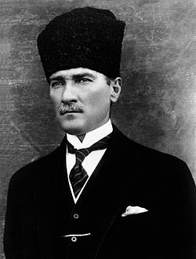



Happy 29th of October
Republic Day

