Slide 1
CLASSROOM RULES
Resimleri inceleyip uygun olan cevabı tıklayarak ilerleyin ve oyunu yanlış yapmadan bitirmeye çalışın. Zaten yanlış yaptığınızda en başa döneceksiniz. Çalışmaya her başladığınızda bu oyunu sonuna kadar 1 kere tamamlamadan oyunu bırakmayın.
4-1
START

Slide 2
1)
Close The Door
Raise Your Hand
Be Quiet
Sit Down

Slide 3
2)
Turn off the Lights
Clean the Board
Look at the Board
Stand Up

Slide 4
3)
Close the Window
Close the Door
Open the Door
Open the Window

Slide 5
4)
Stay There
May I come in?
Go Back to Your Place
Come Here

Slide 6
5)
Turn on
Clean
Give
Listen

Slide 7
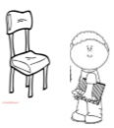
6)
Be Quiet
Go Back to Your Place
Join the Game
Raise Your Hand

Slide 8
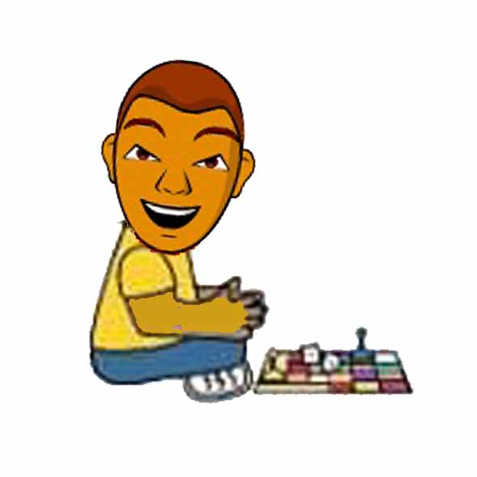
7)
Join the Game
Stand Up
Take the Ball
Give Me the Book

Slide 9
8)
Join the Game
Stay There
Go Back yo Your Place
Leave Your Books Here

Slide 10
9)
Listen
Look
Give
Take

Slide 11
10)
Come in
Close the Window
Look at the Board
Clean the Board

Slide 12
11)
May I Clean the Board?
May I go to the Toilet?
May I Come in?
Can I join Your Game?

Slide 13
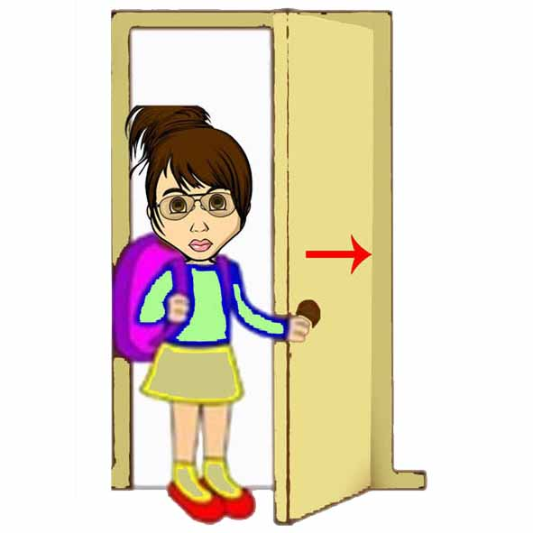
12)
Close The Door
Open the Window
Close the Window
Open the Door

Slide 14
13)
Come in
Raise Your Hand
Listen
Be Quiet

Slide 15
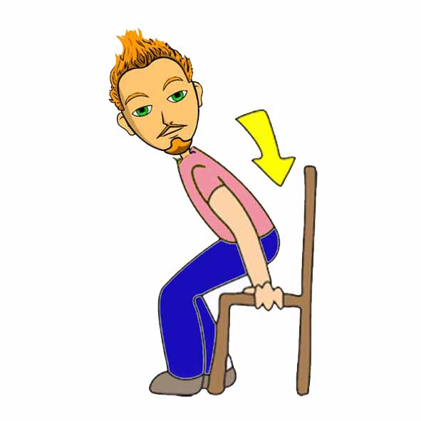
14)
Come Here
Come in
Sit Down
Stand Up

Slide 16
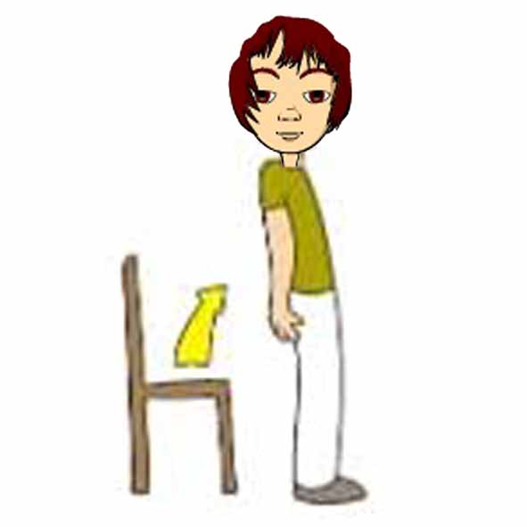
15)
Stand Up
Come Here
Stay There
Sit Down

Slide 17
16)
Save the Energy
Stay There
Be Quiet
Take the Ball

Slide 18
17)
Turn Off
Come in
Take
Listen

Slide 19
18)
Turn On The Lights
Turn Off the Lights
Join the Game
Go Back to Your Place

Slide 20
19)
Go Back to Your Place
Join the Game
Turn On the Lights
Turn Off the Lights

Slide 21
20)
May I come in?
Can I Join Your Game?
May I Open the Window?
May I Go To the Toilet?

Slide 22
CONGRATULATIONS

