Slide 1

CLASSROOM
OBJECTS
4-1
START

Slide 2


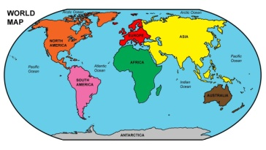

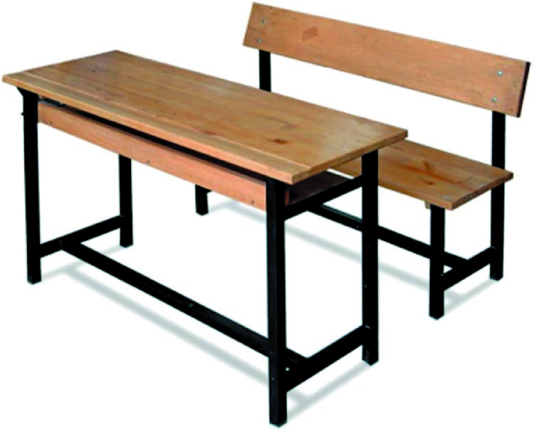
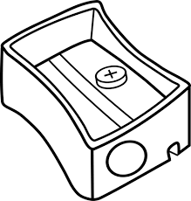
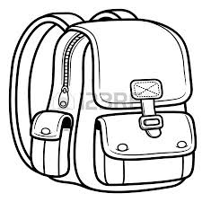

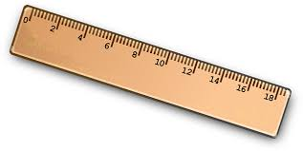



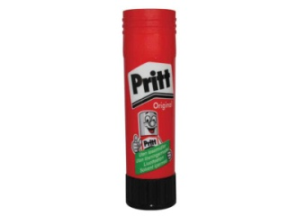

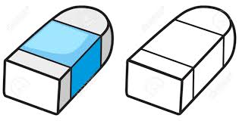
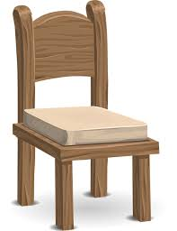
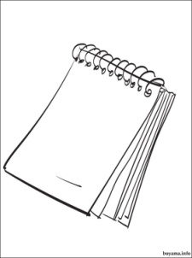
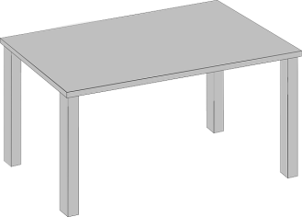

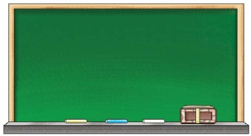
1-Door

Slide 3
2-Window

Slide 4
3-Board

Slide 5
4-Map

Slide 6
5-Book

Slide 7
6-Desk

Slide 8
7-Dictionary

Slide 9
8-Pencilcase

Slide 10
9-Pencil sharpener

Slide 11
10-Eraser

Slide 12
11-Ruler

Slide 13
12-Table

Slide 14
13-Pen

Slide 15
14-Scissors

Slide 16
15-Bag

Slide 17
16-Chair

Slide 18
17-Crayon

Slide 19
18-Notebook

Slide 20
19-Glue

Slide 21
20-Pencil

Slide 22
CONGRATULATIONS

