Slide 1

CARTOON CHARACTERS
START
4-3

Slide 2

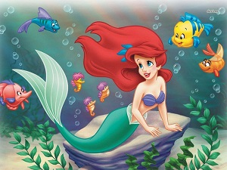
She
………… is a mermaid. …………name is Ariel.
Her
She can …………………… and ……………………
But she can’t …………………..
swim
dive
walk
walk – swim – she – dive - her

Slide 3
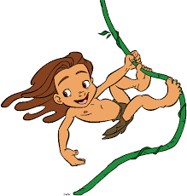
He
………… is a boy.
……… name is Tarzan.
His
swing
climb trees
He can …………………… and …………………………
But he can’t ………………
fly
fly – he – his – swing - climb trees

Slide 4
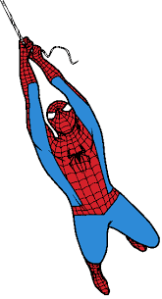
He
………… is a super hero.
…… name is Spiderman.
His
swing
He can ……………………and ………….
But he can’t ……………………………………….
climb buildings
play the guitar
his– play the guitar – climb buildings – swing - he

Slide 5
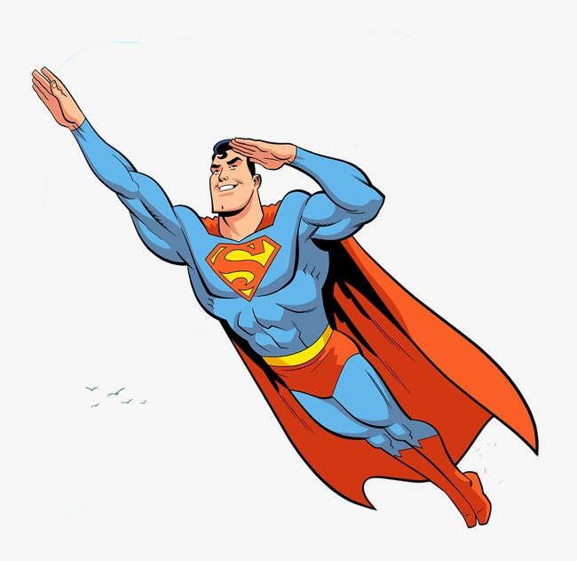
He
……….. is a super hero.
…….. name is Superman.
His
fly
He can ……………………
But he can’t ……………………………………….
sing a song
fly– he – sing a song – his

Slide 6
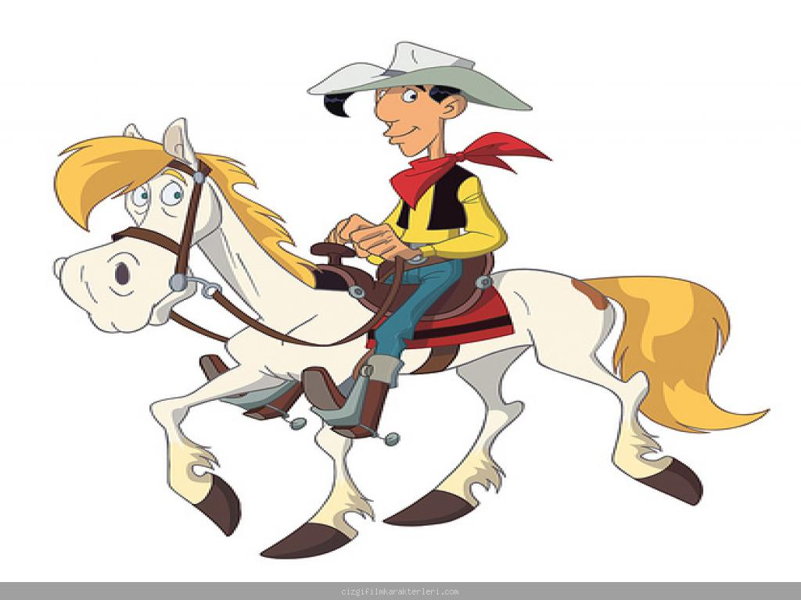
He
………. is a cowboy.
……… name is Lucky Luke.
His
ride a horse
He can ……………………
But he can’t ……………………………………….
ride a bike
he– ride a horse – his – ride a bike

Slide 7
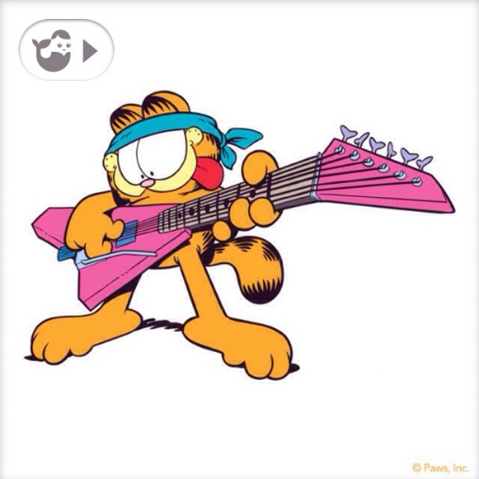
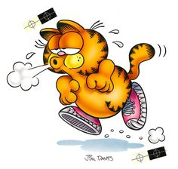
It
………… is a cat.
……… name is Garfield.
Its
play the guitar
It can ……………………
But it can’t ……………………………………….
run fast
play the guitar– run fast – its – it

Slide 8

It
…………… is a bear.
…………… name is Alex.
Its
do puzzle
It can ……………………
But it can’t ……………………………………….
climb a tree
It – do puzzle – Its - climb a tree

Slide 9

It
……….. is a bird.
………… name is Lucas.
Its
sing a song
fly
It can ……………… and …………..
But it can’t ……………………………………….
drive a car
Its– It– drive a car – sing a song – fly

Slide 10
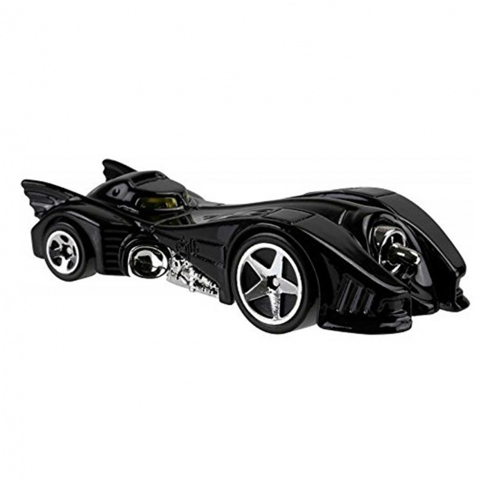
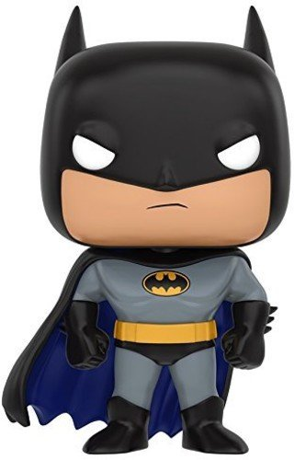
Whose car is this?
It is ………………………… car. = It’s …………………… car.
Batman’s
his

Slide 11
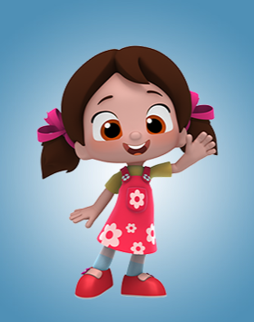

Whose turtle is this?
It is ………………………… turtle. = It’s …………………… turtle.
Niloya’s
her

Slide 12
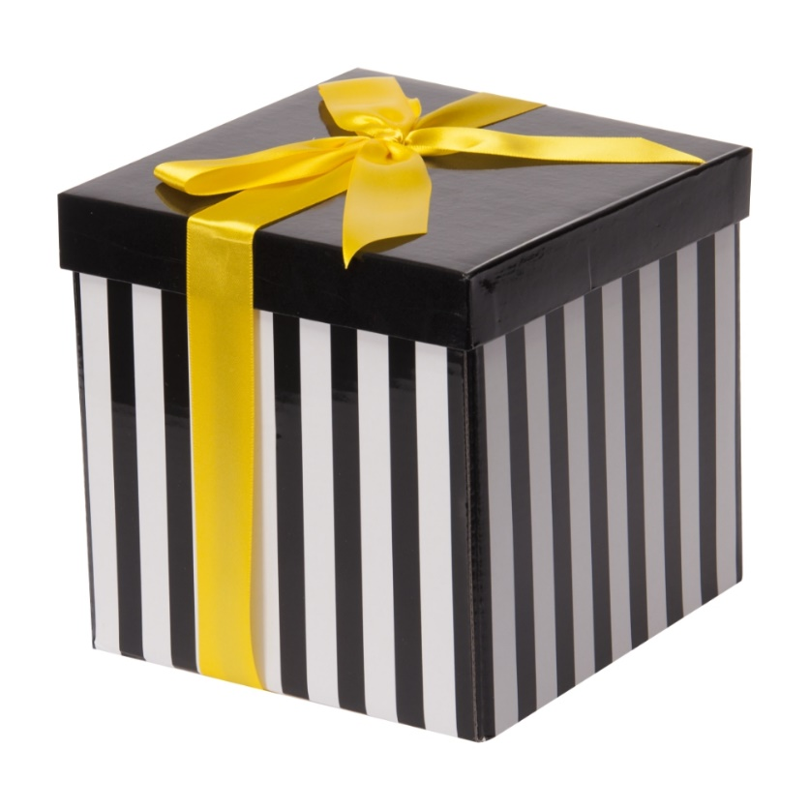
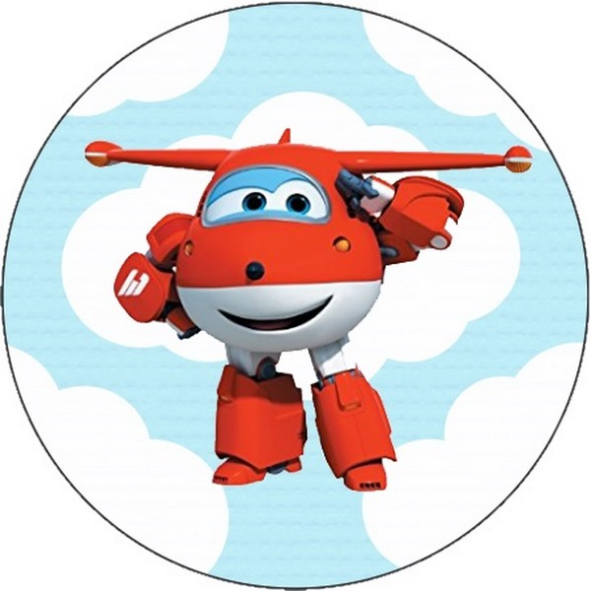
Whose box is this?
It is ………………………… box. = It’s …………………… box.
Jet’s
its

