Slide 1

MY FRIENDS
Grade – 4
Unit - 9
START

Slide 2



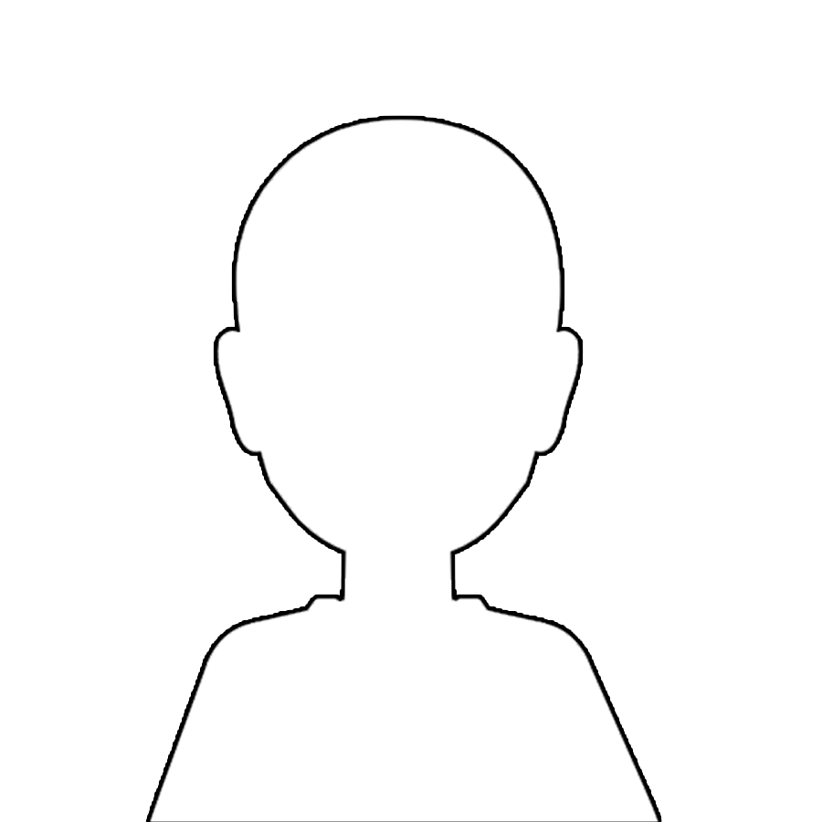
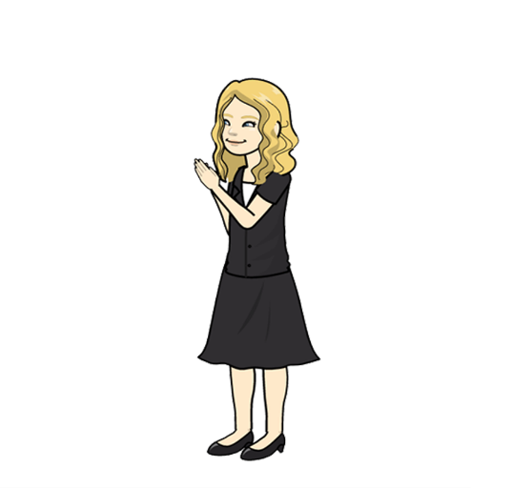
?
boy
girl
Daisy is my best friend.
She is ten years old.
She is a student.
She is from England.
She is English.
She likes reading books.
Please, find Daisy’s photo.
Daisy

Slide 3
Click here
he
she
X
boy
girl
Daisy is my best friend.
She is ten years old.
She is from England.
She is English.
She likes reading books.
Please, find Daisy’s photo.
Daisy

Slide 4
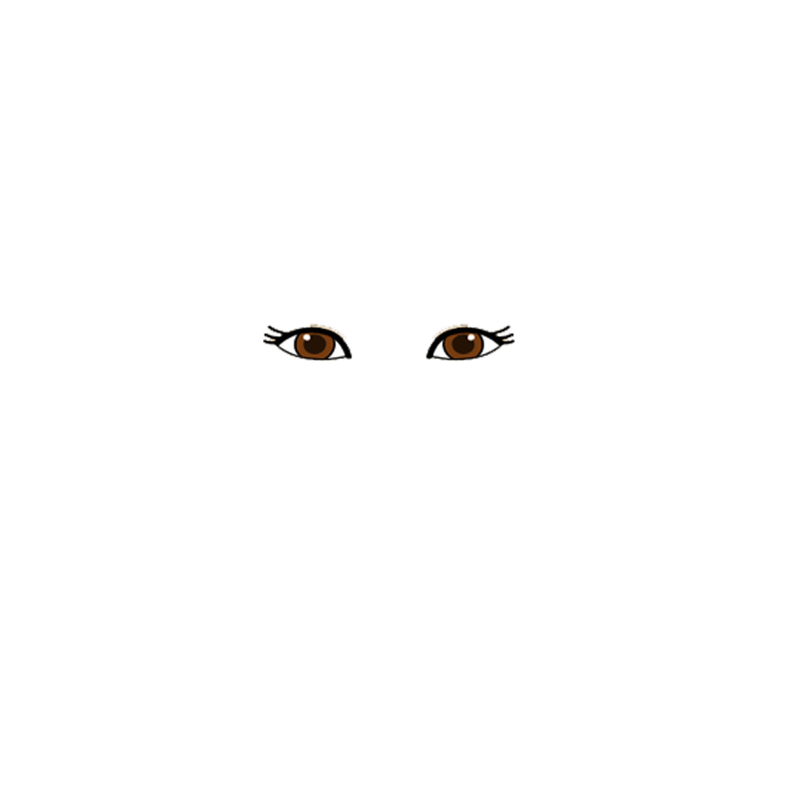
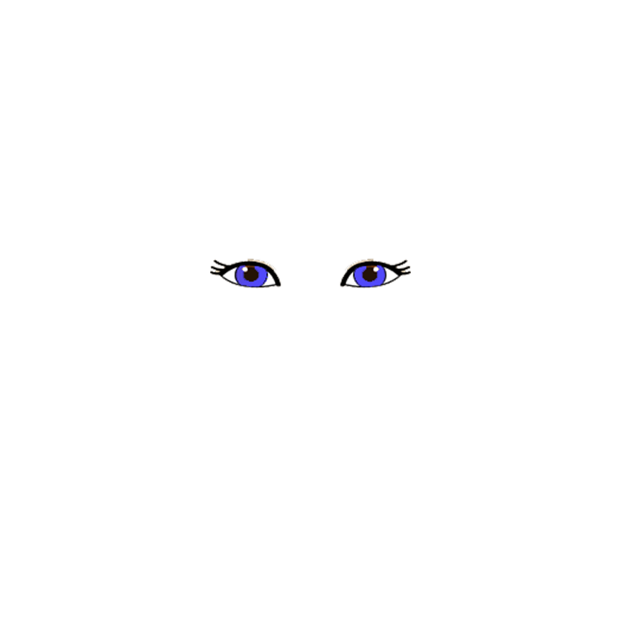


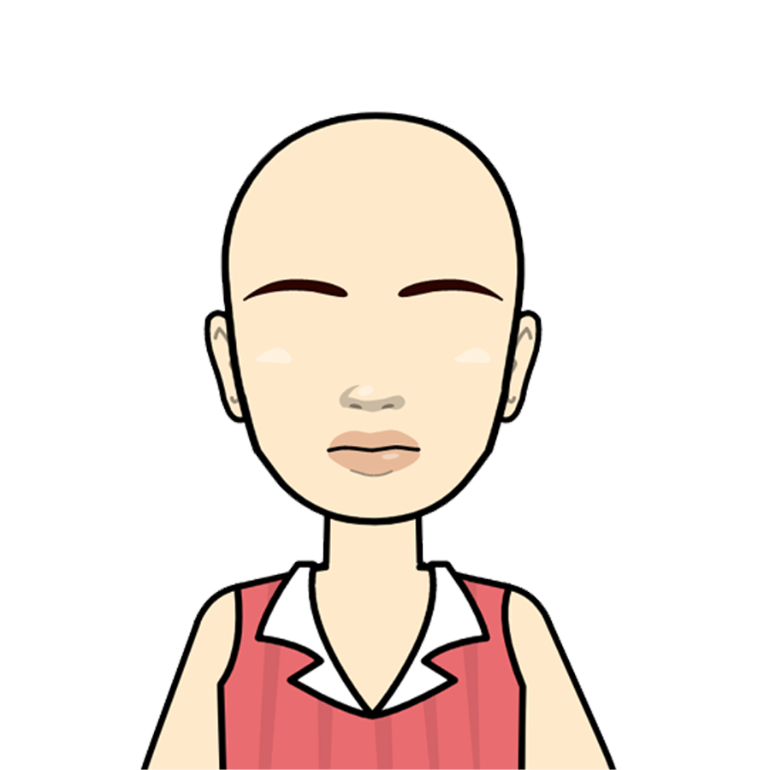
She has green eyes.

Slide 5
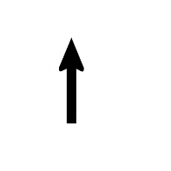
X
X
X
brown eyes
green eyes
blue eyes
black eyes
She has green eyes.

Slide 6
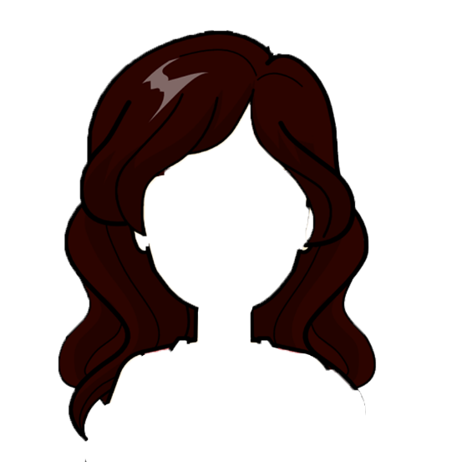
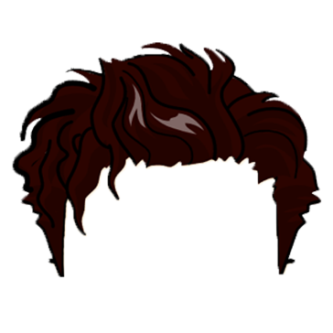
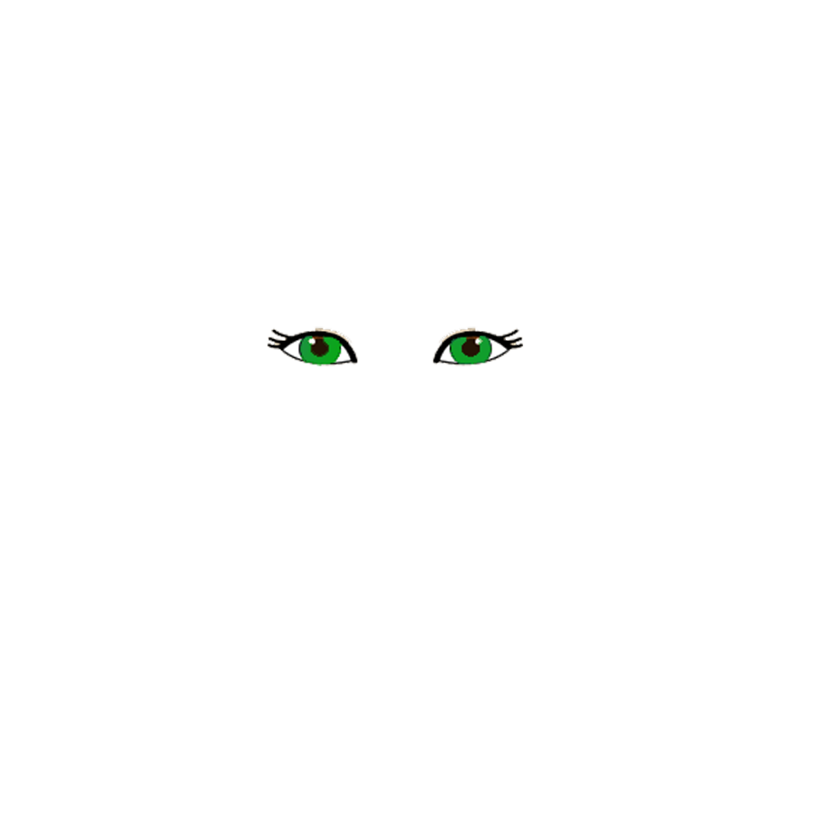
She has long hair.

Slide 7
X
short hair
long hair
She has long hair.

Slide 8
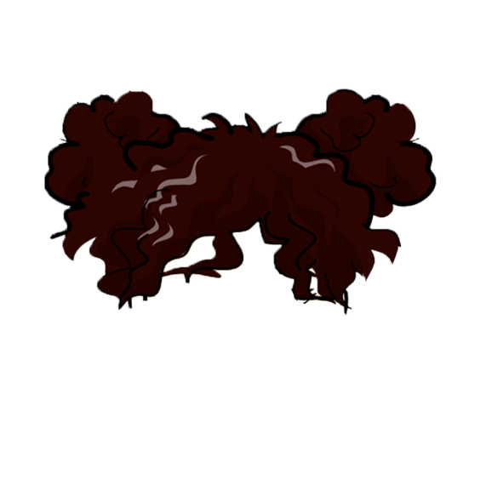
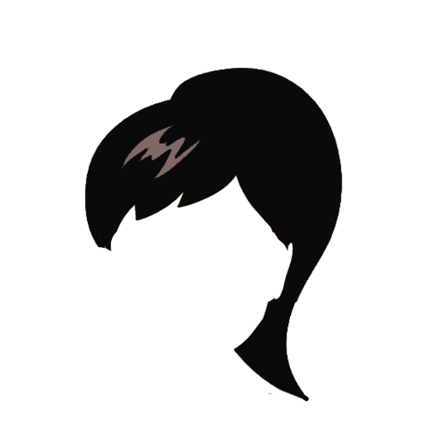
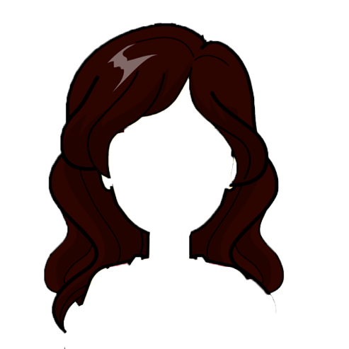
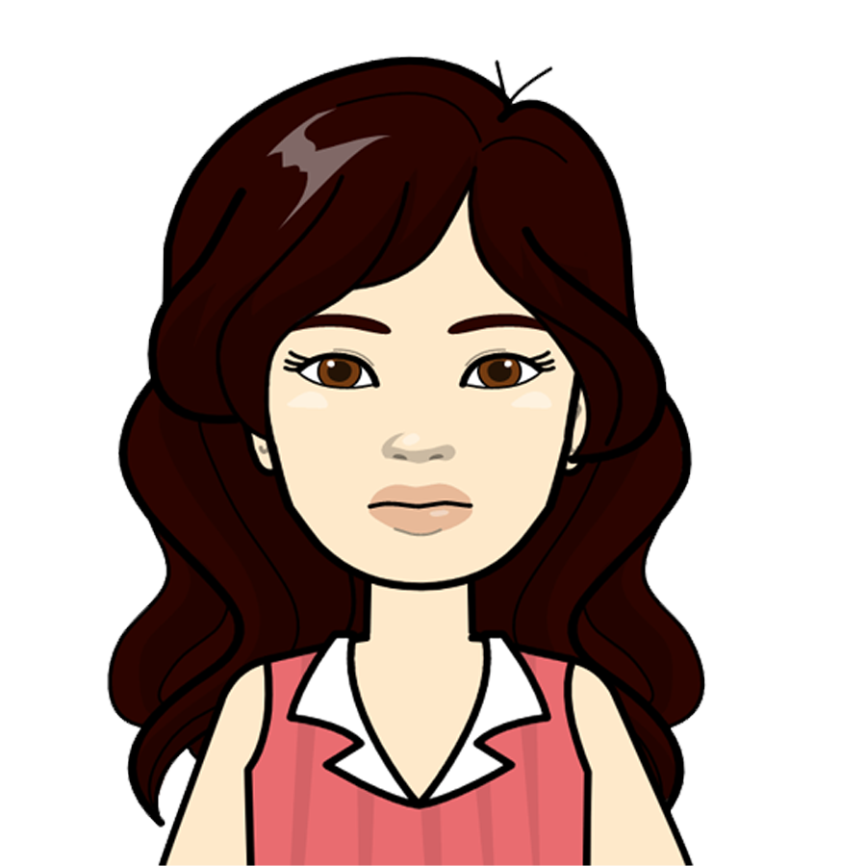
She has straight hair.

Slide 9

X
X
straight
hair
curly hair
wavy
hair
She has straight hair.

Slide 10
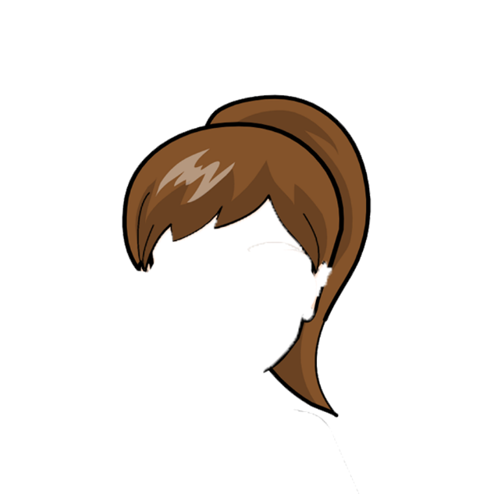
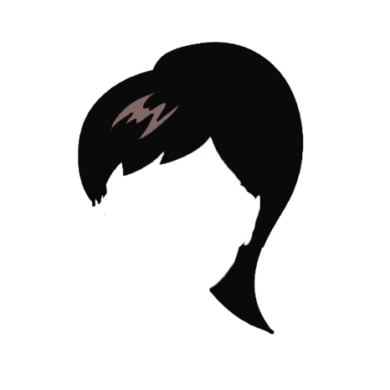

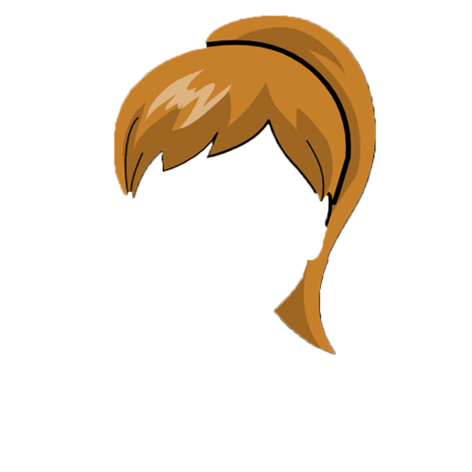
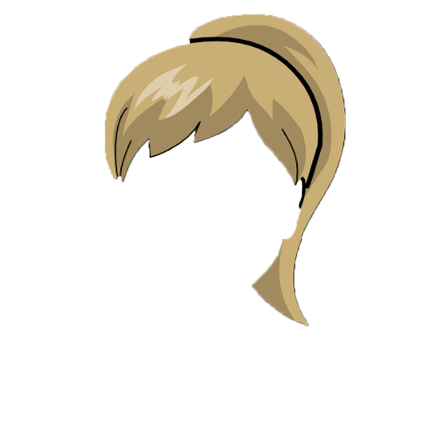

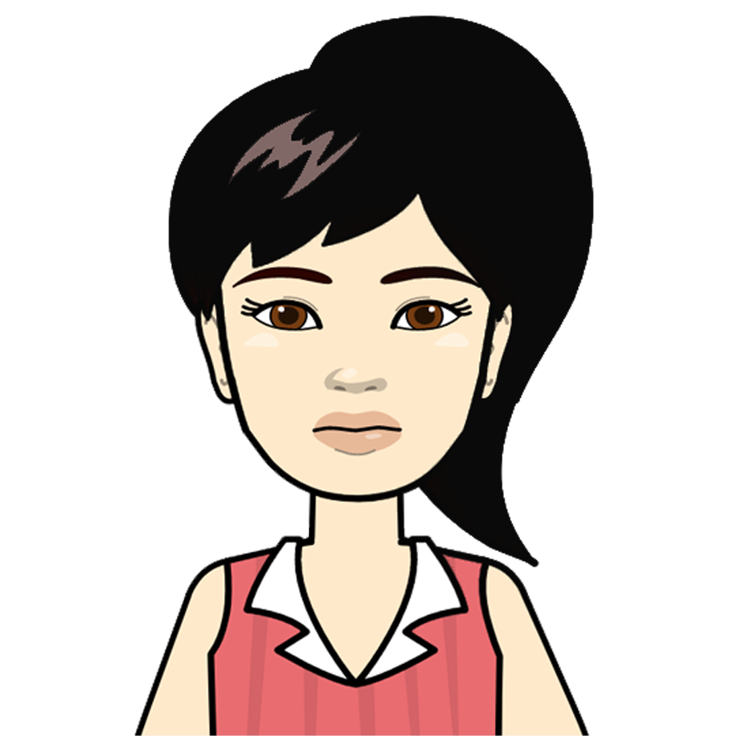
She has fair hair.

Slide 11

X
X
X
X
dark hair
red hair
fair hair
blonde hair
brown hair
She has fair hair.

Slide 12

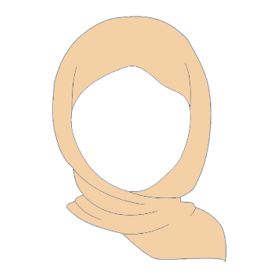

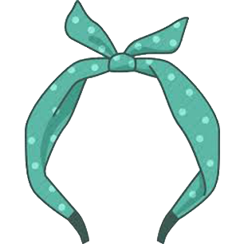
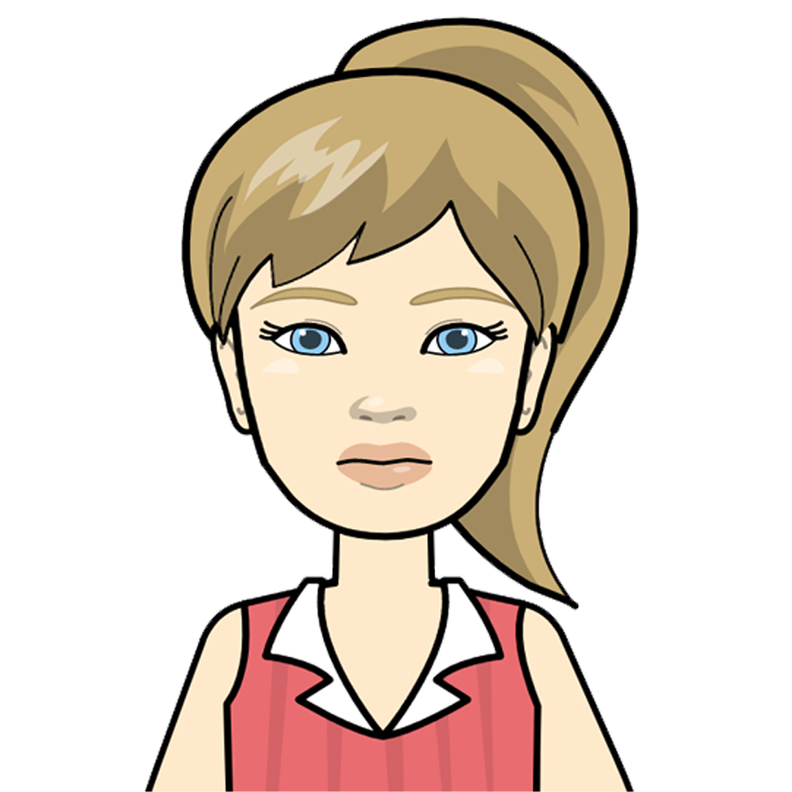
She has a hair band

Slide 13
X
X
X
headscarf
hat
scarf
hair band
She has a hair band

Slide 14
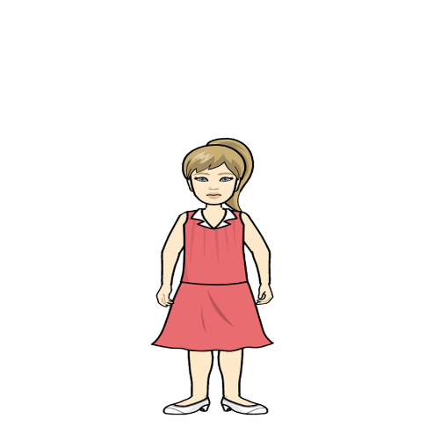


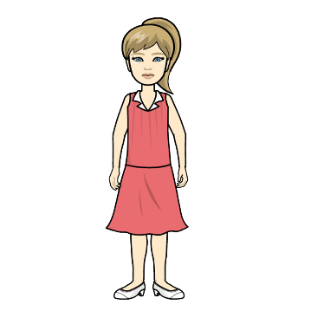
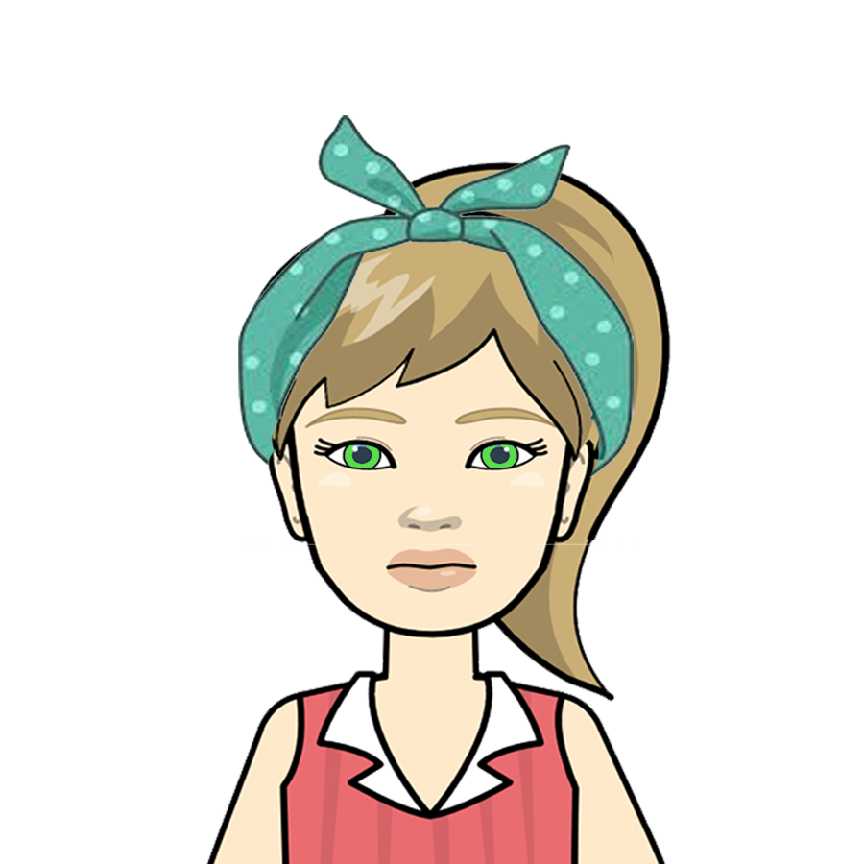
She is slim and tall.

Slide 15
X
X
X
tall-fat
tall-slim
short-fat
short-slim
She is slim and tall.

Slide 16
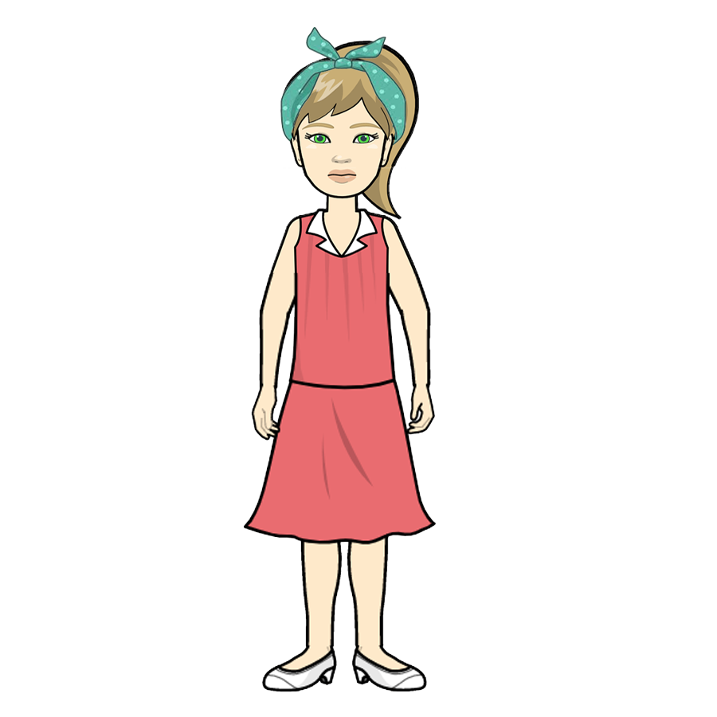
Yes! She is Daisy.
Thank you!

Slide 17
?
boy
girl
Can you help to find John’s photo now?
He is a my friend.
John

Slide 18
he
she
X
boy
girl
Can you help to find John’s photo now?
He is a my friend.
John

Slide 19
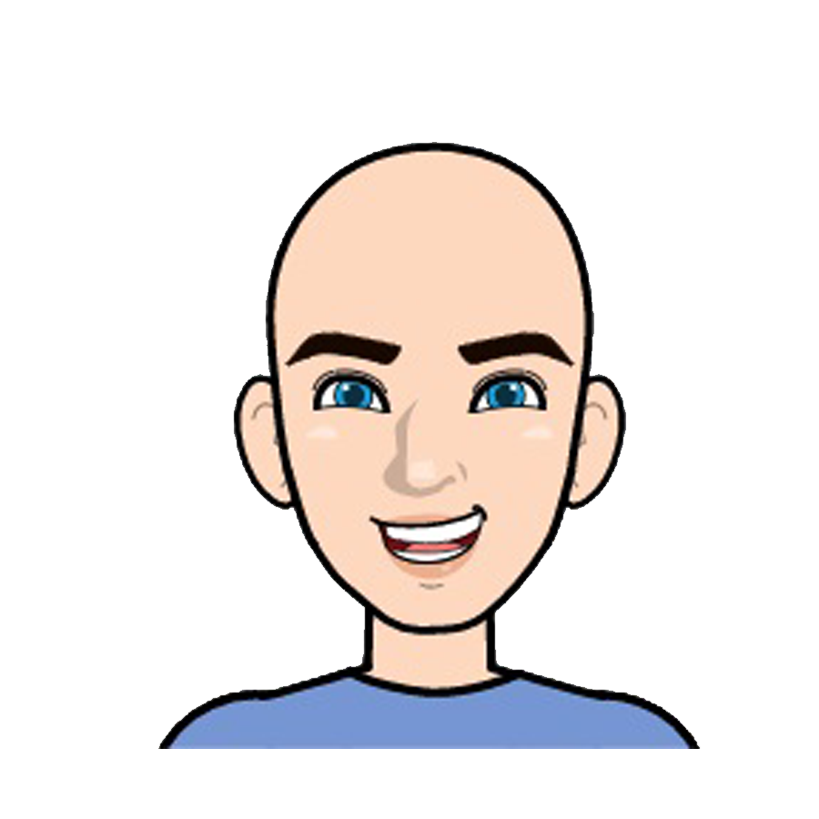

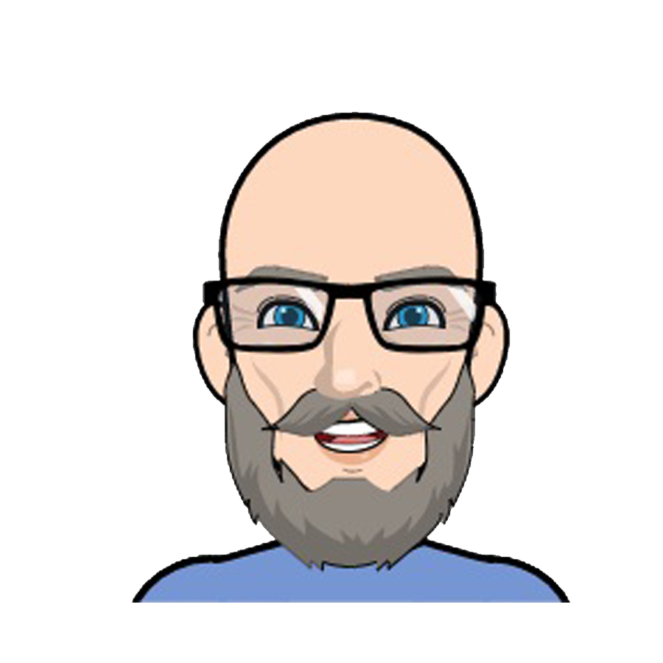
He is young.
?

Slide 20
He is young.
young
X
old

Slide 21
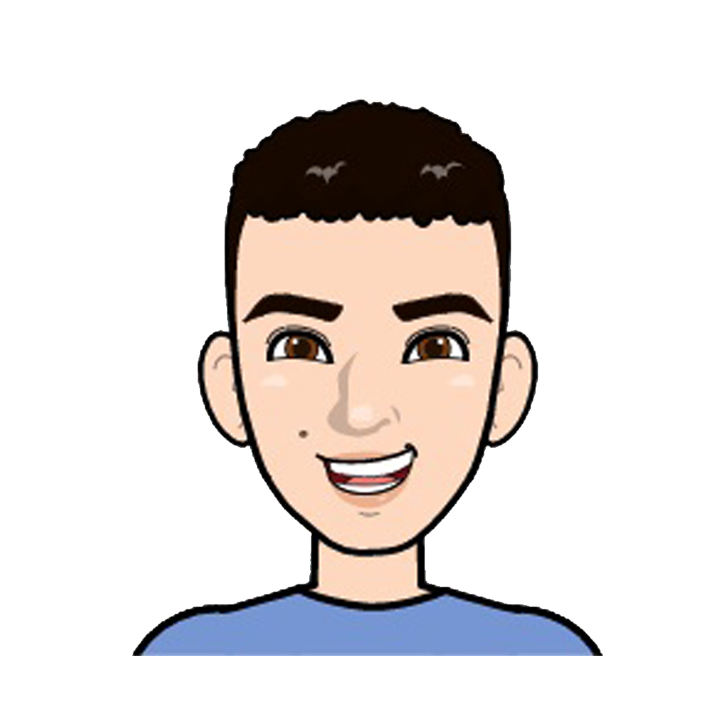
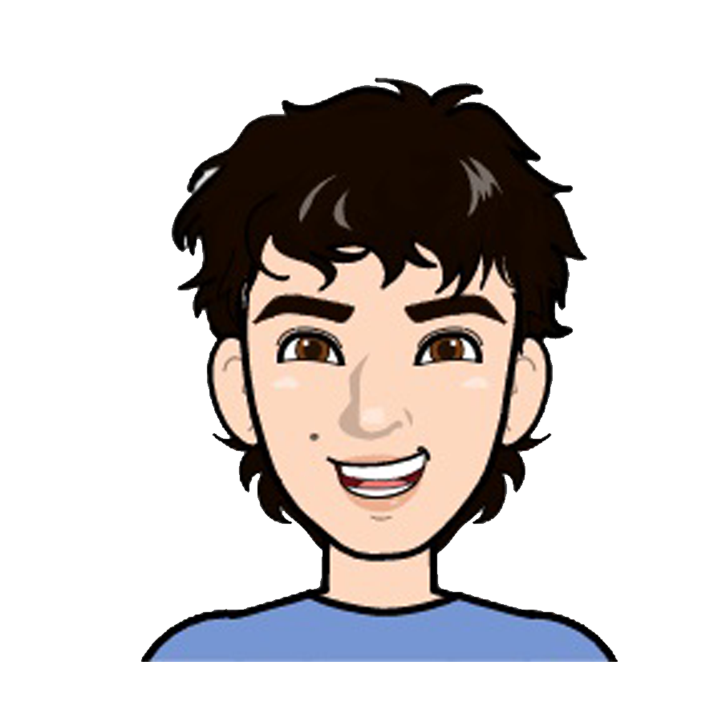
He has long hair
?

Slide 22

He has long hair
X
short hair
long hair

Slide 23
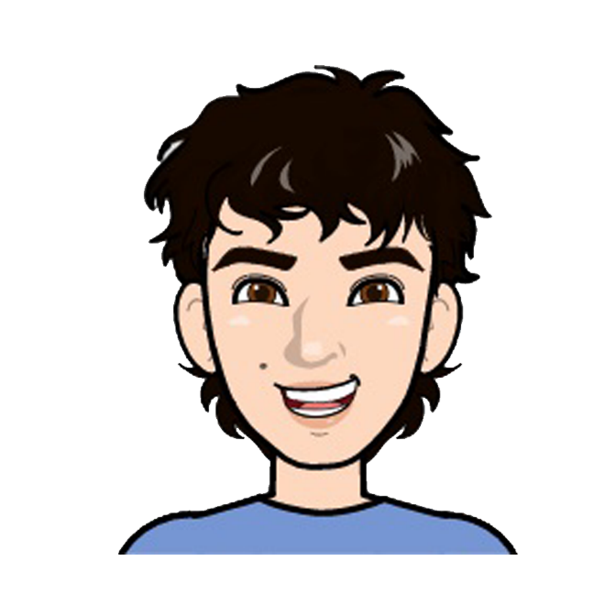
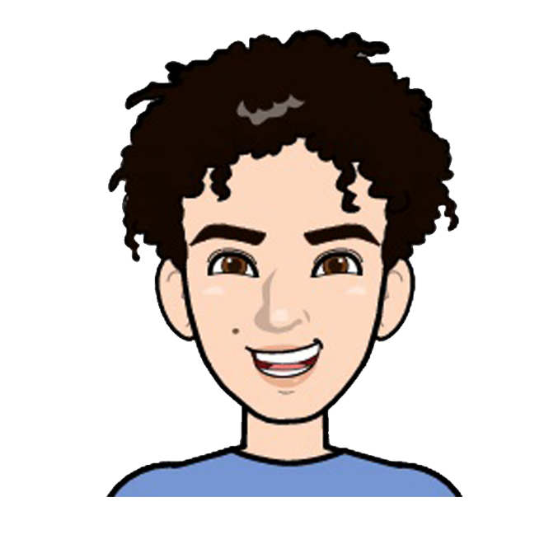
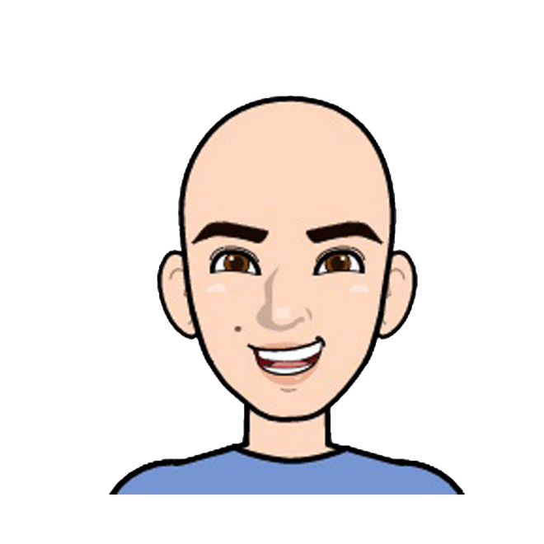
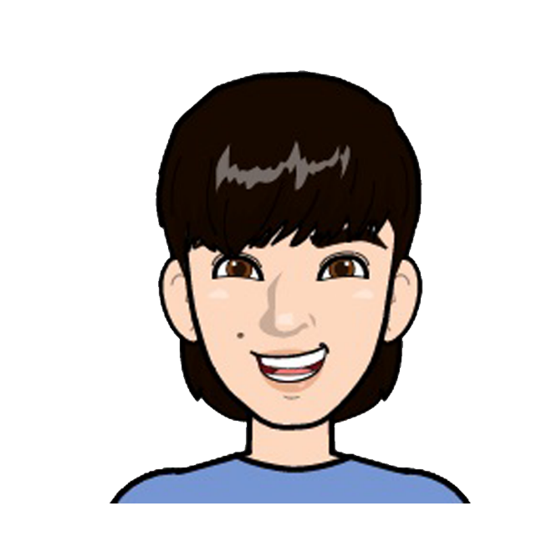
He has wavy hair
?

Slide 24
He has wavy hair
X
wavy hair
curly hair
X
X
bald
straight hair

Slide 25
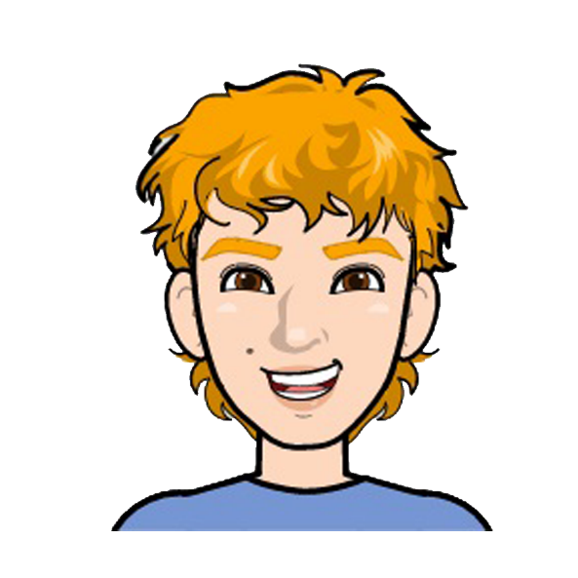
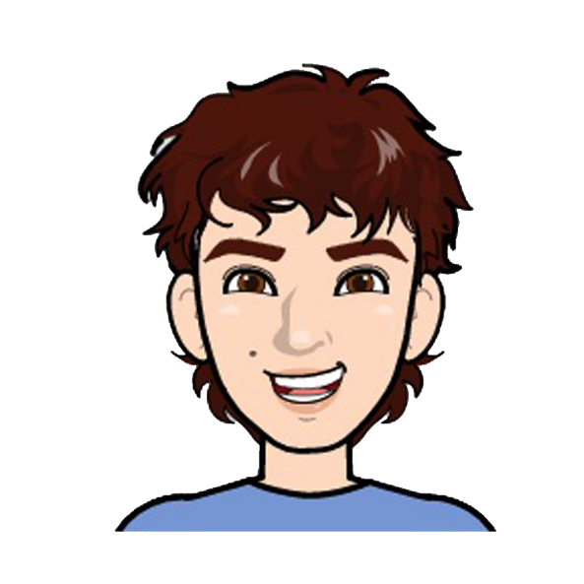
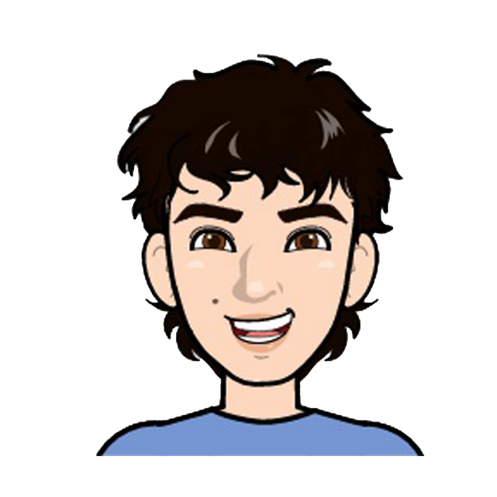
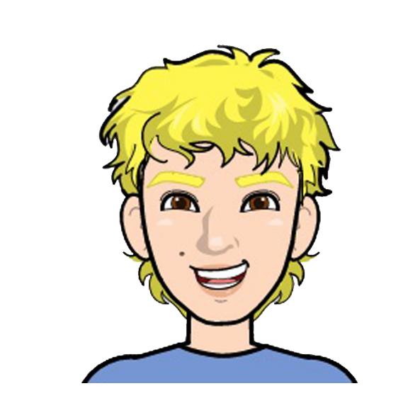
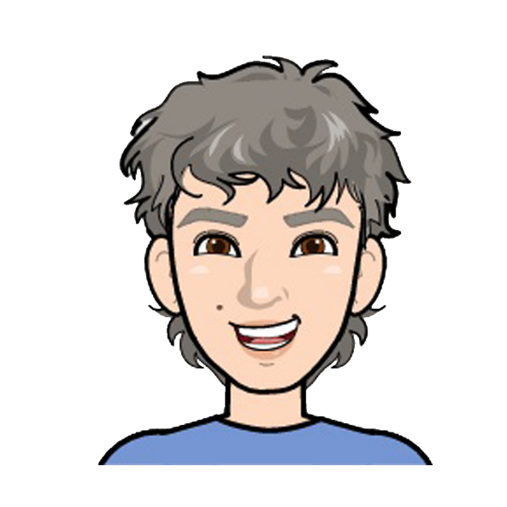
He has dark hair.
?

Slide 26

He has dark hair.
red hair
brown hair
X
X
dark hair
X
blonde hair
grey hair
X

Slide 27
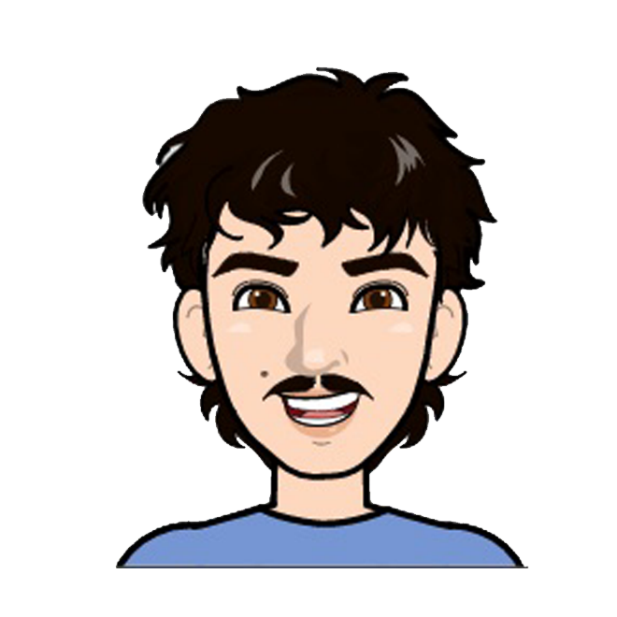
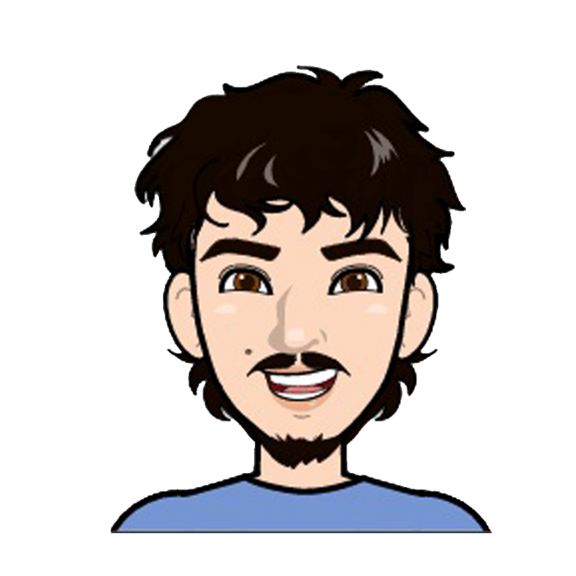

He has beard and moustache
?

Slide 28
He has beard and moustache
X
moustache
moustache
and beard
X
beard

Slide 29
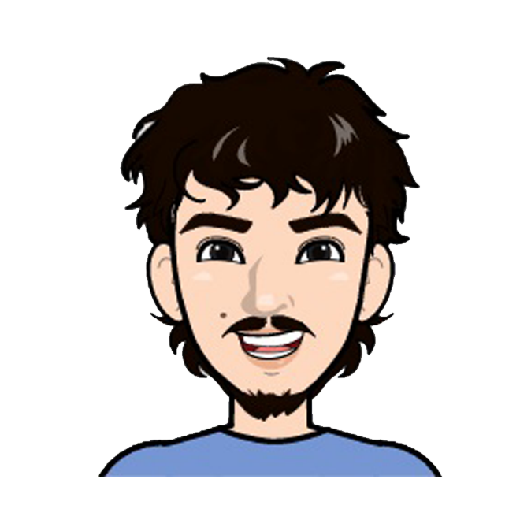
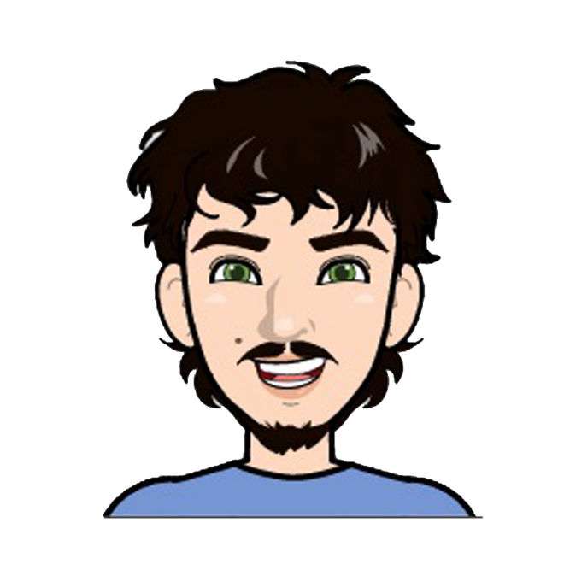
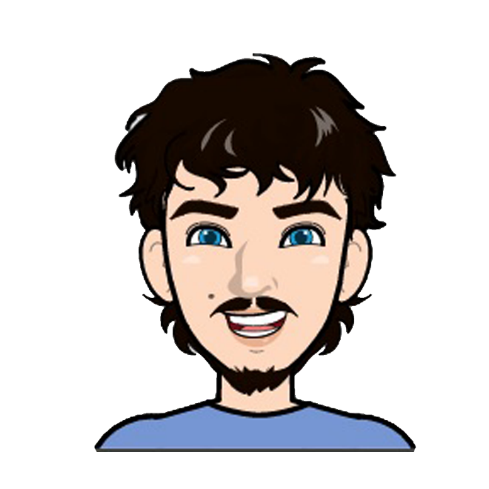
He has brown eyes
?

Slide 30
He has brown eyes
X
brown eyes
black eyes
green eyes
blue eyes
X
X

Slide 31
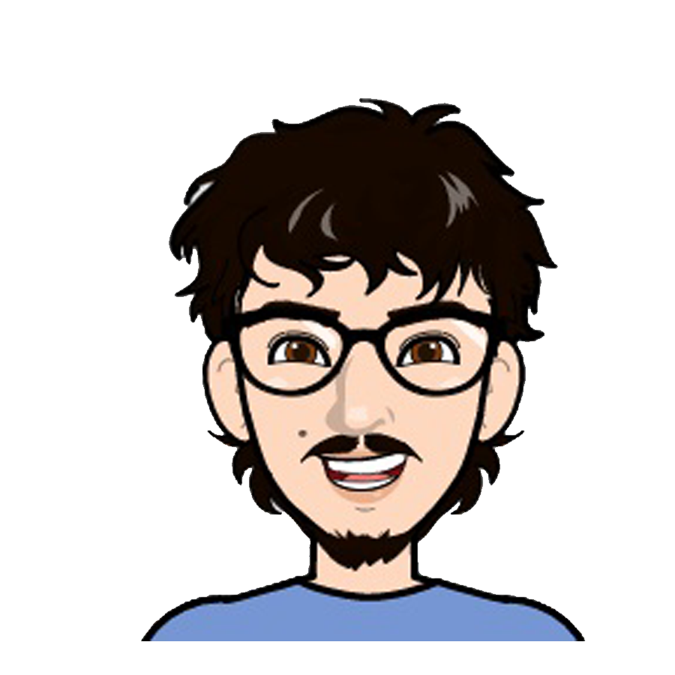
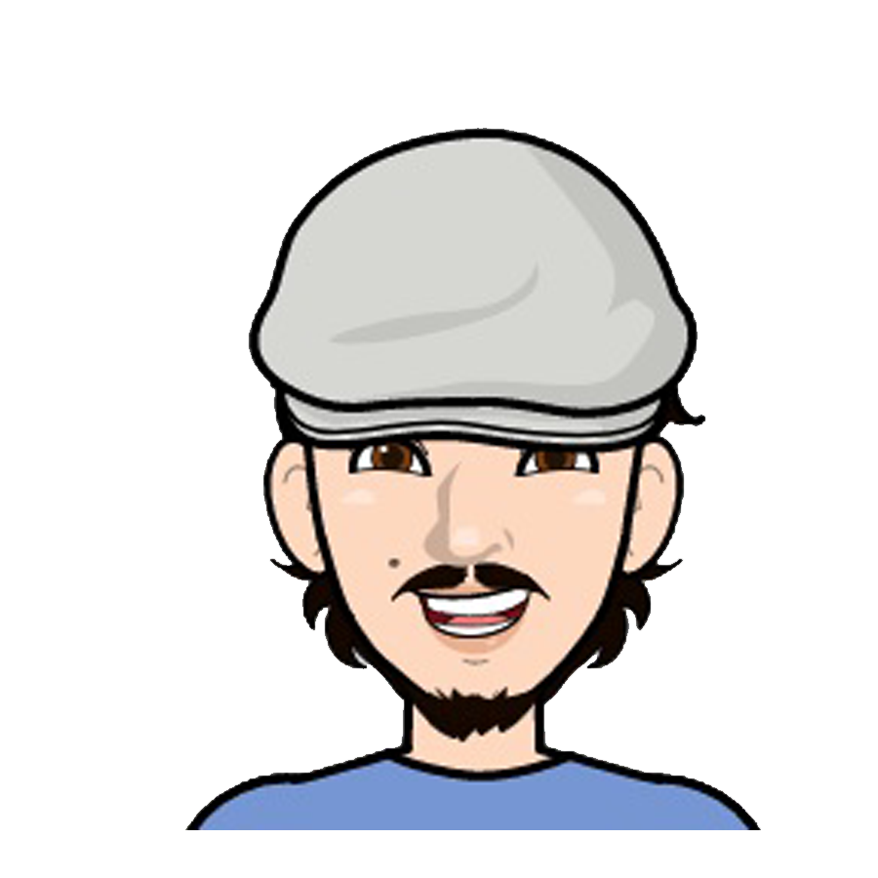
He has a hat.
?

Slide 32
He has a hat.
glasses
X
hat

Slide 33
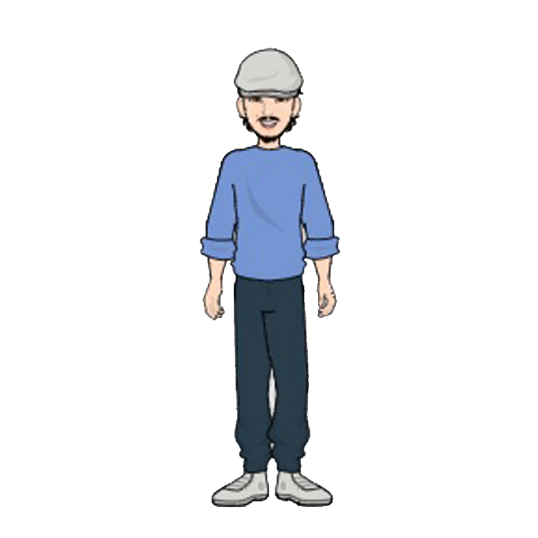
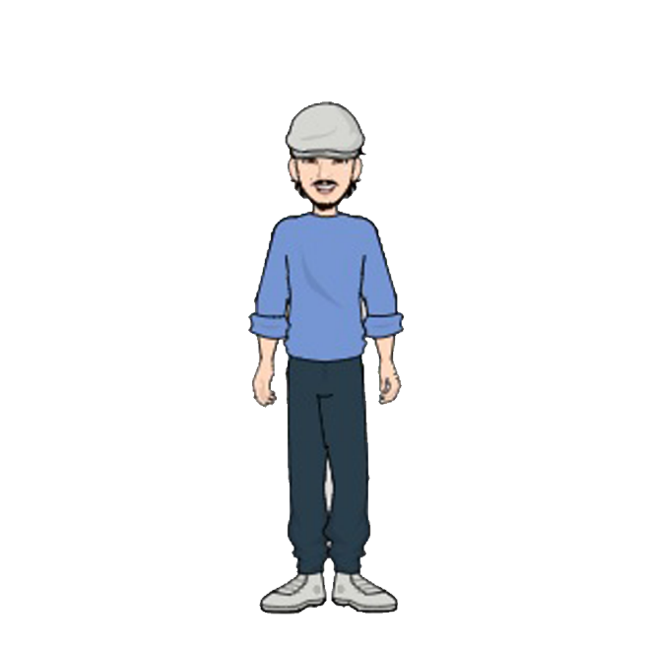
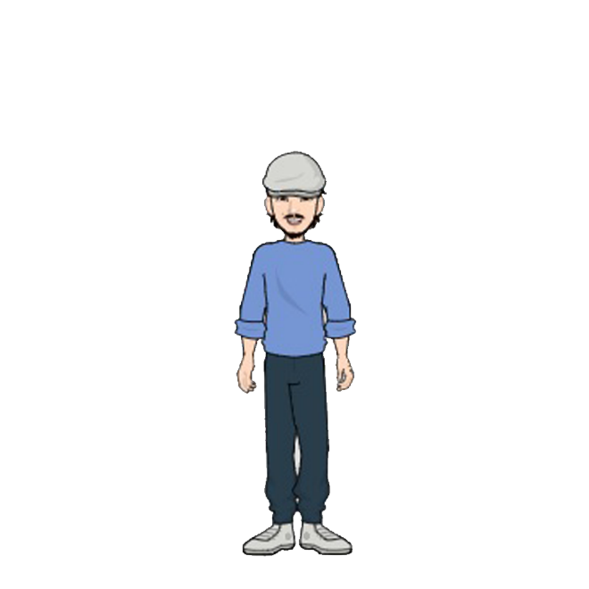
He is tall.
?

Slide 34
He is tall.
X
X
tall
middle
height
short

Slide 35
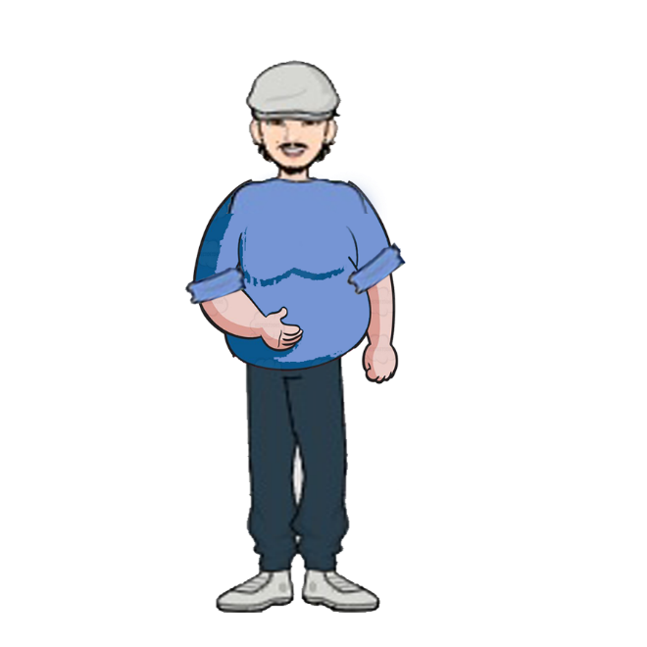
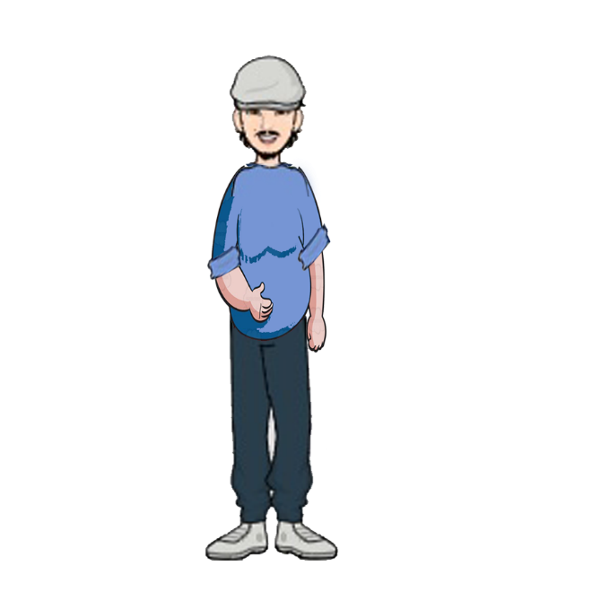
He is slim
?

Slide 36
He is slim
X
X
fat
middle
weight
slim

Slide 37
Well Done!
Yes, this is John.
Thank you.

