Slide 1


4.3- Cartoon Characters
Hello! I’m Eggman.
I’m a superhero.

Slide 2


I have strong eyes.

Slide 3

I have a magic suit.
I can be invisible.

Slide 4

I can change my shape.

Slide 5

I can fly.

Slide 6

I can drive a car.

Slide 7

I can save people
I can help people

Slide 8
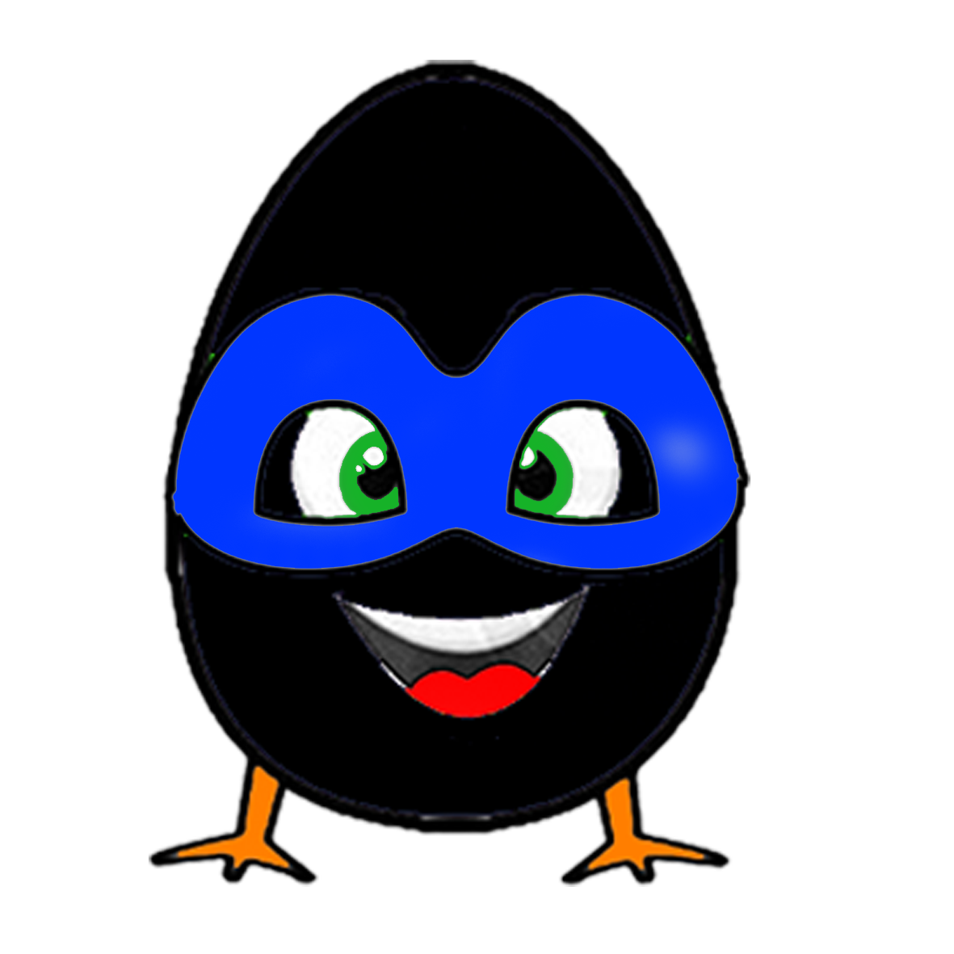
I can turn black.

Slide 9
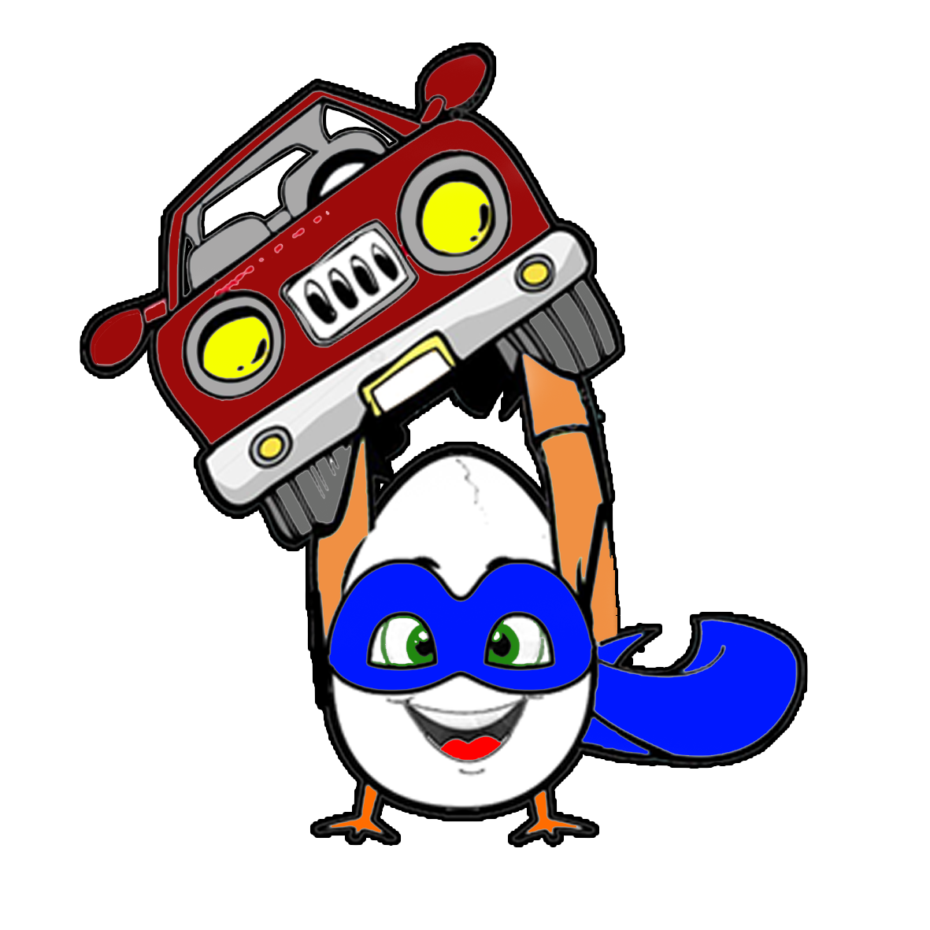
I can carry a car.

Slide 10
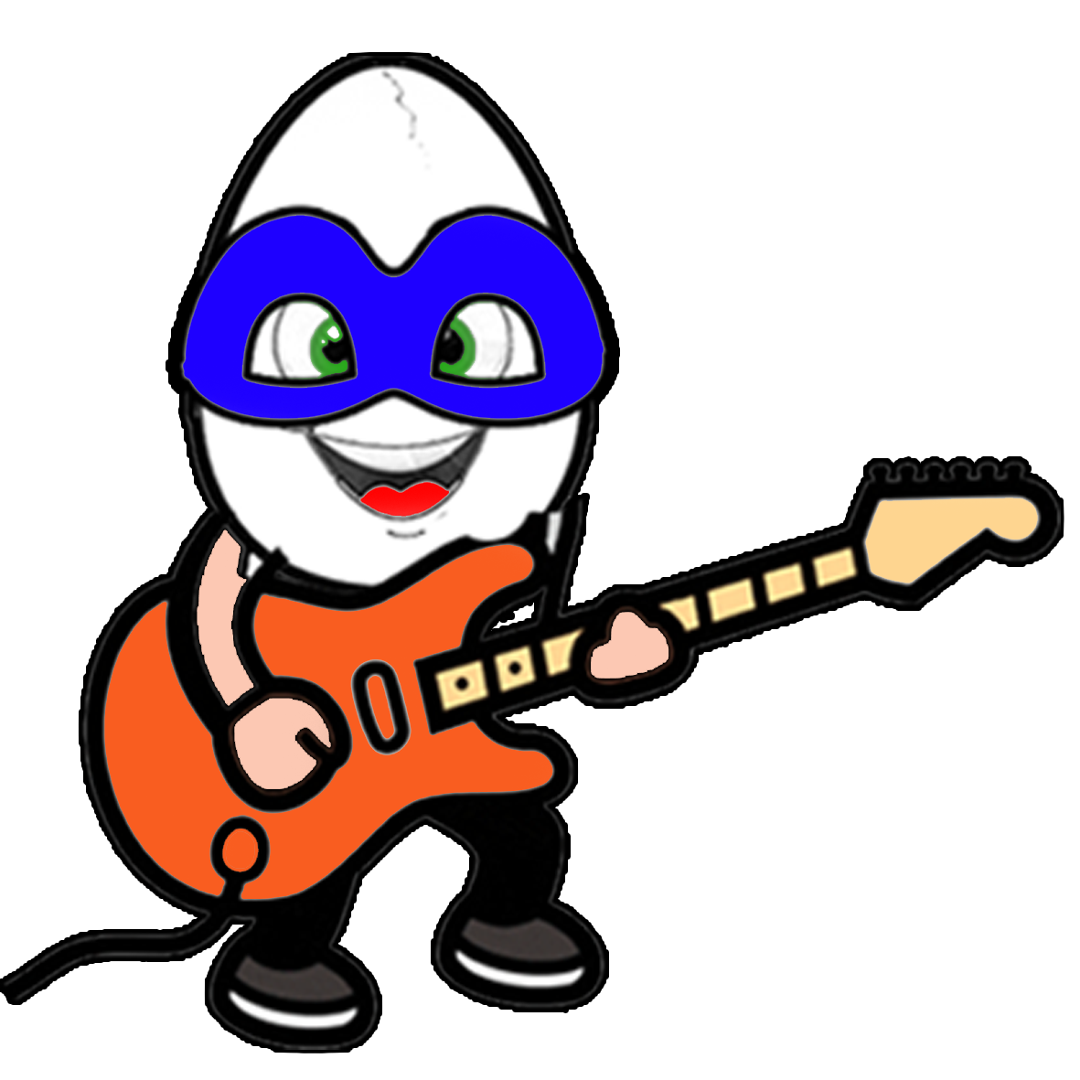
I can play the guitar.

Slide 11

I can catch the ball.

Slide 12

But I can’t climb trees

Slide 13

I can play the drum.

Slide 14
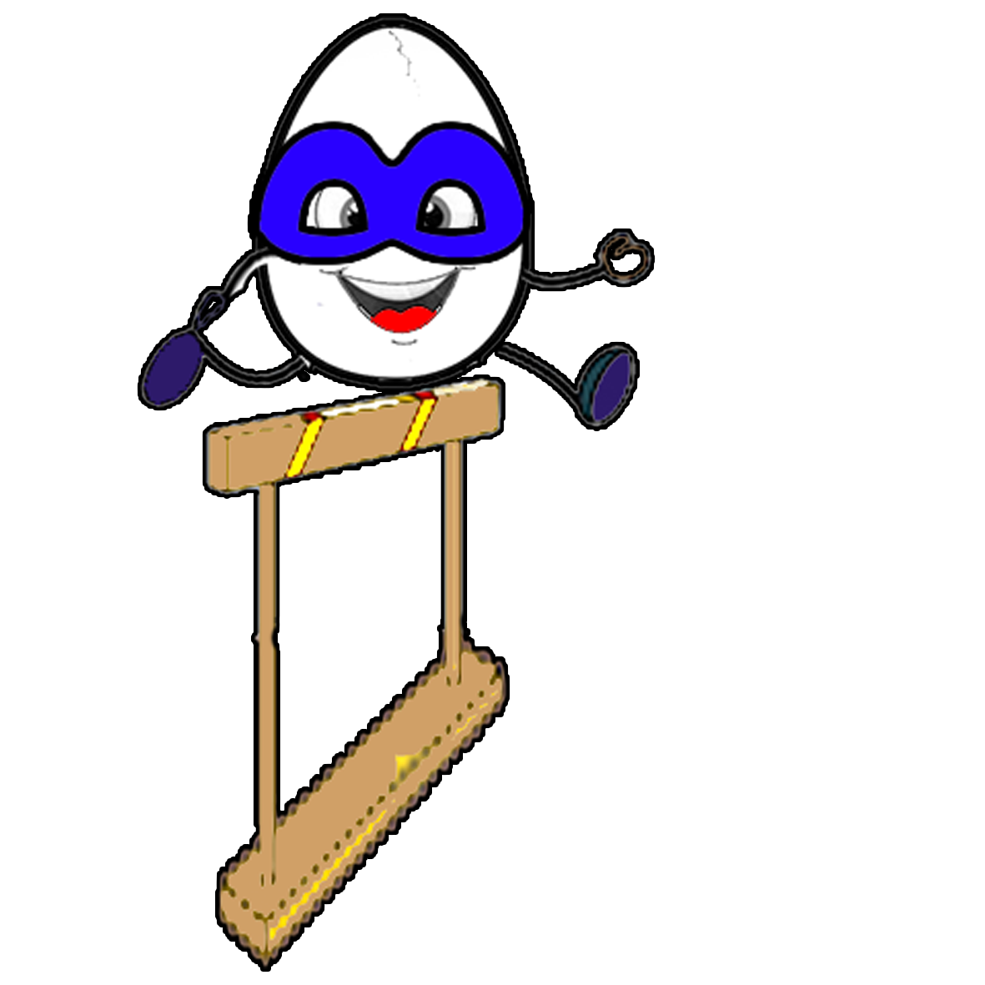
I can jump high.

Slide 15

I can ride a horse.

Slide 16
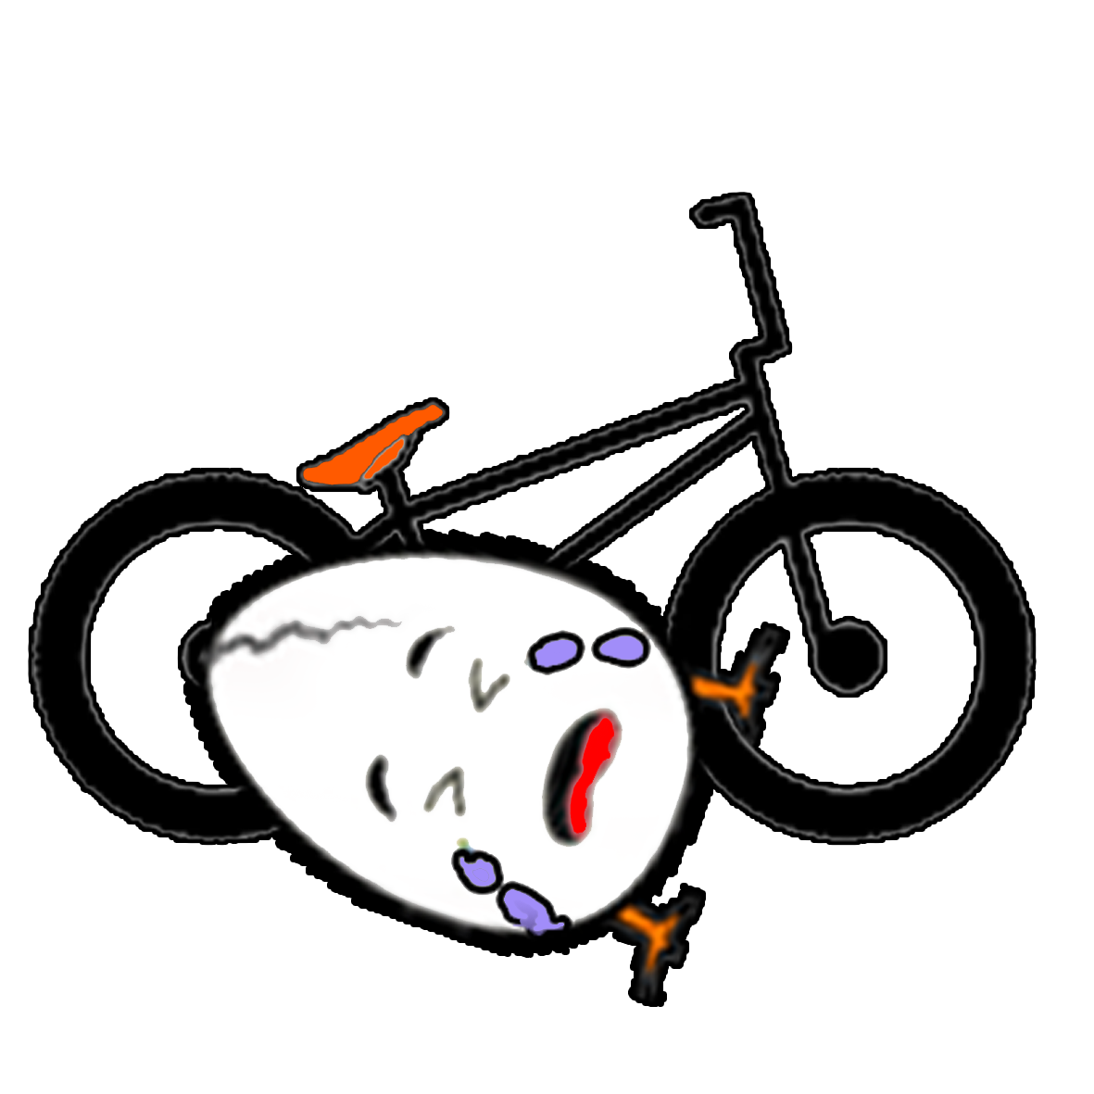
But I can’t ride a bike.

Slide 17
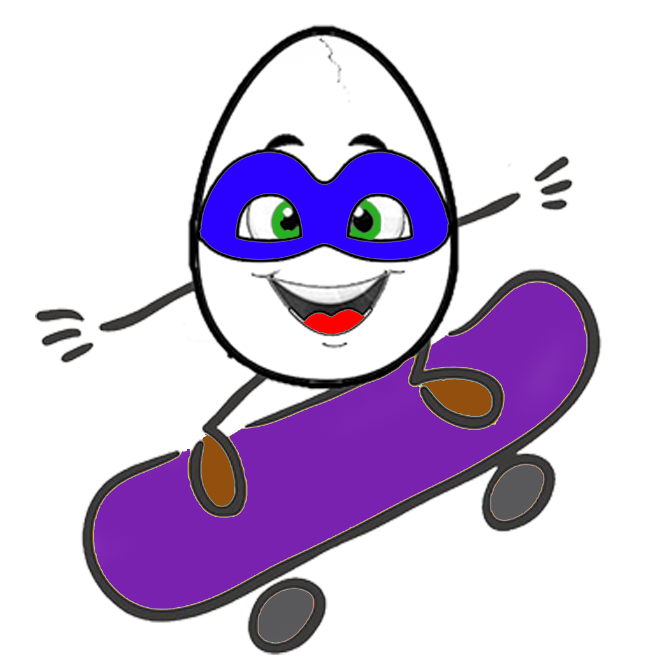
I can ride a skateboard.

Slide 18

I can sing songs.

Slide 19

I can run fast.

Slide 20

I can swim.

Slide 21

I can walk.

Slide 22
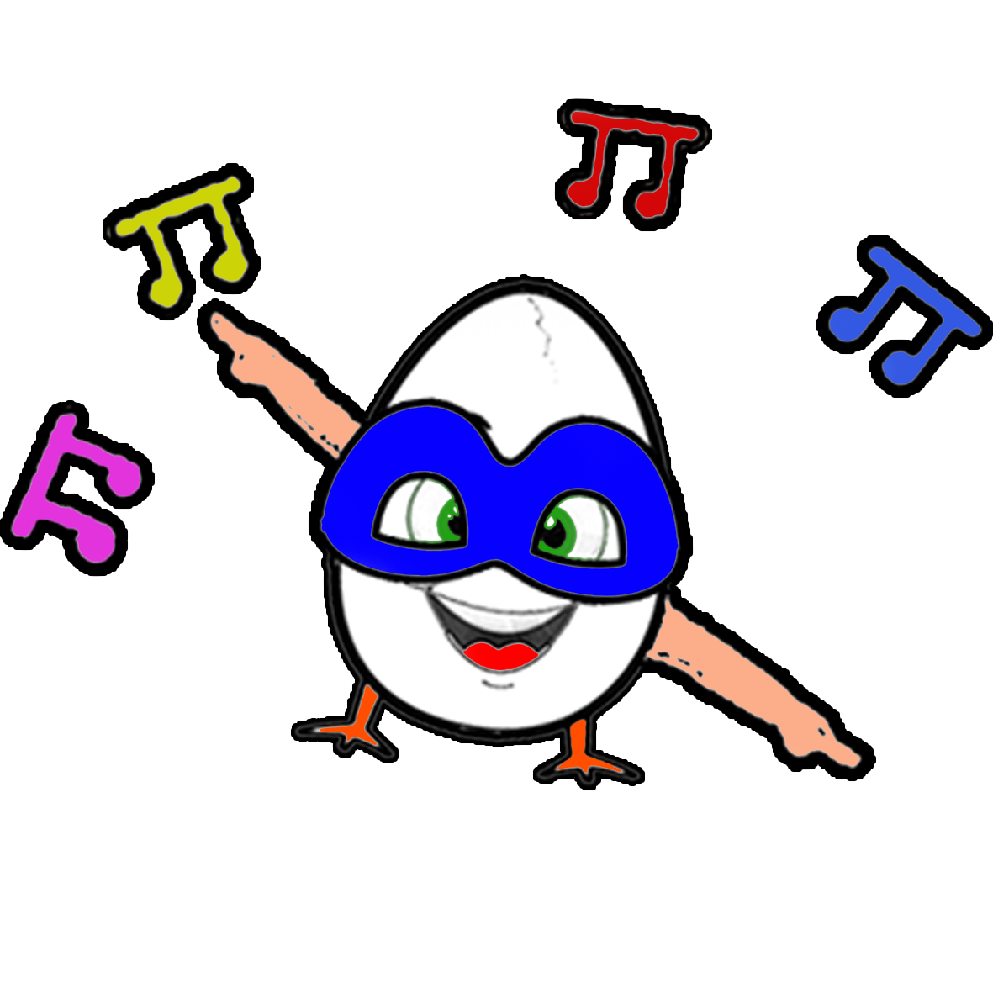
I can dance.

Slide 23
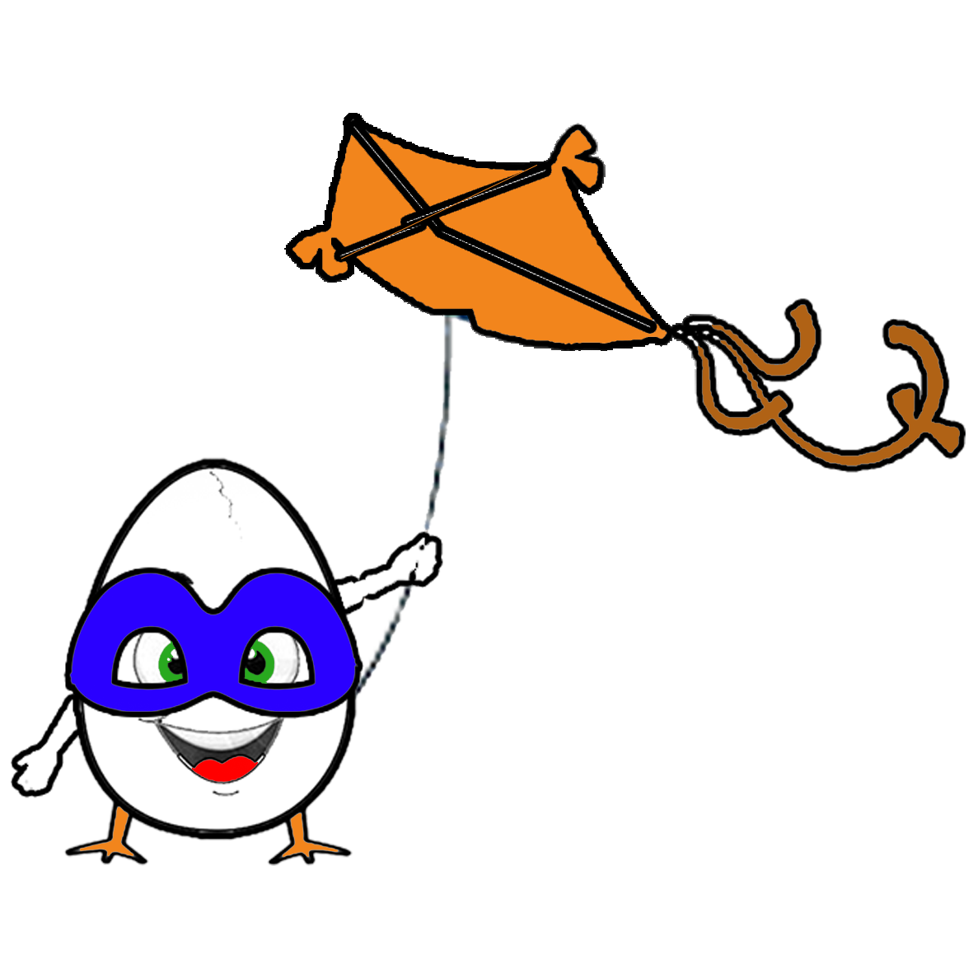
I can fly a kite.

Slide 24
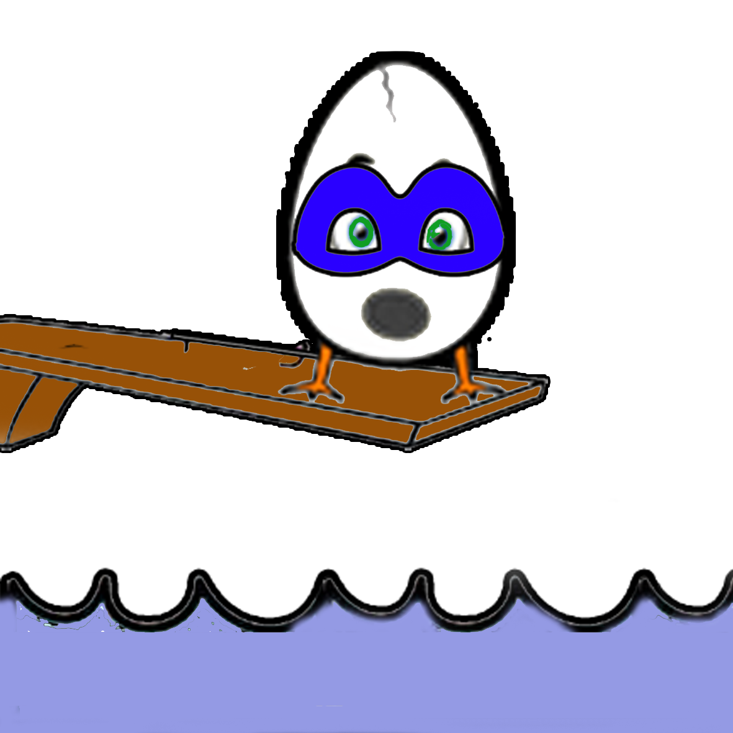
But I can’t dive.

Slide 25
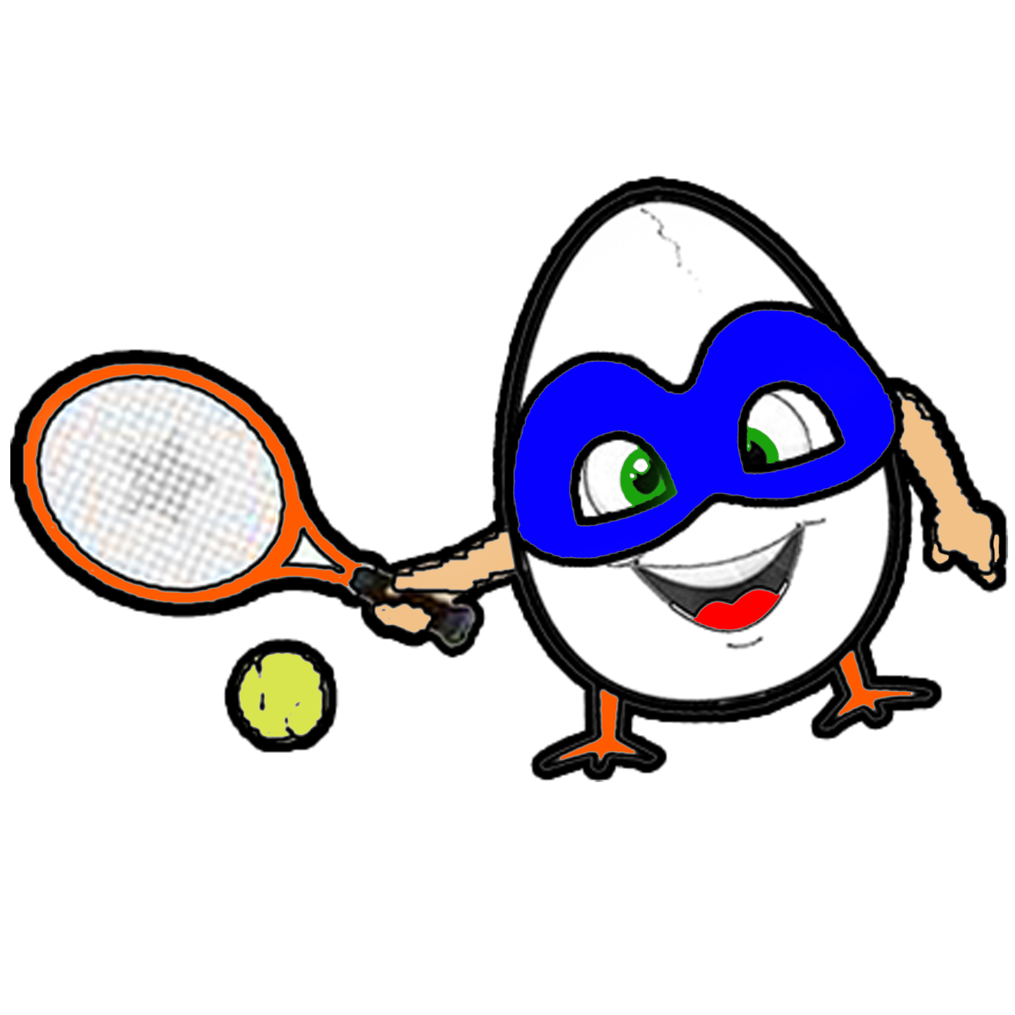
I can play tennis.

Slide 26

I can read a book.

Slide 27
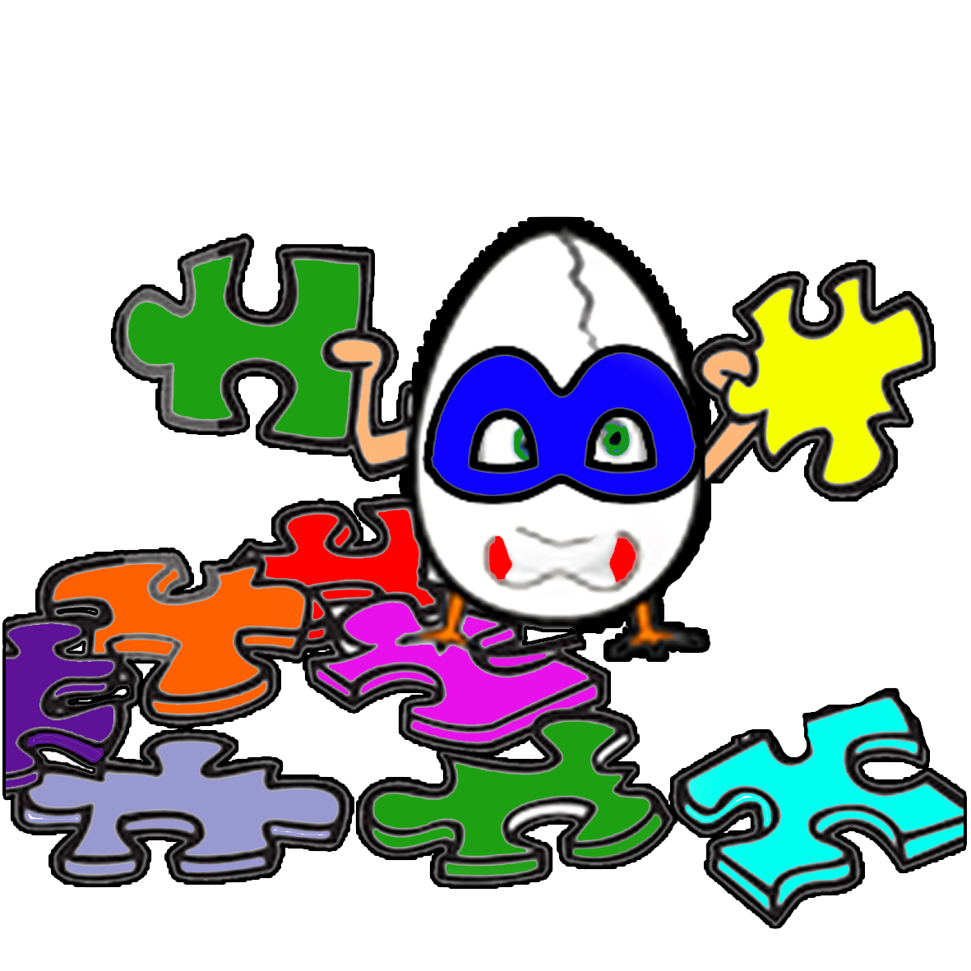
But I can’t do puzzle.

