Slide 1
DIRECTIONS
START
QUIZ

Slide 2
Go four dots to the east.
START

Slide 3
Go two dots to the south.
START

Slide 4
Go three dots to the west.
START

Slide 5
Go five dots to the south.
START

Slide 6
Go four dots to the east.
START

Slide 7
Go two dots to the north.
START

Slide 8
Go three dots to the east.
START

Slide 9
Go five dots to the north.
START

Slide 10
Go two dots to the east.
START

Slide 11
Go six dots to the south.
START

Slide 12
Go one dot to the west.
START

Slide 13
Go two dots to the south.
START

Slide 14
Go one dot to the east.
START

Slide 15
Go two dots to the south.
START
FINISH

Slide 16
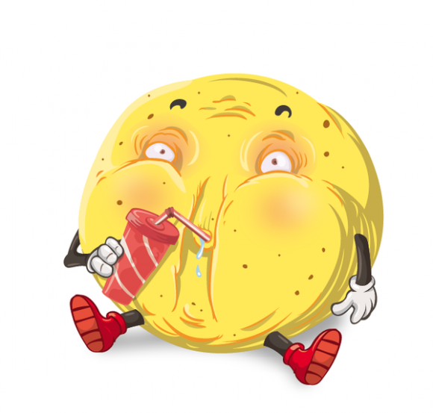
I’m full.
Congratulations

