Slide 1

CLASSROOM OBJECTS
4-1
START

Slide 2
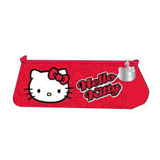

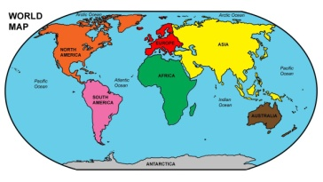

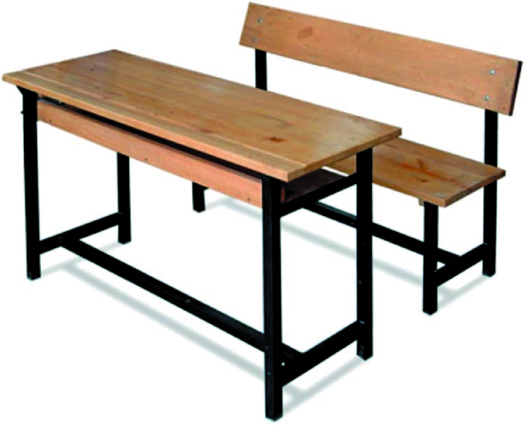
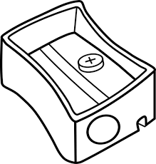
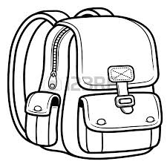

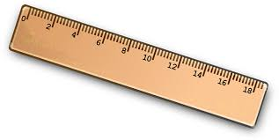
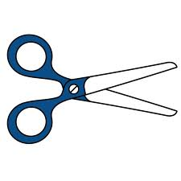


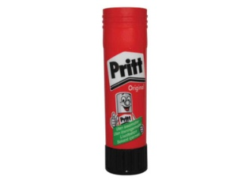

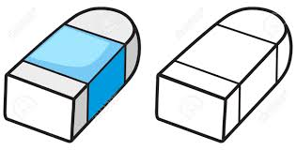
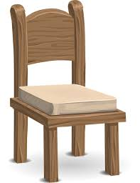
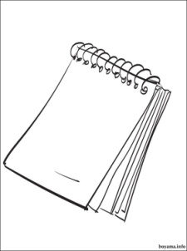
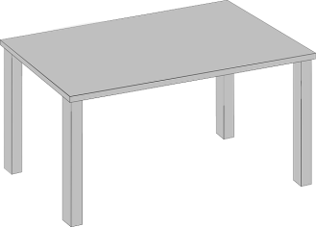

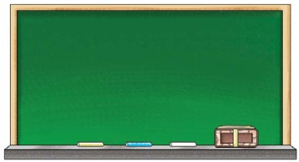
SCHOOL OBJECTS
1-Door

Slide 3
SCHOOL OBJECTS
2-Window

Slide 4
SCHOOL OBJECTS
3-Board

Slide 5
SCHOOL OBJECTS
4-Map

Slide 6
SCHOOL OBJECTS
5-Book

Slide 7
SCHOOL OBJECTS
6-Desk

Slide 8
SCHOOL OBJECTS
7-Dictionary

Slide 9
SCHOOL OBJECTS
8-Pencilcase

Slide 10
SCHOOL OBJECTS
9-Pencil sharpener

Slide 11
SCHOOL OBJECTS
10-Eraser

Slide 12
SCHOOL OBJECTS
11-Ruler

Slide 13
SCHOOL OBJECTS
12-Table

Slide 14
SCHOOL OBJECTS
13-Pen

Slide 15
SCHOOL OBJECTS
14-Scissors

Slide 16
SCHOOL OBJECTS
15-Bag

Slide 17
SCHOOL OBJECTS
16-Chair

Slide 18
SCHOOL OBJECTS
17-Crayon

Slide 19
SCHOOL OBJECTS
18-Notebook

Slide 20
SCHOOL OBJECTS
19-Glue

Slide 21
SCHOOL OBJECTS
20-Pencil

Slide 22
CONGRATULATIONS

