Slide 1


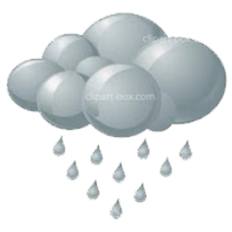

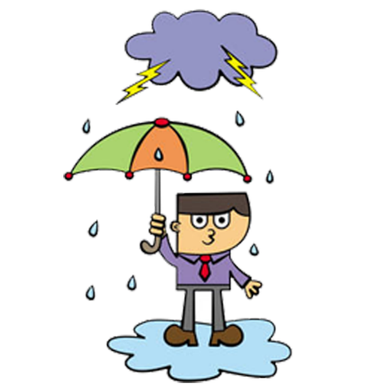
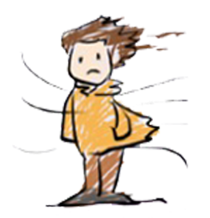







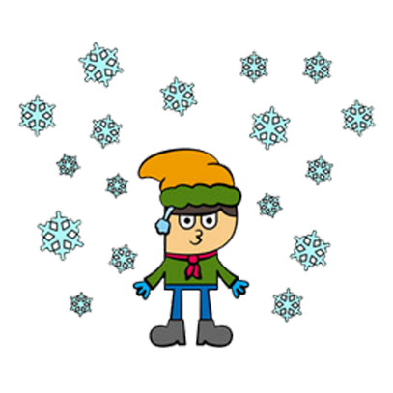



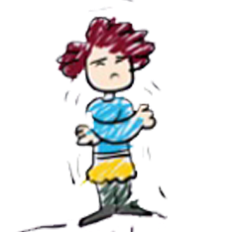


WEATHER
START
3.9

Slide 2


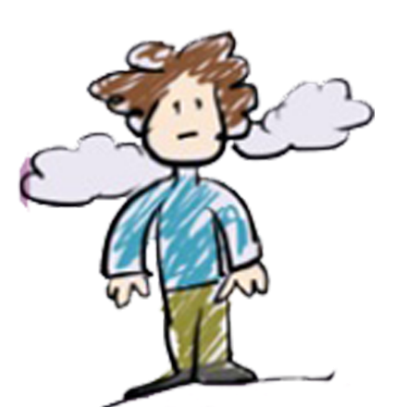


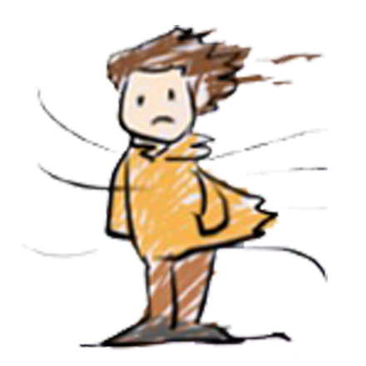

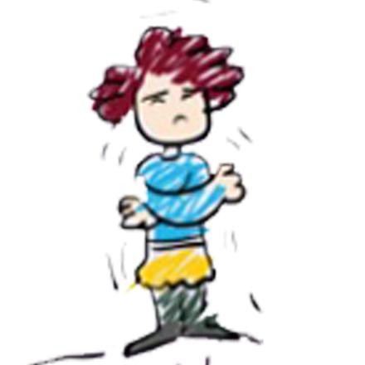


2-hot
1-cold
7
8
5
6
3
4-warm
5-sunny
3-rainy
7-cloudy
1
2
4
6-windy
8-snowy

Slide 3
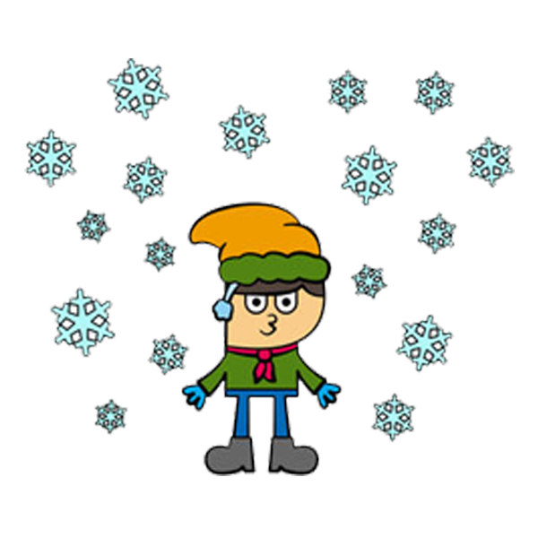


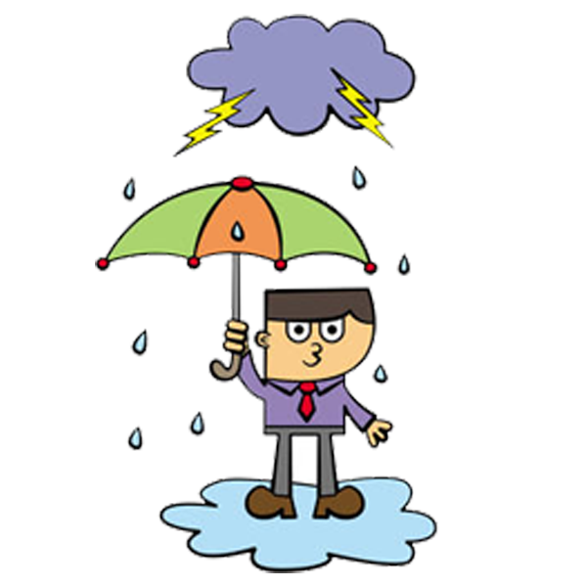

HOW IS THE WEATHER?
rainy
snowy
2-It is ……………………
snowy
windy
1-The weather is ……………………
sunny
cloudy
3-It is ……………………
4-It is ……………………
sunny
cloudy
windy
rainy
5-It is ……………………

Slide 4

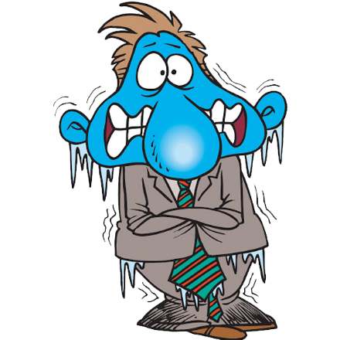







HOW IS THE WEATHER?
cool
warm
It is
It is
It is
It is
It is
freezing
cold
cool
warm
hot
hot
cold
freezing

Slide 5


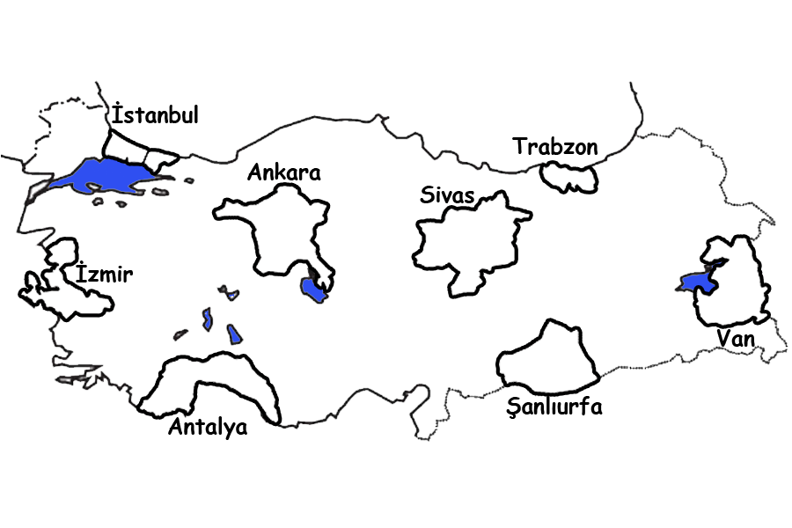

























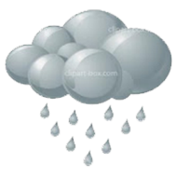




How is the weather in ……………?
1- It is sunny and hot in Antalya. 2- It is warm and rainy in Trabzon.
3- It is windy and warm in İstanbul. 4- It is snowy and freezing in Sivas.
5- It is snowy and cold in Ankara. 6- It is windy and hot in İzmir.
7- It is rainy and cool in Van. 8- It is cloudy and hot in Şanlıurfa.

Slide 6








Is the weather ………………?
No, it isn’t
Yes, it is
1-Is the weather sunny?
2-Is it snowy?
Yes, it is
………………
No. It is windy
………………
No, it isn’t
3-Is it windy in Muğla?
4-Is it snowy in Kars?
No, it isn’t
…………………
…………………
Yes, it is
…………………
No. It is rainy

Slide 7






Let’s ………………..
study at home
swim in the sea
1-It’s windy.
Let’s…………………….
2-It’s snowy.
Let’s…………………….
go home by bike
play snowball
3-It’s rainy.
Let’s…………………….
walk in the rain
play snowball
walk in the rain
5-It’s sunny and hot. Let’s…………………….
4-It’s cold.
Let’s…………………….
swim in the sea
study at home
go home by bike

Slide 8


