Slide 1
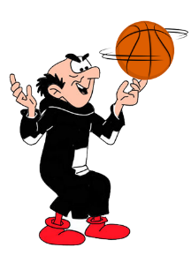
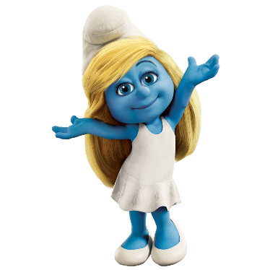
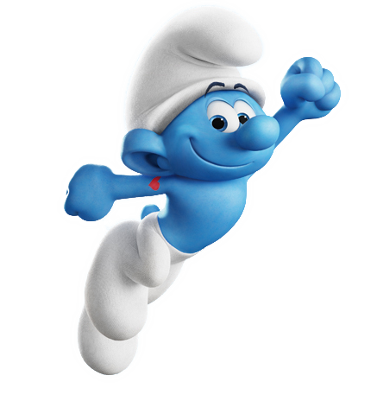

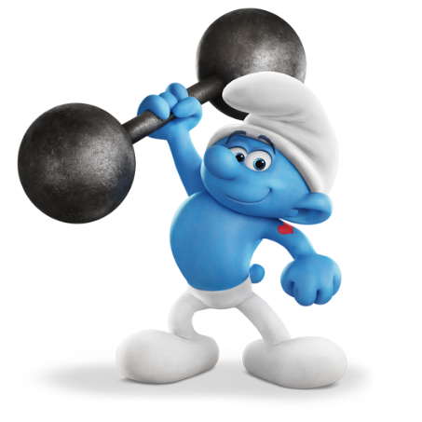
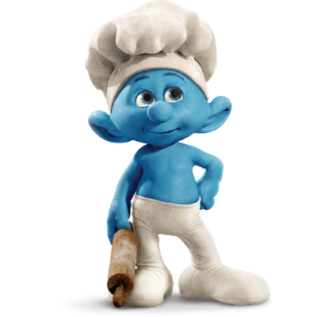
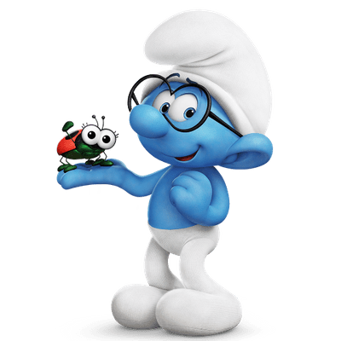
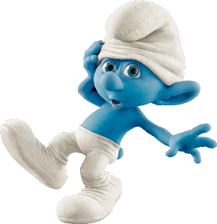
3.3 – People I Love
START
SMURFS
can / can’t

Slide 2
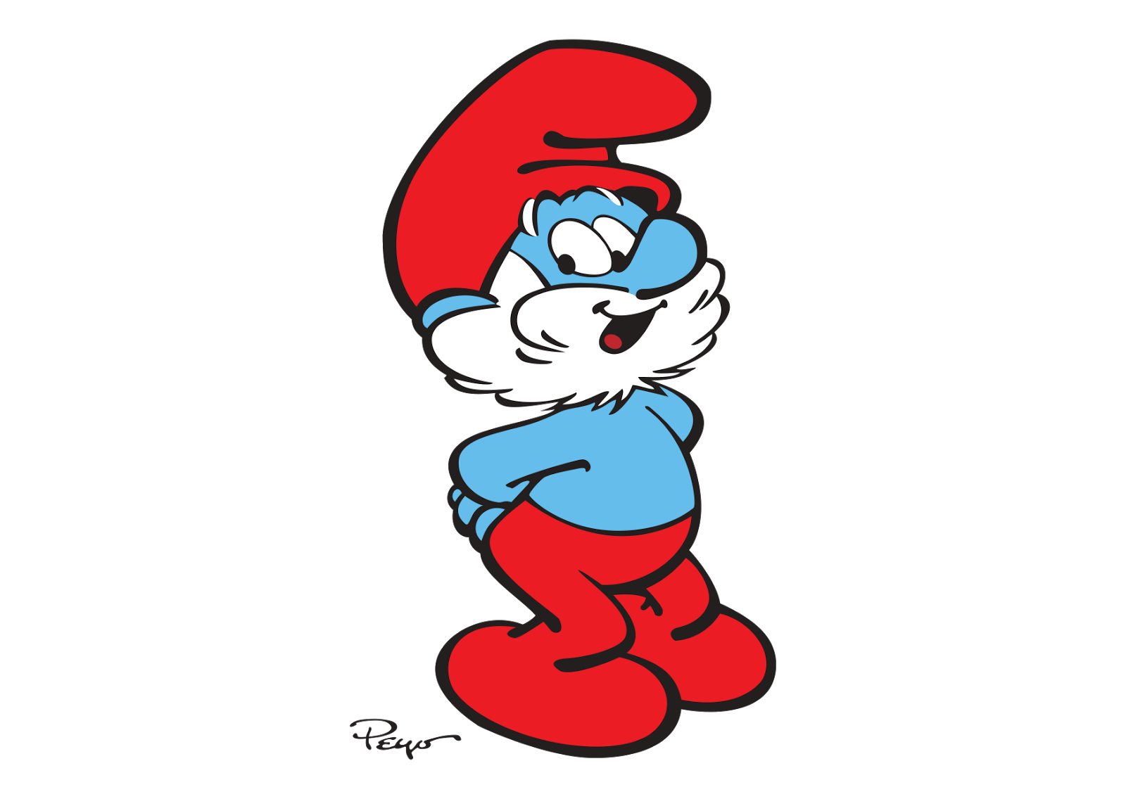
Papa Smurf is ………………
tall
young
fast
old

Slide 3
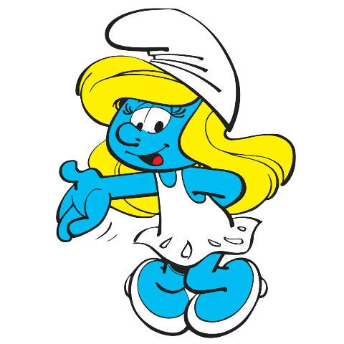
Smurfette is …………… and ………………
ugly and
tall
heavy and
beautiful
old and
fast
thin and
beautiful

Slide 4
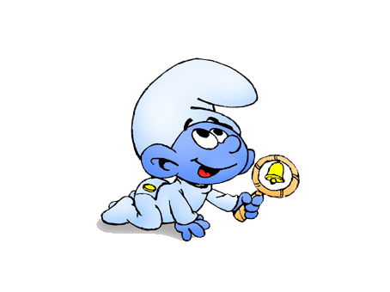
Baby Smurf is ……………………………
fast
big
young
heavy

Slide 5
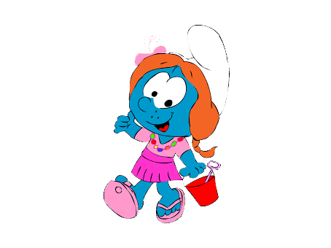
Sassette Smurfling is ……………… and ……………………
short and
young
tall and
old
small and
strong
old and
thin

Slide 6
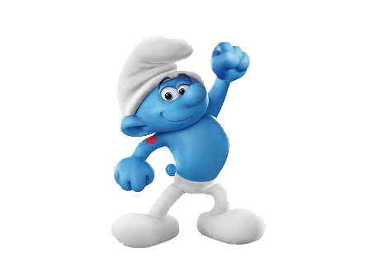
Hefty Smurf is …………………………
weak
strong
beautiful
fat

Slide 7
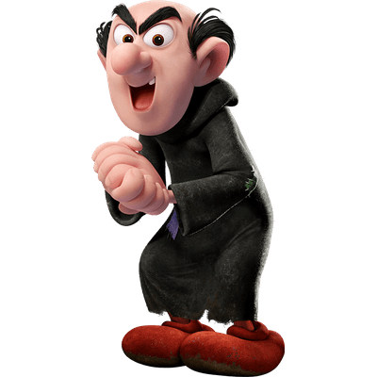
Gargamel is …………………………
heavy
tall
beautiful
short

Slide 8
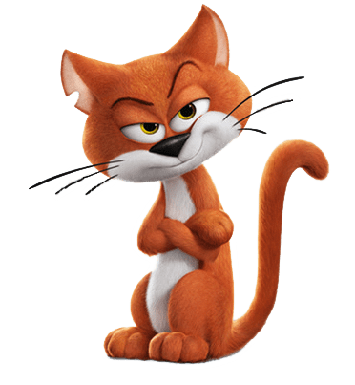
Azrael(Azman) is …………………………
slow
weak
fast
old

Slide 9
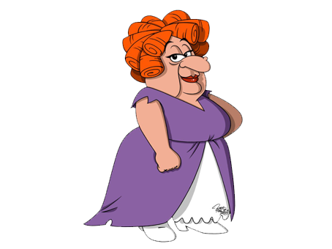
Hogatha is …………………………
young
beautiful
thin
ugly

Slide 10
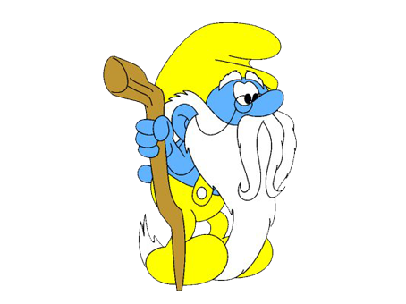
Grandpa Smurf is …………… and ………………
slow and
weak
fast and
young
heavy and
strong
fat and
big

Slide 11
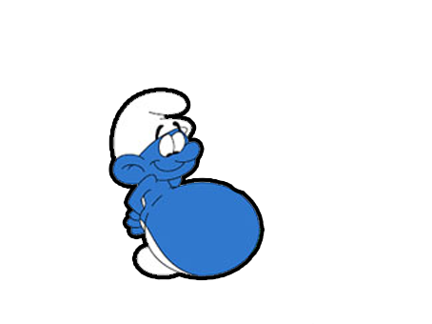
Greedy Smurf is …………………………
old
fast
tall
heavy

Slide 12
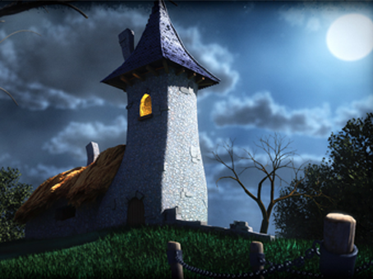
big
small
slow
thin
Gargamel’s house is …………………………

Slide 13
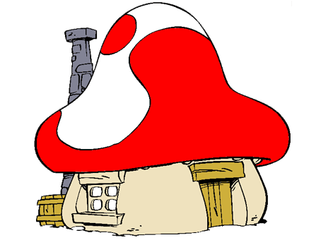
Papa Smurf’s house is …………………………
big
small
slow
thin

Slide 14
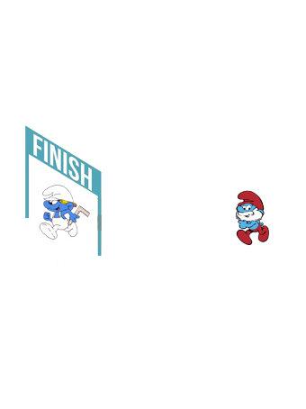
Papa Smurf ………………… run fast.
can
can’t

Slide 15
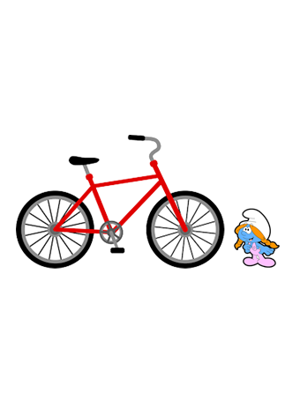
can
can’t
Sassette Smurfling ………………… ride a bike.

Slide 16
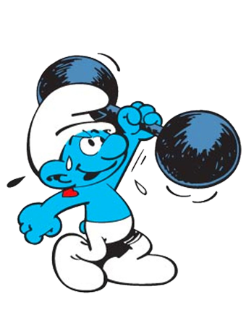
Hefty Smurf ………………… lift heavy things.
can
can’t

Slide 17
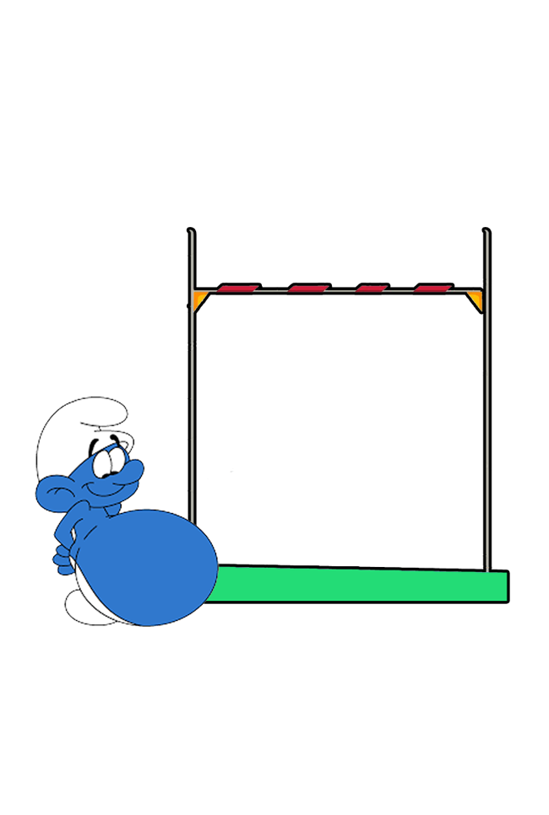
Greedy Smurf ………………… jump high.
can
can’t

Slide 18

Scaredy Smurf …………… climb trees.
can
can’t

Slide 19
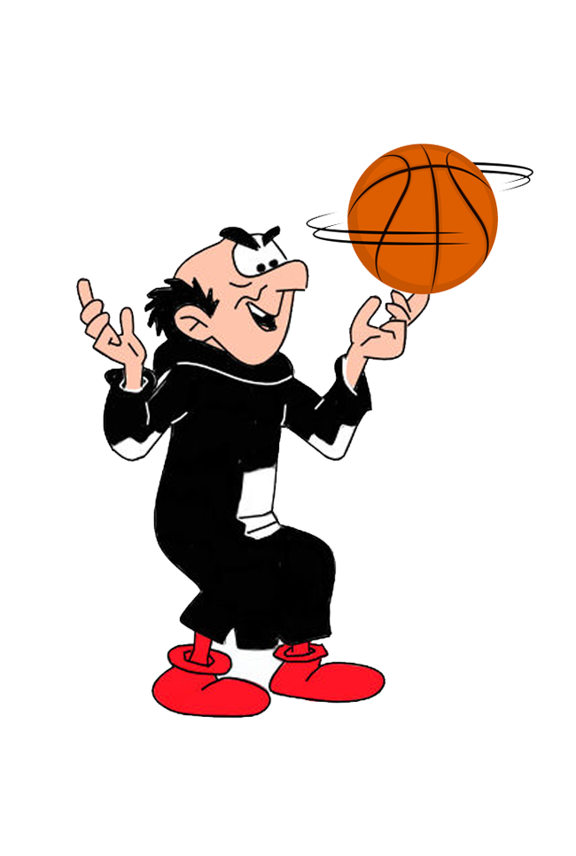
can
can’t
Gargamel ……………… play basketball.

Slide 20
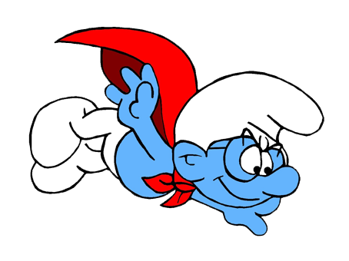
can
can’t
Brainy Smurf ………………… fly.

Slide 21
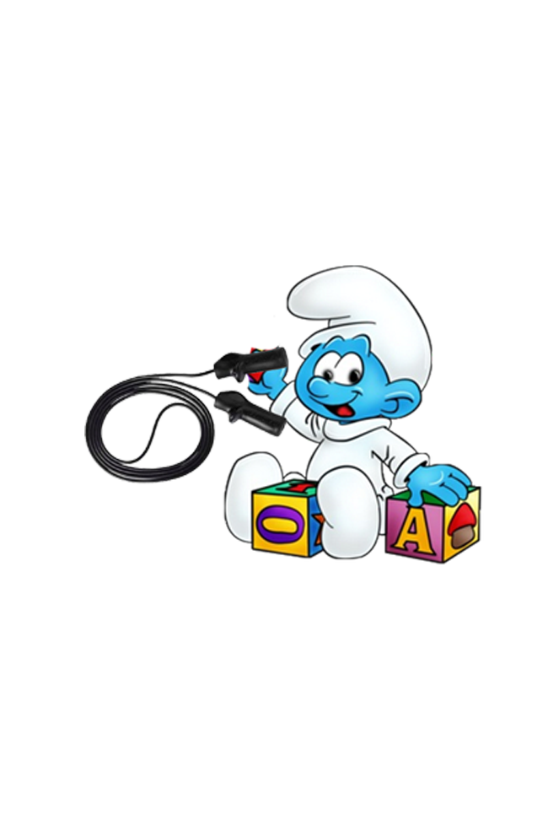
Baby Smurf …………… jump rope.
can
can’t

Slide 22
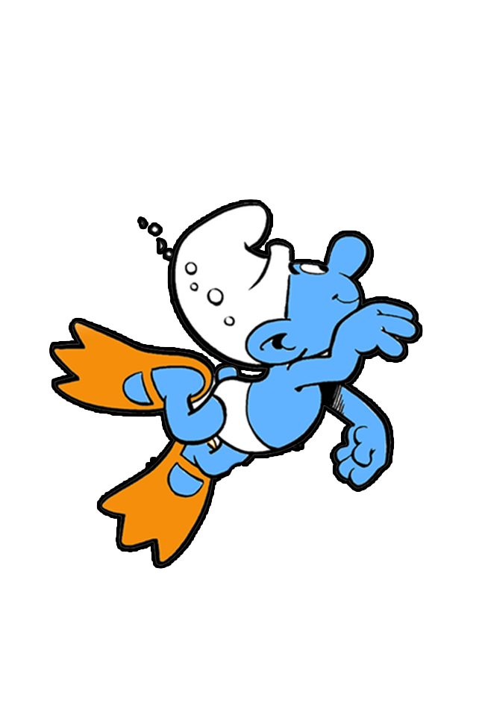
can
can’t
Handle Smurf ………………… swim.

Slide 23
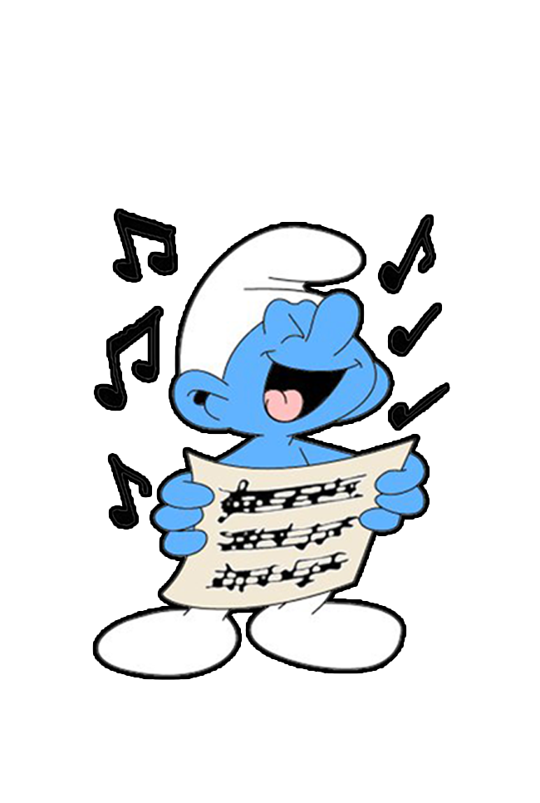
Poet Smurf …………… sing songs.
can
can’t

Slide 24
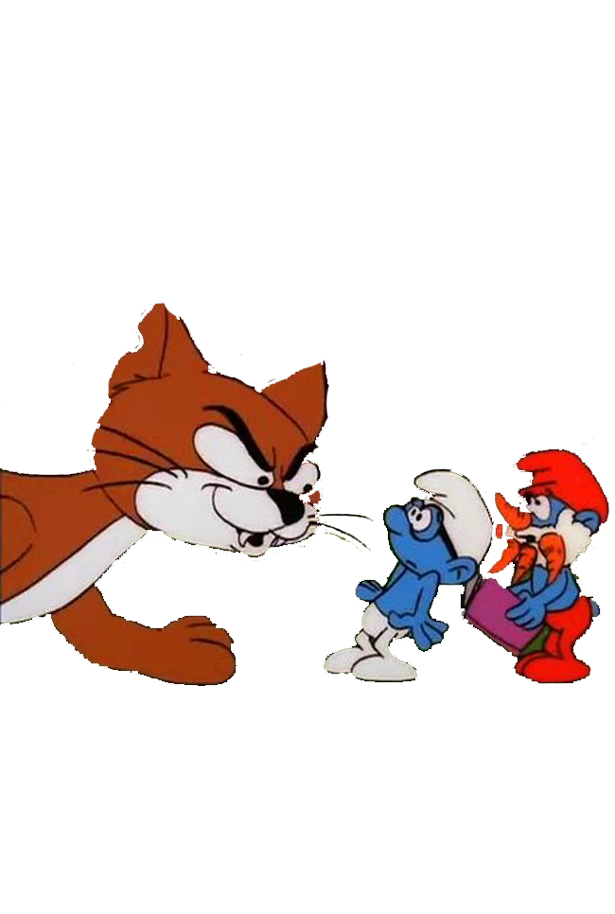
Azrael(Azman) ………………… run fast.
can
can’t

Slide 25
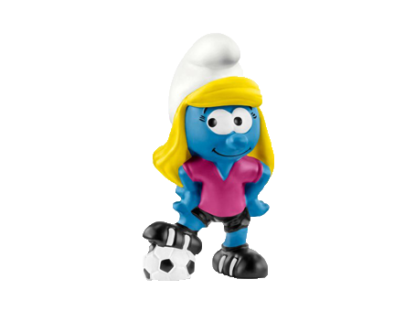
can
can’t
Smurfette ……………… play football

Slide 26

Good Job

