Slide 1

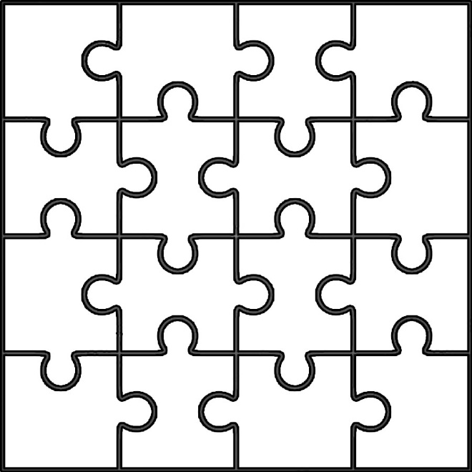
START
Do the puzzle
and find the secret message.

Slide 2

What is this?
It is an orange
It is a peach
It is an apple
It is a melon

Slide 3
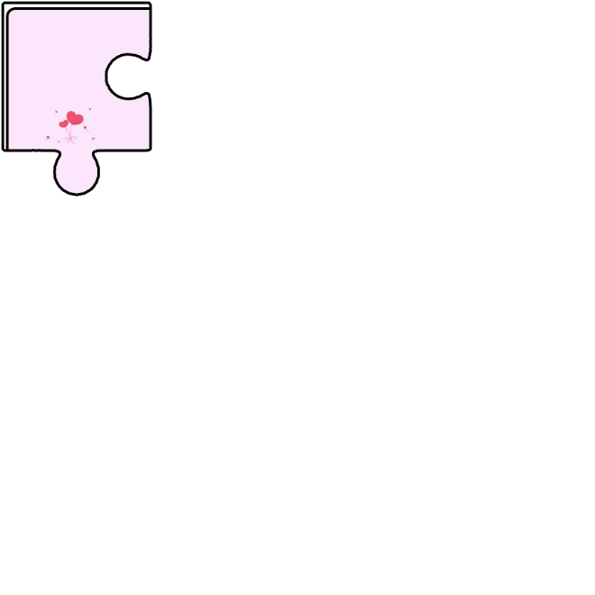
What colour is a banana?
blue
red
brown.
yellow

Slide 4

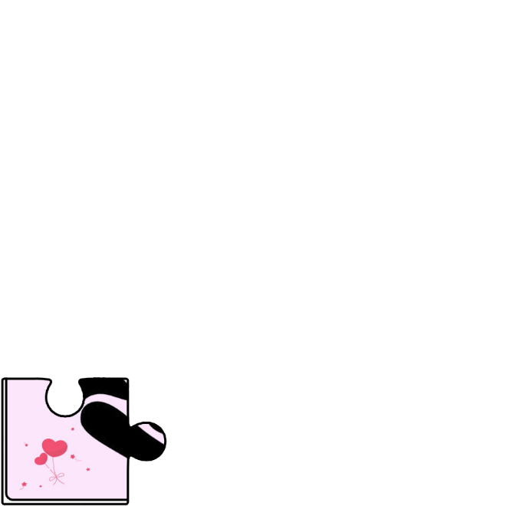
How many lemons… ?
three
yellow
Yes, it is
No, it isn’t

Slide 5

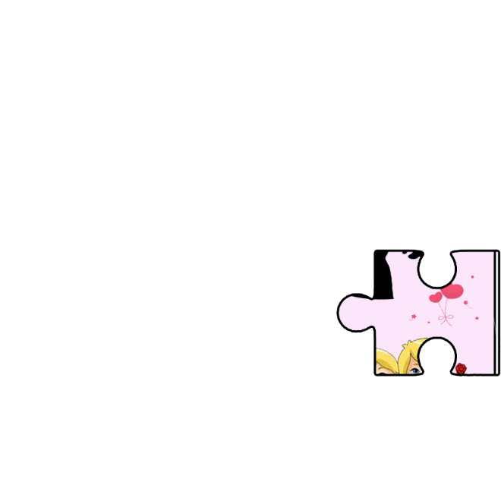
How many….?
Two cherry
Two cherrys
Two apples
Two cherries

Slide 6
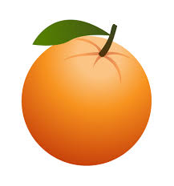

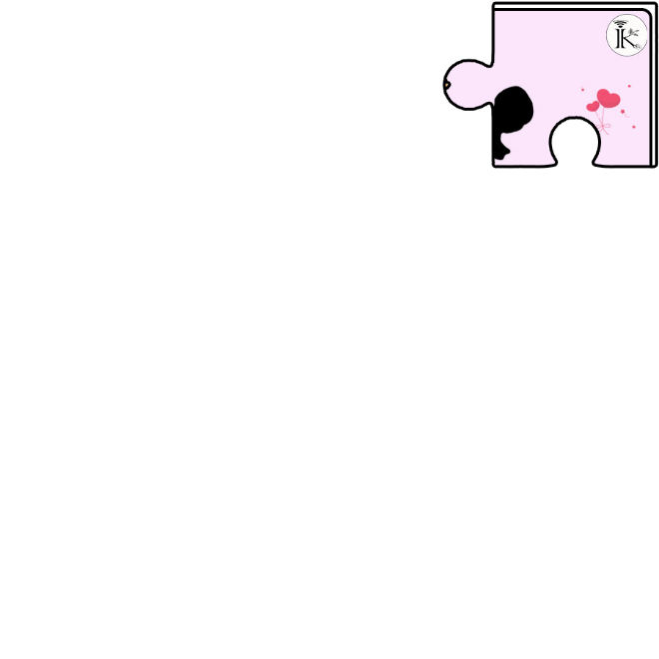
I like and
oranges-bananas
bananas-oranges
bananas-lemons
banana-orange

Slide 7

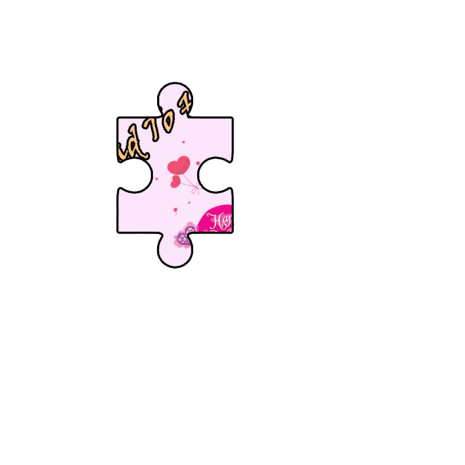
I don’t like
grapes
pear
watermelon
apricot

Slide 8

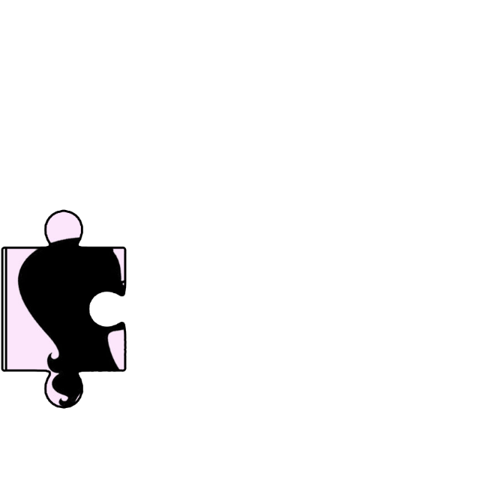
Do you like ?
watermelon
peach
melon
pear

Slide 9
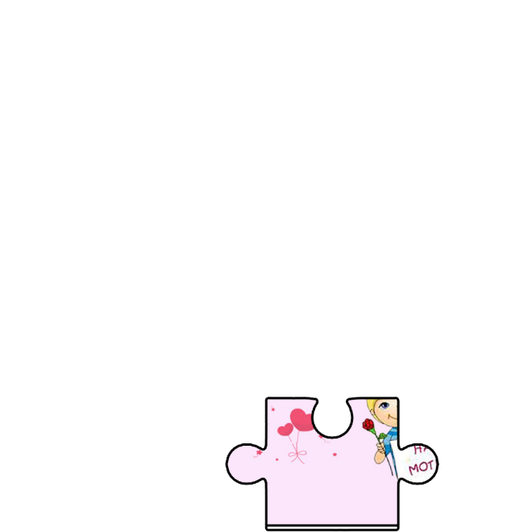
A ……………………… is red.
lemon
melon
banana
cherry

Slide 10
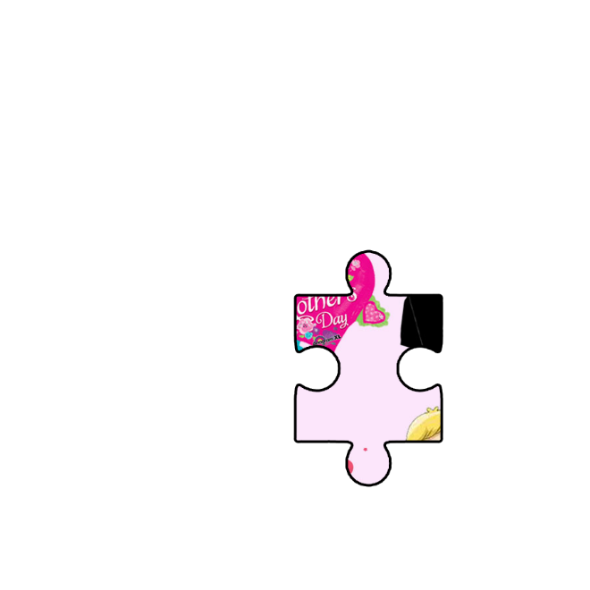
A ……………… isn’t yellow.
pear
banana
strawberry
lemon

Slide 11
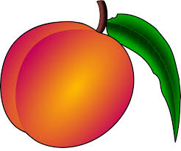
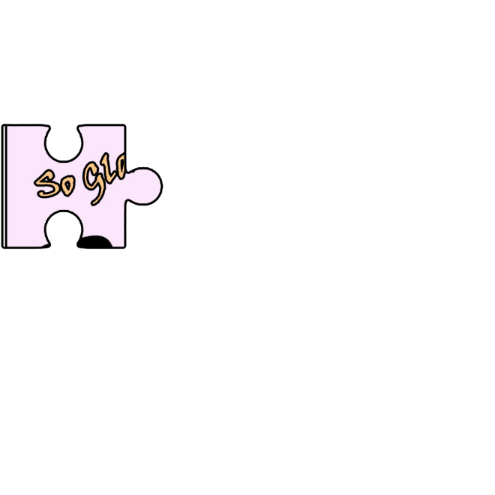
They are four …………………………
peach
peaches
peachs
peachies

Slide 12
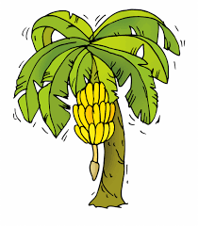
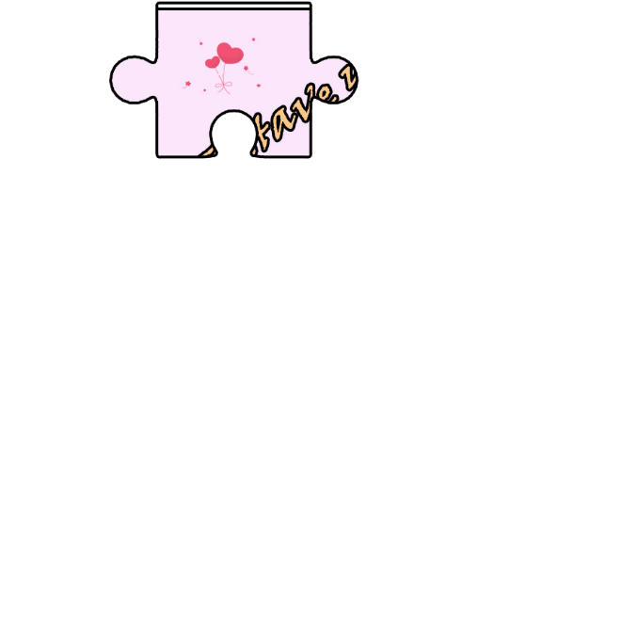
It is a ……………………
banana salad
banana basket
banana
banana tree

Slide 13
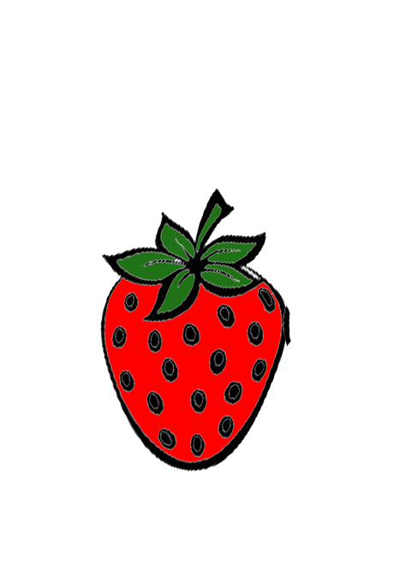
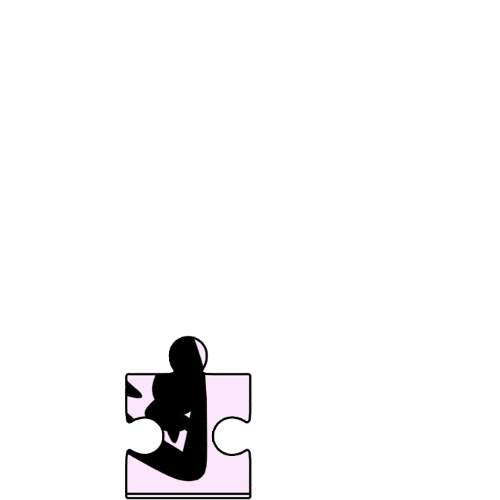
Is it a strawberry?
Yes, it is
No, it is
No, it isn’t
Yes, it isn’t

Slide 14
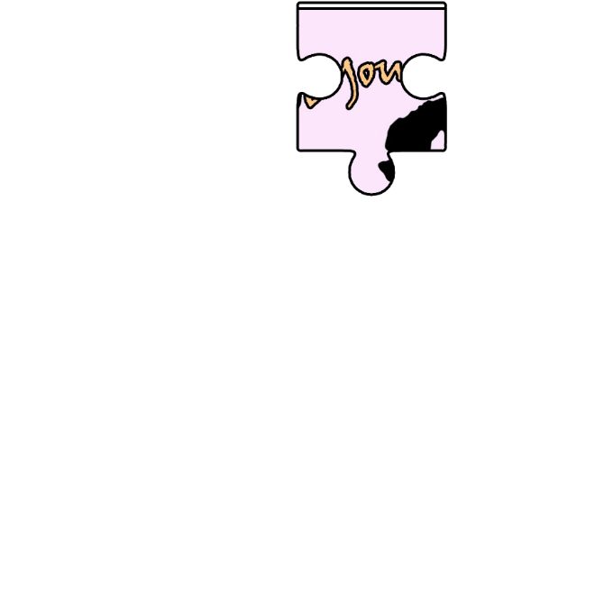
Is it a peach?
No, I don’t
No, it isn’t.
Yes, it is.
Yes, I do

Slide 15
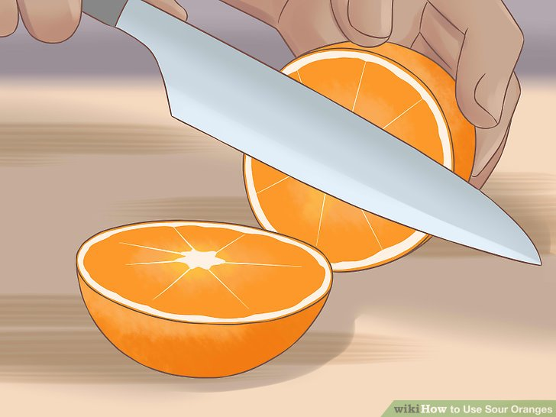
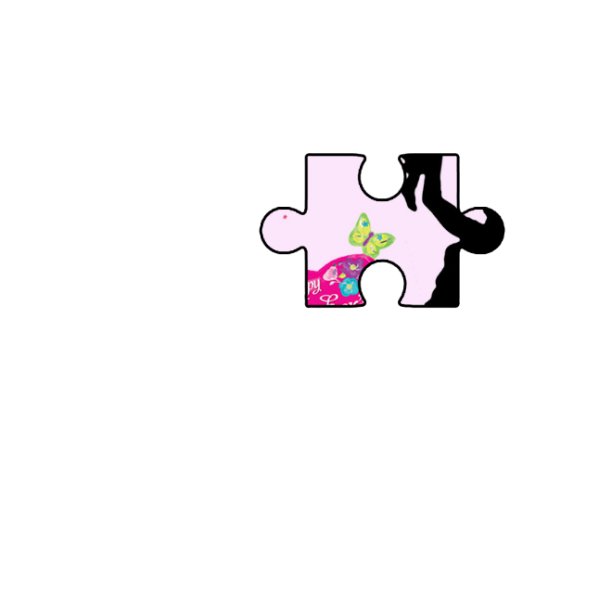
……………… the orange
Eat
Draw
Cut
Give

Slide 16
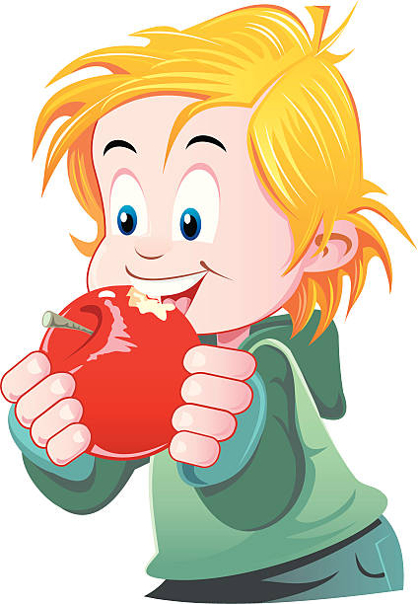
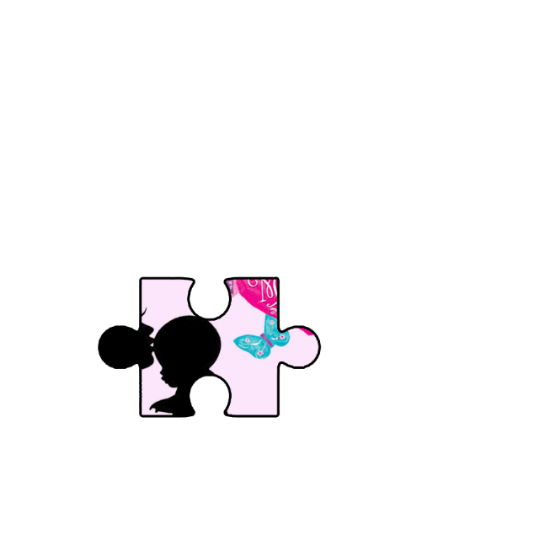
…………………… the apple
Eat
Give
Cut
Draw

Slide 17
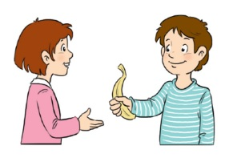
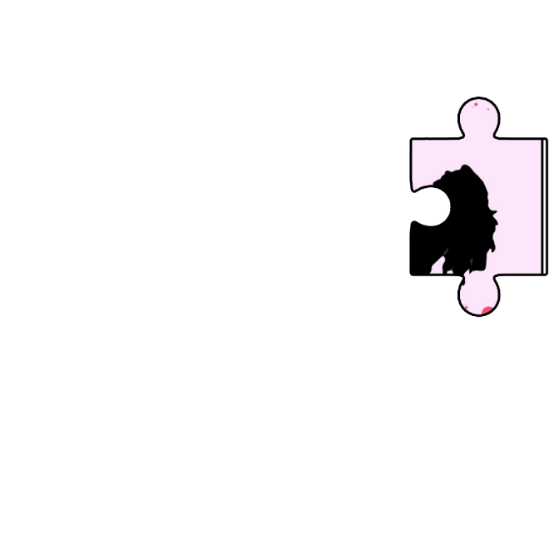
…………… me the banana
Cut
Eat
Draw
Give

Slide 18

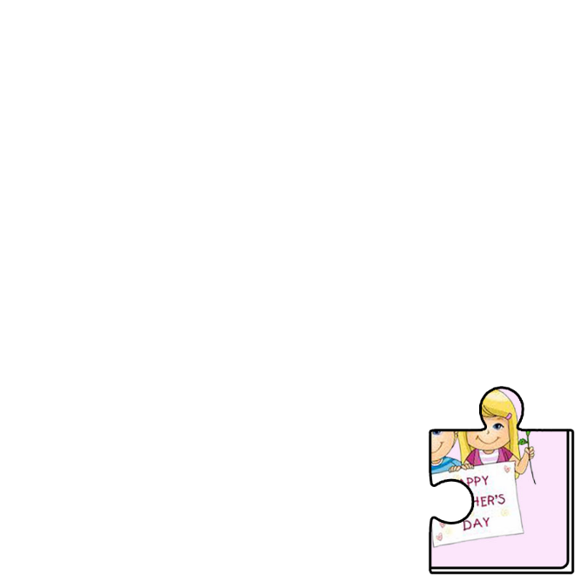

Find the secret message
_ _ _ _ _ _ _ _ _ _ _’_ _ _ _
H
P
Y
M
T
H
R
Y

