Slide 1



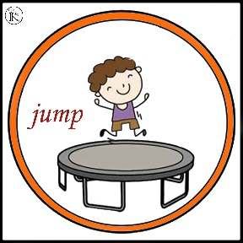









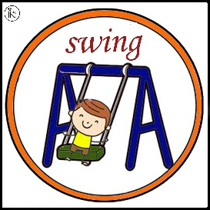
At The Playground
START
2-6

Slide 2

1-Let’s ………………………
Run
Skip rope
Sing
Dance

Slide 3

2-Let’s ………………………
Slide
Swing
Walk
Kick a ball

Slide 4

3-Let’s ………………………
Swing
Skip rope
Ride a bike
Dance

Slide 5

4-Let’s ………………………
Kick a ball
Slide
Play basketball
Skip rope

Slide 6

5-Let’s ………………………
Run
Walk
Sing
Jump

Slide 7

6-Let’s ………………………
Skip rope
Ride a bike
Play hide and seek
Kick a ball

Slide 8

7-Let’s ………………………
Swing
Slide
Sing
Walk

Slide 9

8-Let’s ………………………
Swing
Sing
Slide
Jump

Slide 10

9-Let’s ………………………
Walk
Skip rope
Hop
Swing

Slide 11

10-Let’s ………………………
Play basketball
Slide
Jump
Kick a ball

Slide 12

11-Let’s ………………………
Skip rope
Walk
Sing
Swing

Slide 13

12-Let’s ………………………
Slide
Skip rope
Run
Play hide and seek

Slide 14

13-Let’s ………………………
Skip rope
Ride a bike
Kick a ball
Play hide and seek

Slide 15

Congratulations

